Slide 1


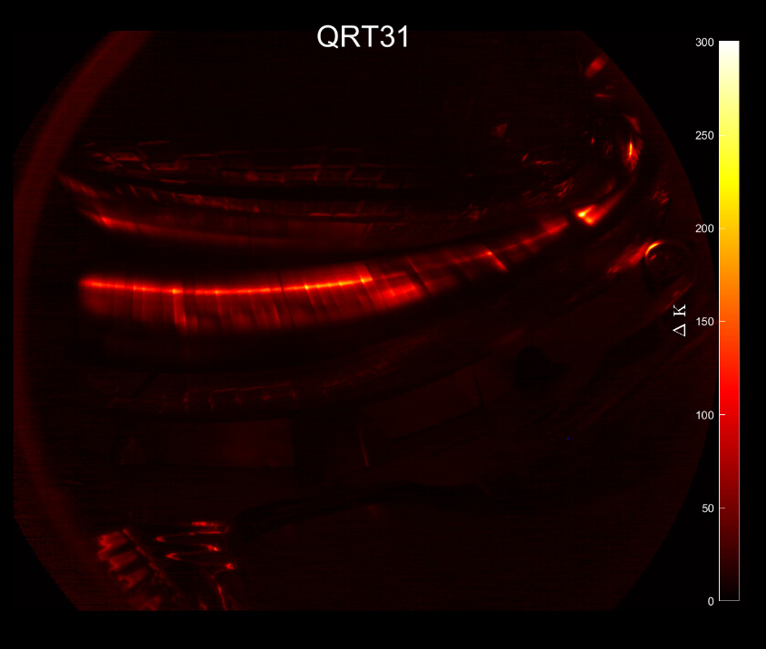
Investigation of fast ion wall loads in W7-X by IR thermography.
Master Internship
Mark J.H. Cornelissen
Supervisors: Samuel Lazerson (IPP), Josefine Proll (TU/e)
Coffee talk IPP 22nd of April 2022

Slide 2
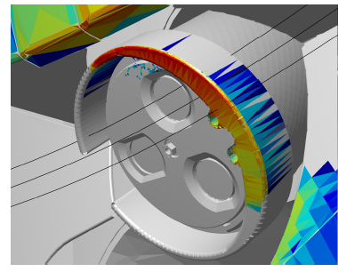
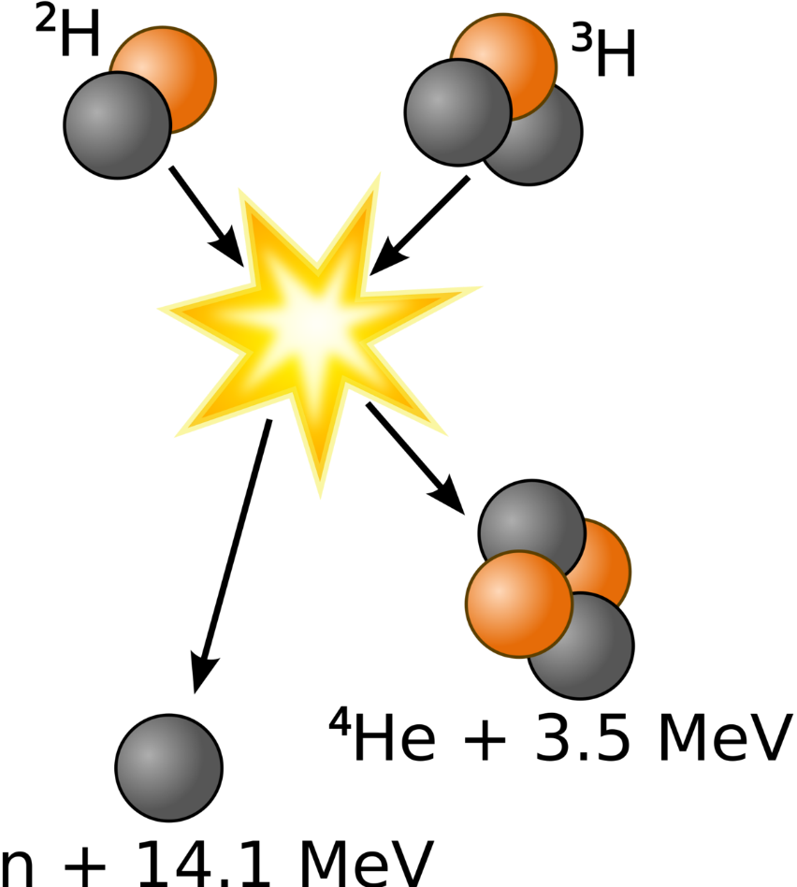


Fast ions can damage plasma-facing components
D-T reaction generates fast ions.
Fast ion loads limit fusion devices.
Loads concentrate at ‘hot spots’.
To apply mitigation strategies, fast ion models are required.
Verification of models by experiments.
[1]
[1] S.Äkäslompolo et al. Fusion Eng. Des 146 (2019) 862-865
Fast ion wall loads in W7-X

Slide 3
Research Question:
What are the magnitude and location of fast ion wall loads in W7-X?
Compare experimental results to numerical simulations.
Basis for the verification of fast ion models.
Fast ion wall loads in W7-X

Slide 4
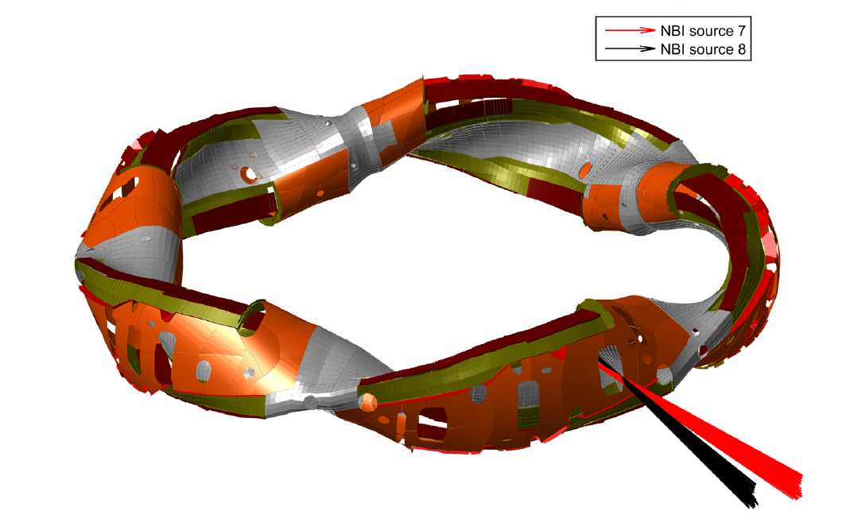
NBI particles mimic fusion alphas
In W7-X, the fusion alphas are mimicked by NBI.
Two neutral beams inject neutral hydrogen.
Energy (55 keV) of neutral
hydrogen chosen such that their
confinement is selfsame to
fusion alphas.
[2]
[2] S.Äkäslompolo et al. Nucl. Fusion 58 (2018) 082010
Fast ion wall loads in W7-X

Slide 5
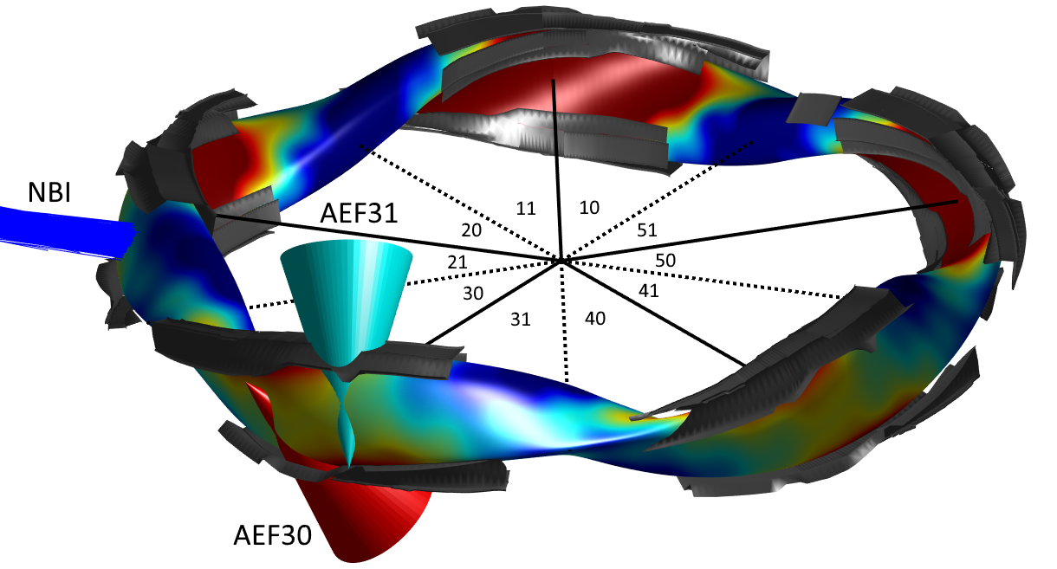
W7-X has a five-fold toroidal symmetry
Each toroidal segment has an upper and lower divertor module.
NBI injects neutrals into toroidal module 2.
Each divertor module is
monitored by an IR camera.
Fast ion wall loads in W7-X

Slide 6
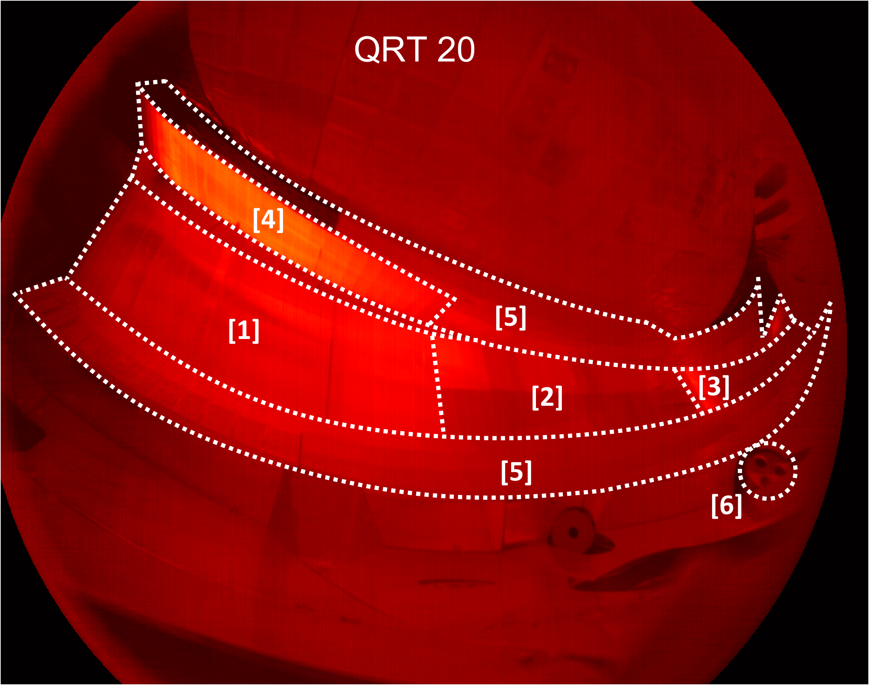
The infrared cameras monitor each divertor
Horizontal Divertor:
[1] Low-iota target
[2] Middle target
[3] High-iota target
[4] Vertical divertor
[5] Baffle plates
[6] AEF port
Fast ion wall loads in W7-X

Slide 7
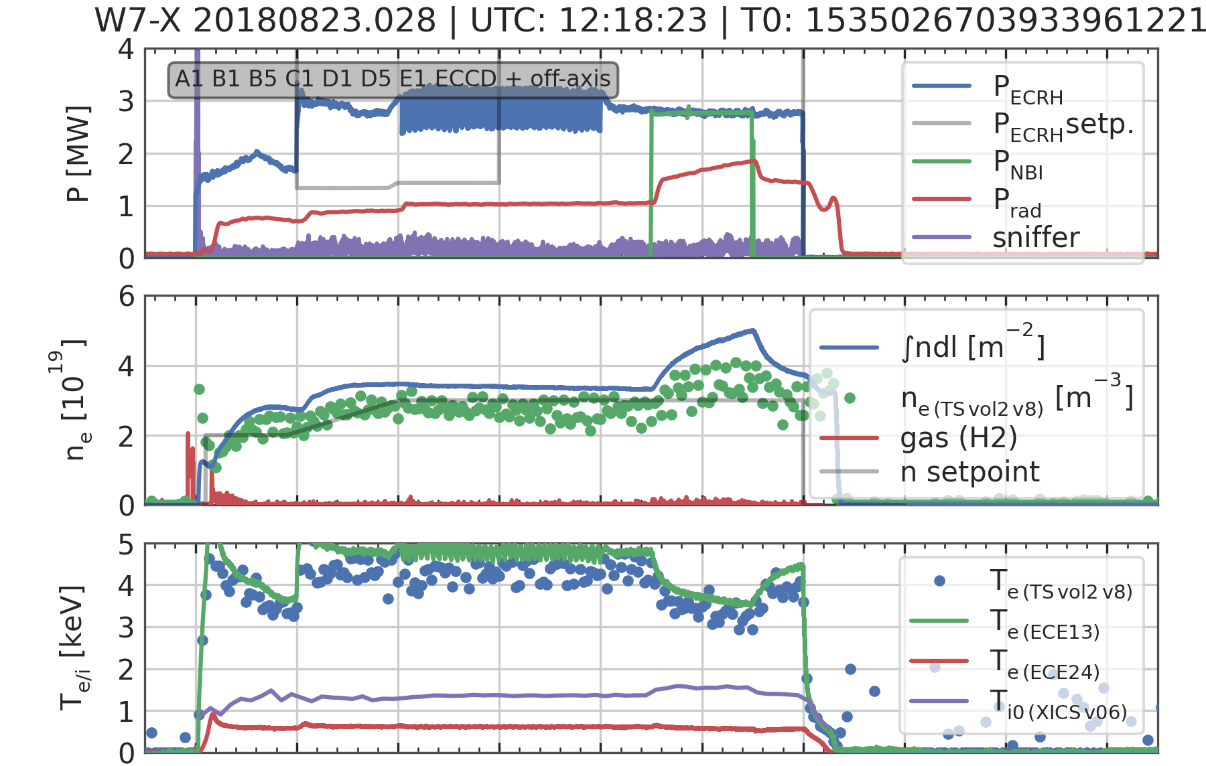

Fast ion loads depend on mag. configuration
Discharges with different
magnetic configurations:
Standard configuration;
High-mirror configuration;
High-iota configuration.
ECRH start-up followed by NBI operation phase.
During NBI operation, $n_{0}$ and $T_{e}$ are altered.
Fast ion wall loads in W7-X

Slide 8


1D heat model is applied to obtain heat flux
The following assumptions are made:
Semi-infinite solid.
Cooling effects are negligible.
Diffusion of heat is negligible along the surface.
1D transient heat conduction model can be applied to obtain the heat flux:
$ΔT\left(t\right)=\frac{q}{C\left(T\right)} \sqrt{t}$ where $C\left(T\right)=\sqrt{πλρc_{p}}/2$
Fast ion wall loads in W7-X

Slide 9
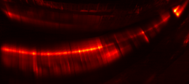
Strike line is monitored to verify method
Standard configuration
Standard: 20180919.33
Fast ion wall loads in W7-X

Slide 10
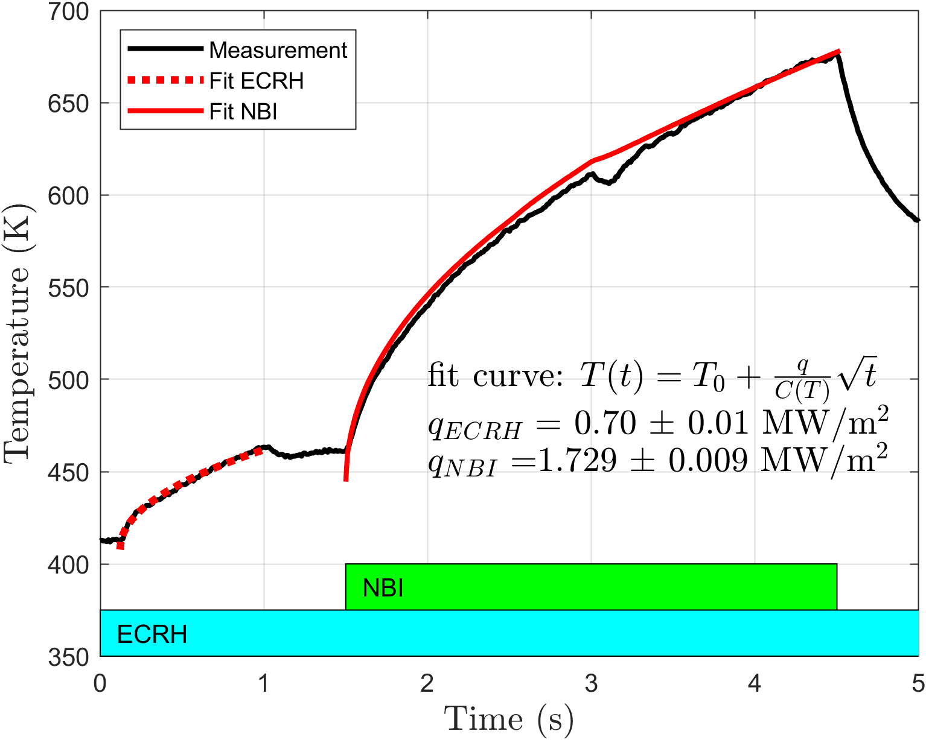
Strike line is monitored to verify method
Standard configuration
Temperature shows square root dependence on time.
Fit is obtained with
acceptable uncertainties.
Change in plasma parameters does not significantly alter the heat flux.
Standard: 20180919.33
Fast ion wall loads in W7-X

Slide 11
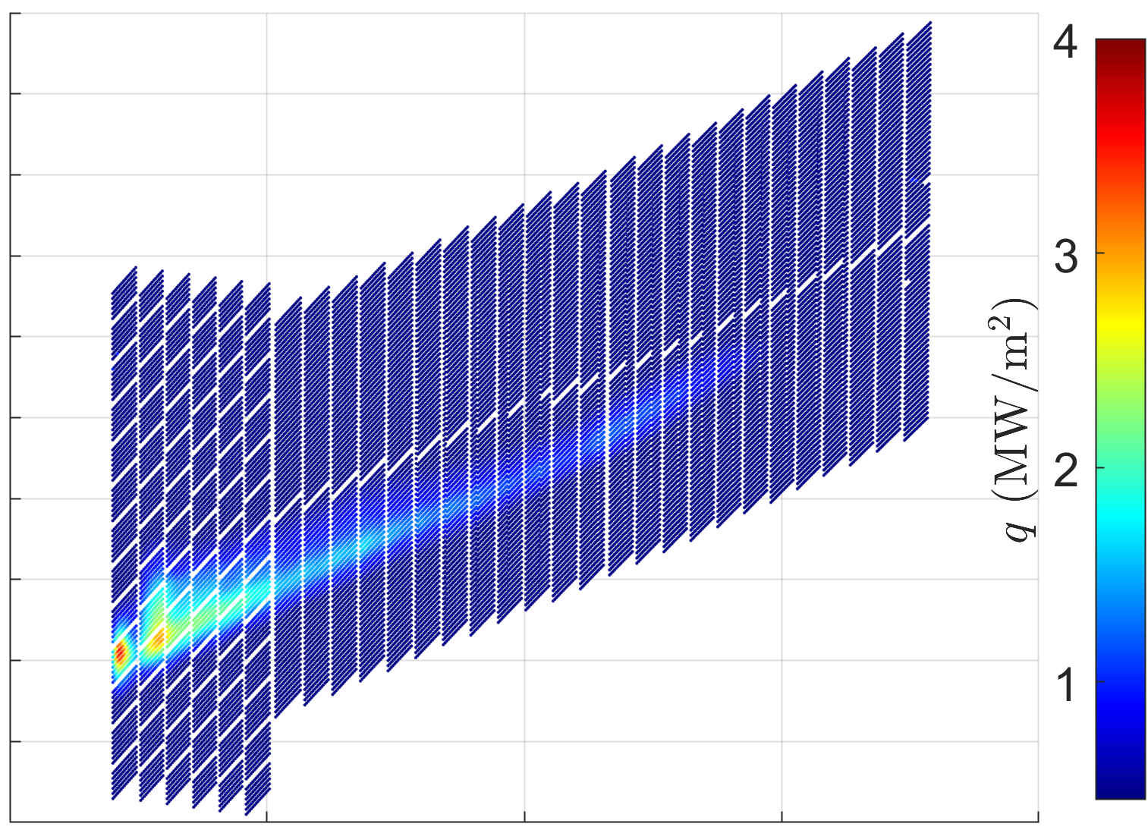


Method and THEODOR show good agreement
Only small discrepancies in the tail of the strike line.
The magnitude differs on average 5%.
High-iota configuration
Method
THEODOR
2D heat diffusion equation:
$$ρc_{p}\frac{∂T}{∂t}=∇(κ∇T)$$
High-iota: 20180822.12
Fast ion wall loads in W7-X

Slide 12
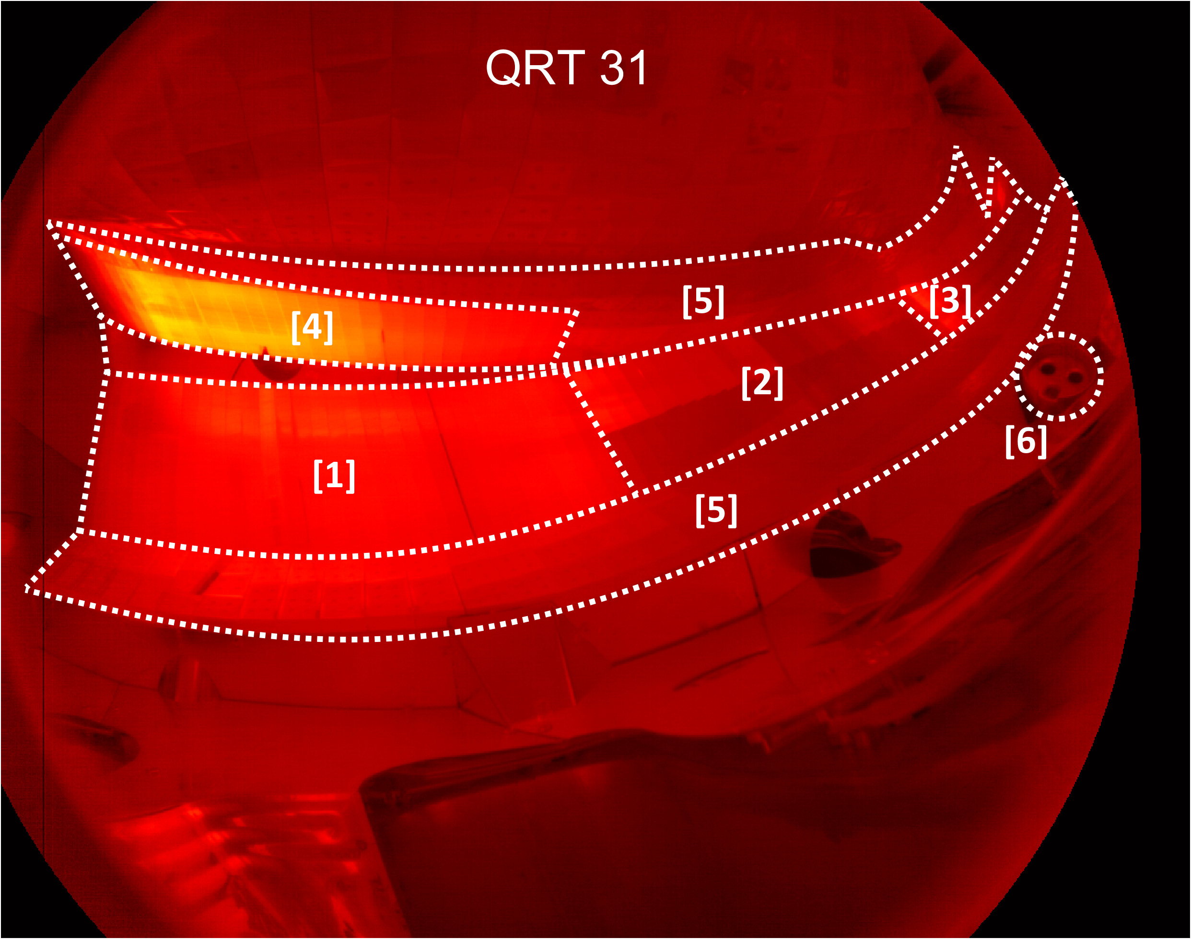
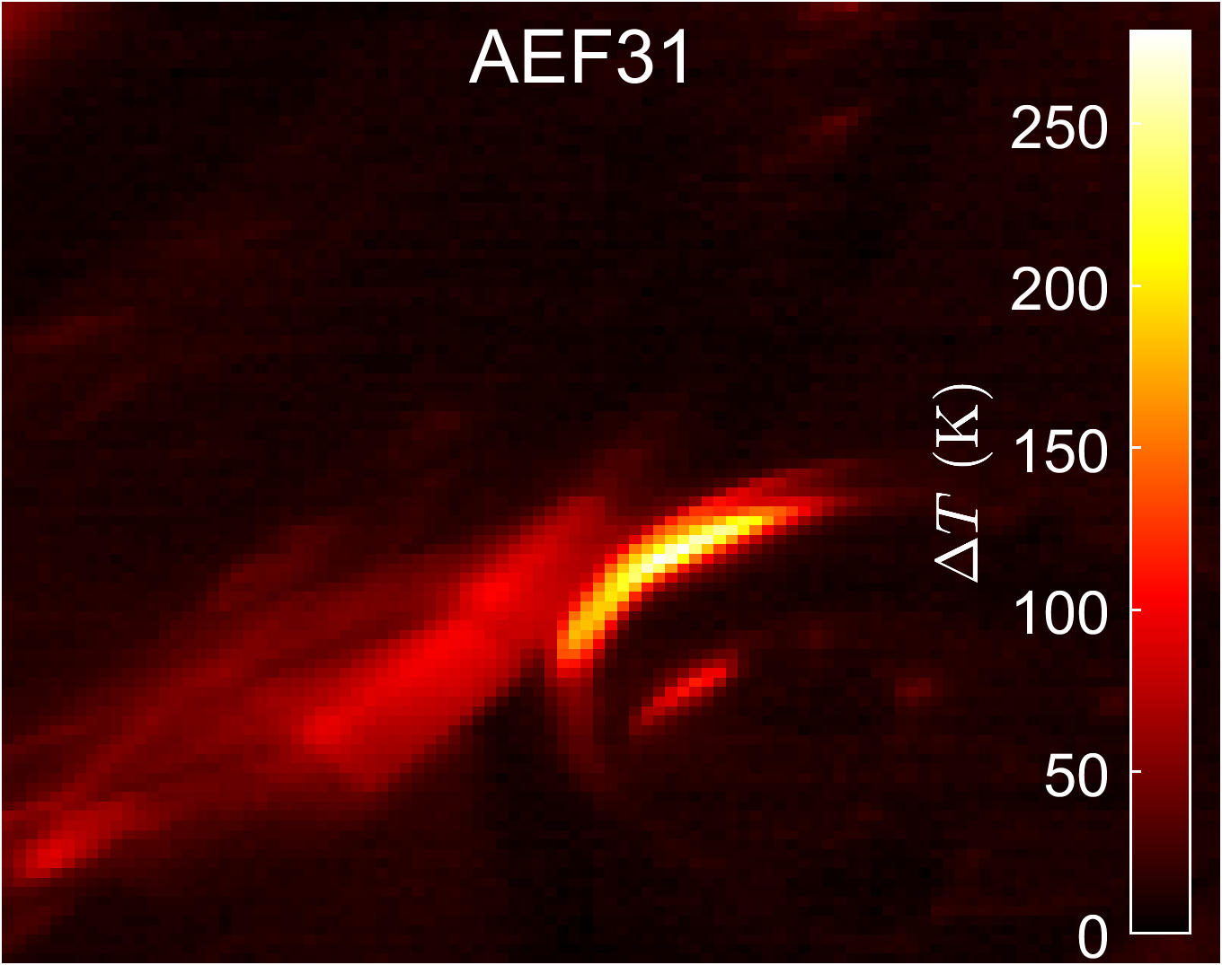
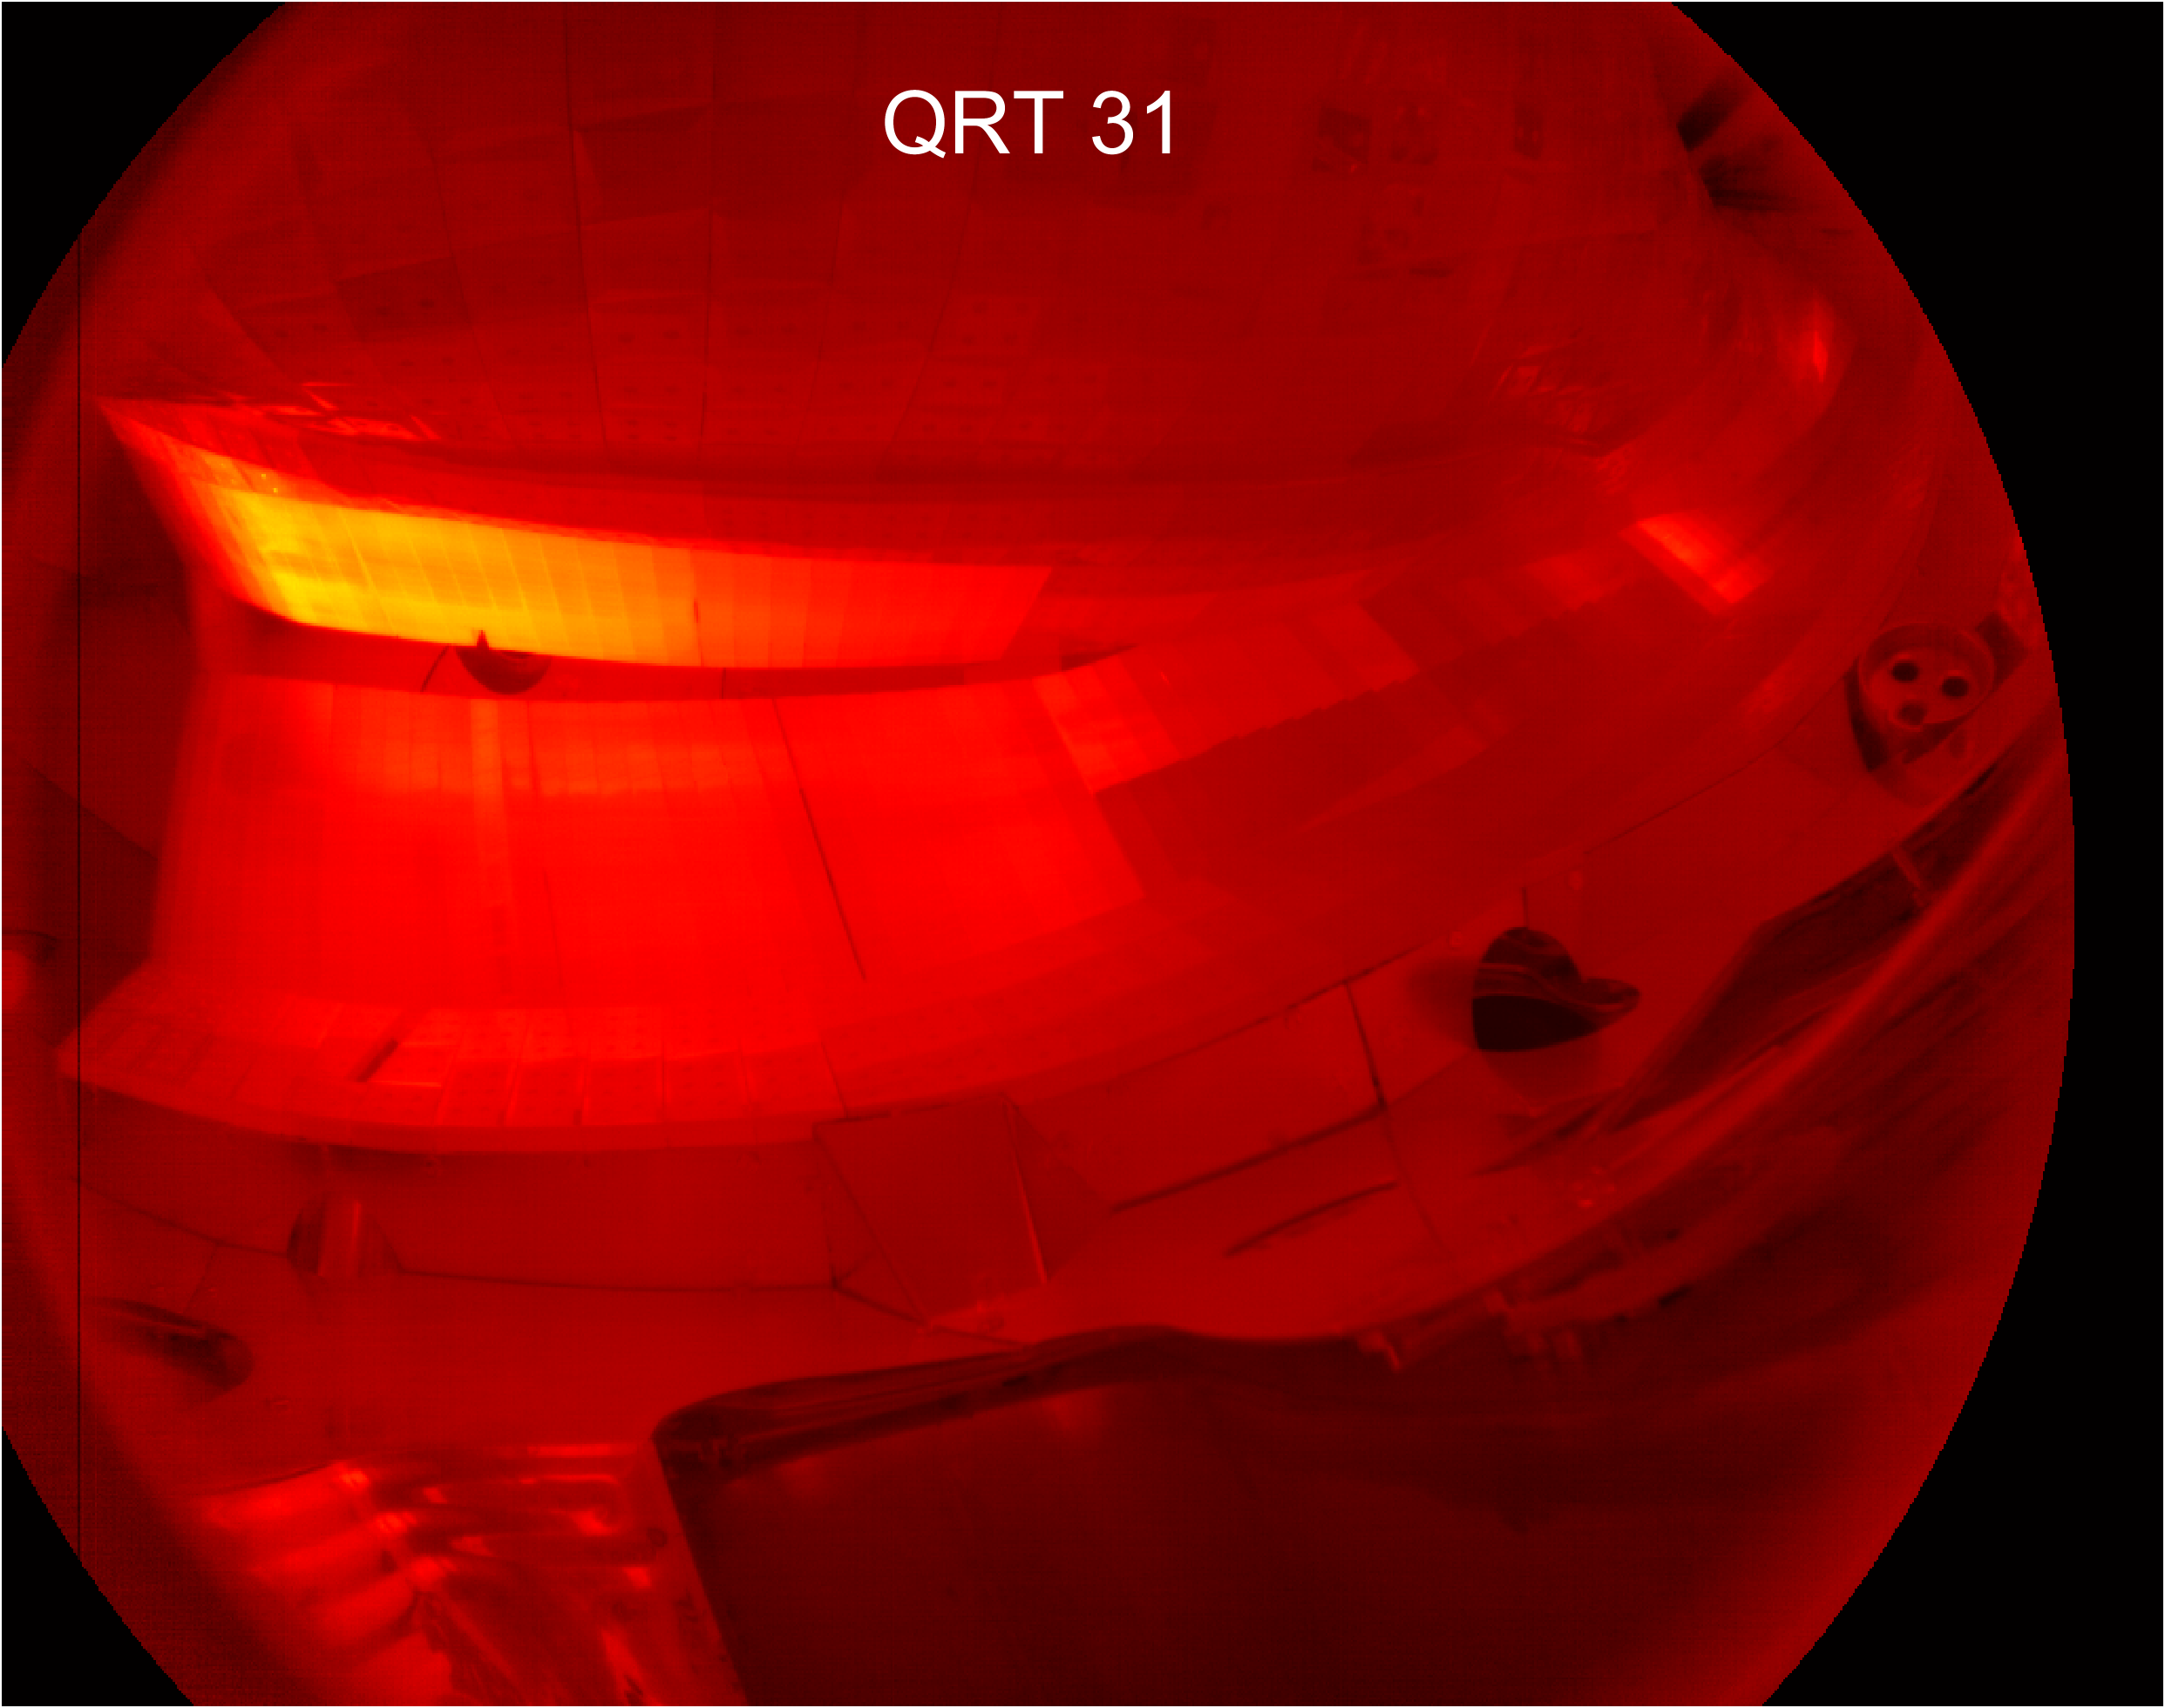
Fast ion wall loads are positioned at baffle
No loads present
during ECRH startup phase.
Fast ion loads are present
during NBI operation.
Load due to fast ions
trapped in magnetic ripples.
Standard configuration: 20180919.16
Fast ion wall loads in W7-X

Slide 13
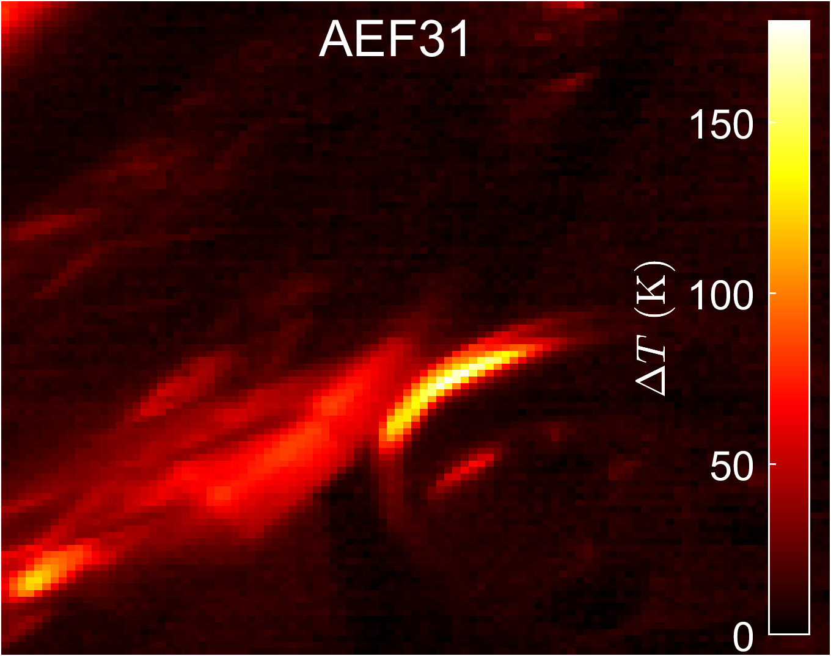
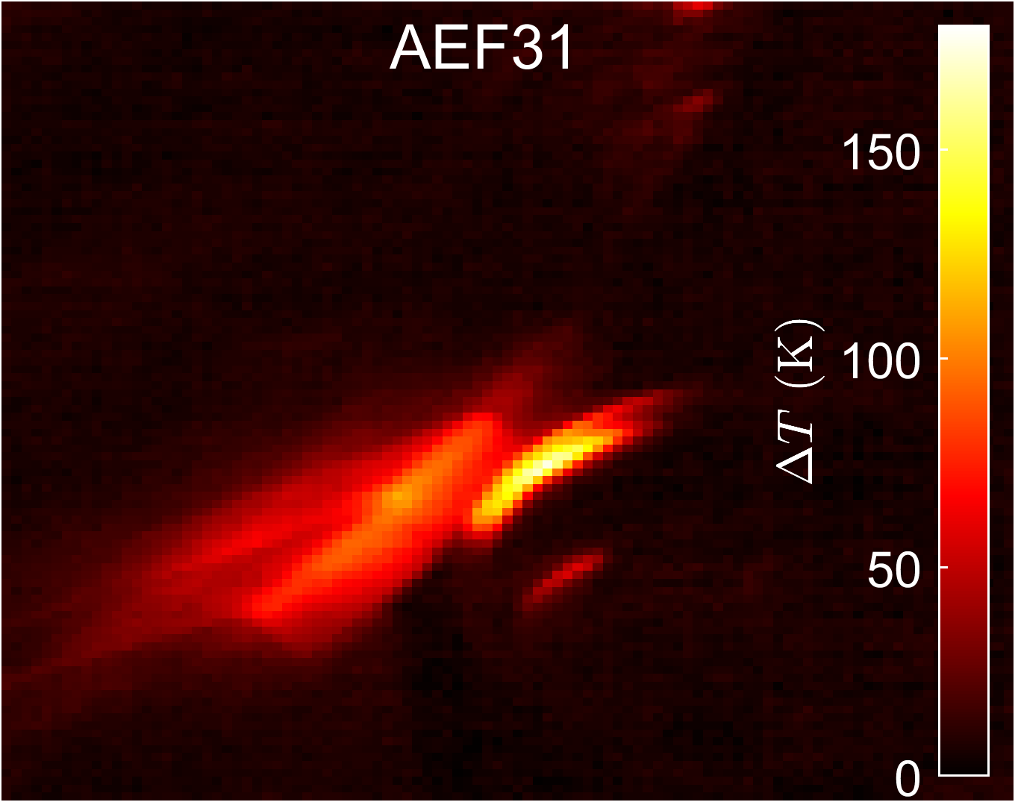
Magnetic configuration alters heat deposition
Standard configuration
20180919.20
High-mirror configuration
20181009.43
Fast ion wall loads in W7-X

Slide 14
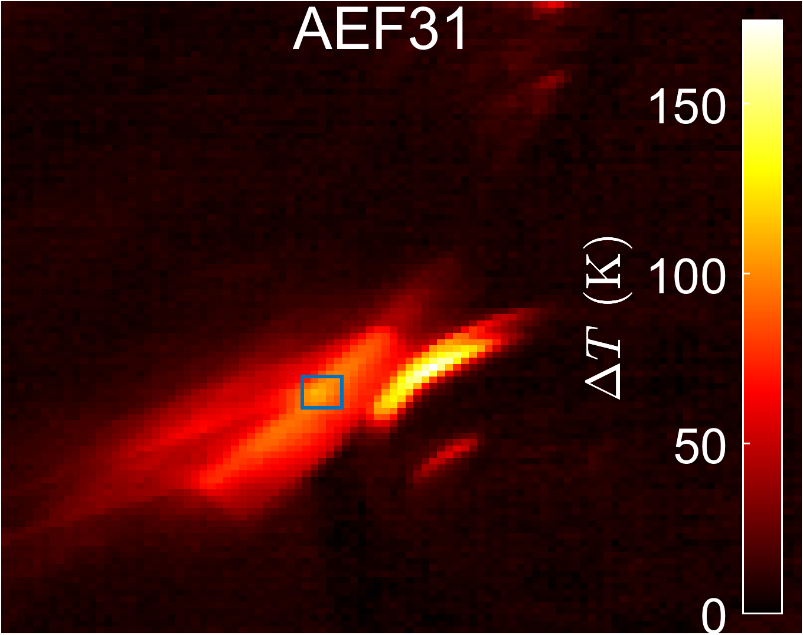
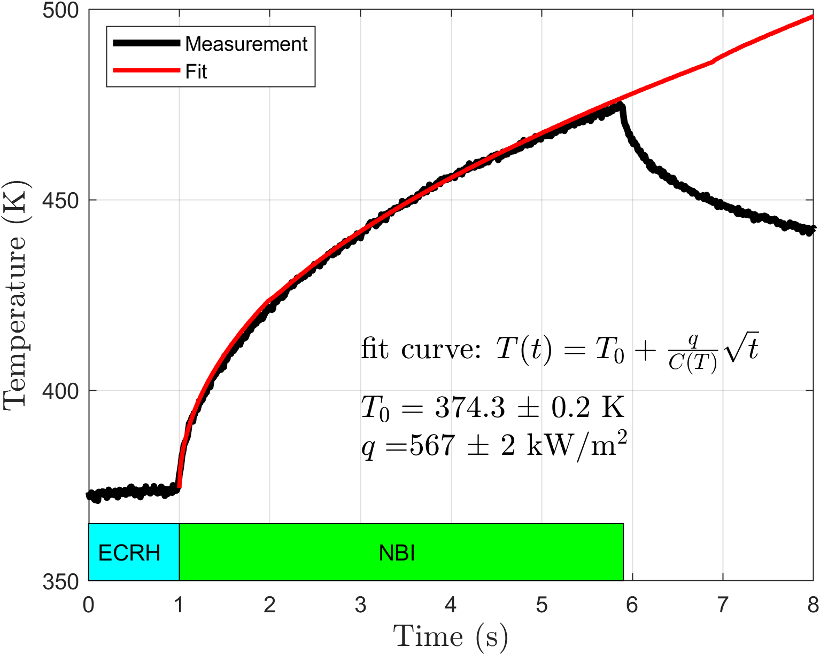
Method to obtain the fast ion heat flux
High-mirror configuration
High-mirror: 20181009.43
Fast ion wall loads in W7-X

Slide 15
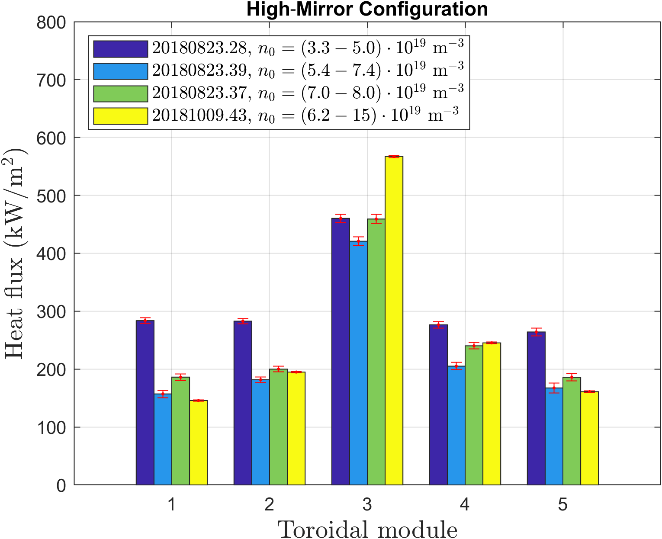
Asymmetries are present in the fast ion loads
Fast ion loads are only present in
the upper sections of W7-X.
Up-down asymmetry:
attributed to drifts.
Toroidal asymmetry:
attributed to solely neutral injection
into toroidal module 2.
Fast ion wall loads in W7-X

Slide 16
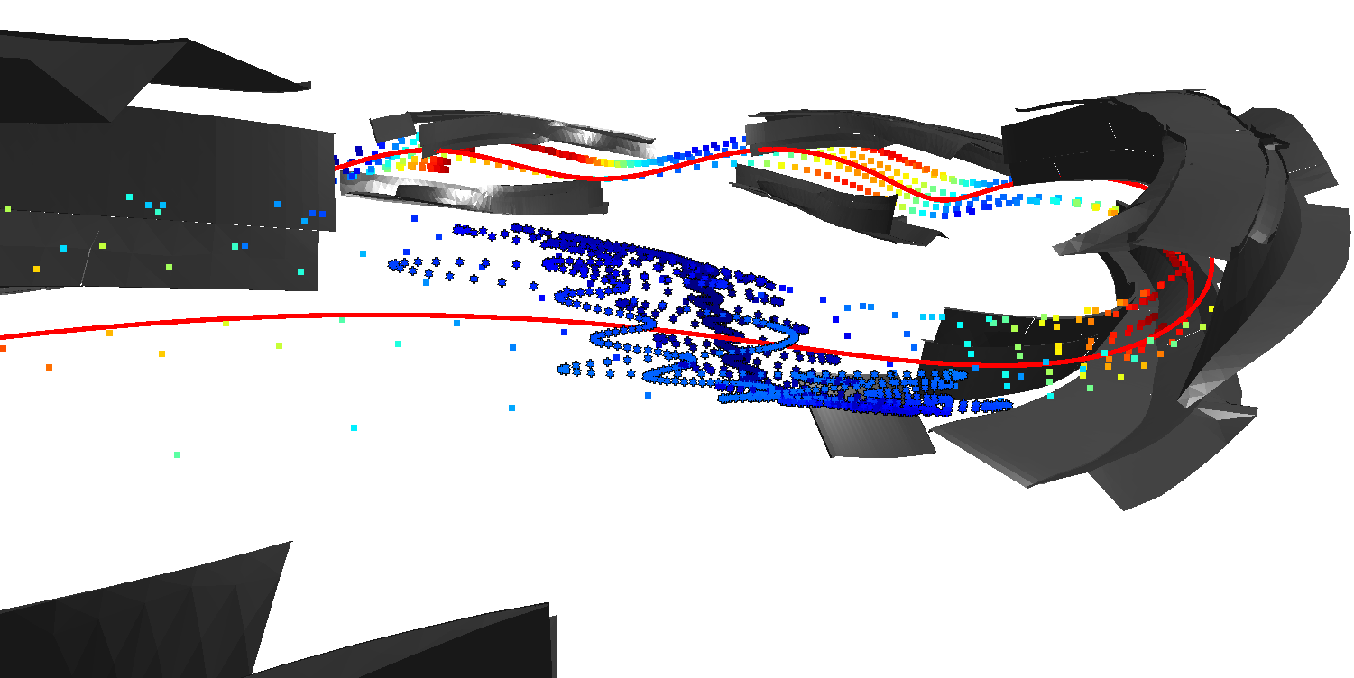
Baffle loads due to trapped particle orbit
Magnetic mirrors due to toroidal variation in magnetic field strength.
Magnetic well between toroidal module 2 and 3 is most populated by NBI.
Fast ion wall loads in W7-X

Slide 17
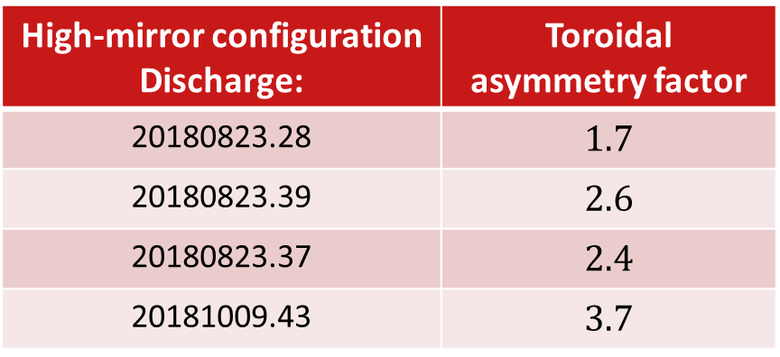
Fast ion load is dependent on plasma density
More pronounced toroidal
asymmetry with increasing density.
High-mirror configuration Discharge: | Toroidal asymmetry factor
20180823.28 | $$1.7$$
20180823.39 | $$2.6$$
20180823.37 | $$2.4$$
20181009.43 | $$3.7$$
Fast ion wall loads in W7-X

Slide 18
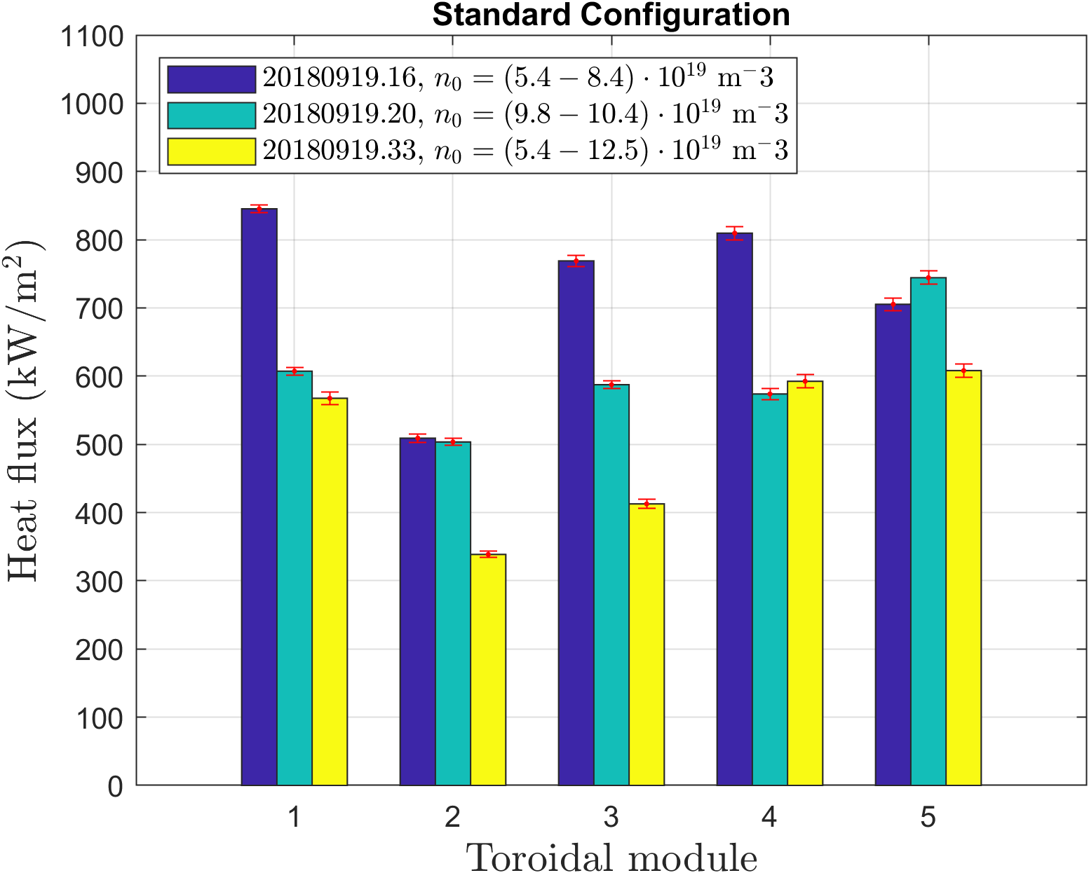
Competing effects of density on fast ion loads
Shine-through of NBI decreases
with increasing density.
Birth profile becomes more
core peaked with increasing density.
Collisional effects become more
pronounced with increasing density.
Fast ion wall loads in W7-X

Slide 19
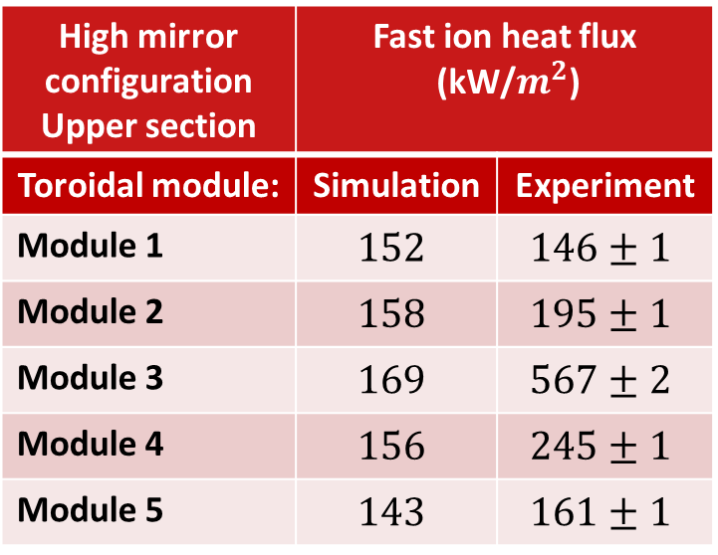
The results are compared to simulations
Simulations of fast ion trajectory
BEAMS3D gyro-center code
ASCOT full orbit code
Agreement in up-down asymmetry.
Toroidal asymmetry and magnitude
are not yet well predicted.
High mirror configuration Upper section | Fast ion heat flux (kW/$m^{2}$)
Toroidal module: | Simulation | Experiment
Module 1 | $$152$$ | $$146±1$$
Module 2 | $$158$$ | $$195±1$$
Module 3 | $$169$$ | $$567±2$$
Module 4 | $$156$$ | $$245±1$$
Module 5 | $$143$$ | $$161±1$$
Fast ion wall loads in W7-X

Slide 20
Conclusion
Evidence of fast ion loads on the baffle plates next to the AEF ports.
Up-down asymmetry due to magnetic curvature drifts.
Toroidal asymmetry due to solely injection of neutrals into module 2.
Qualitative agreement in up-down asymmetry between experiments and simulations, but magnitude and toroidal asymmetry are not yet well predicted by simulations.
Fast ion wall loads in W7-X

Slide 21
Outlook: fast ion loads on the divertor
During NBI operation, the divertor obtains both
convective loads from the thermal plasma particles
fast ion loads from highly energetic particles
Mimic NBI heating system with ECRH heating to assess the fast ion wall loads on the divertor in the upcoming campaign of W7-X.
Fast ion wall loads in W7-X

Slide 22
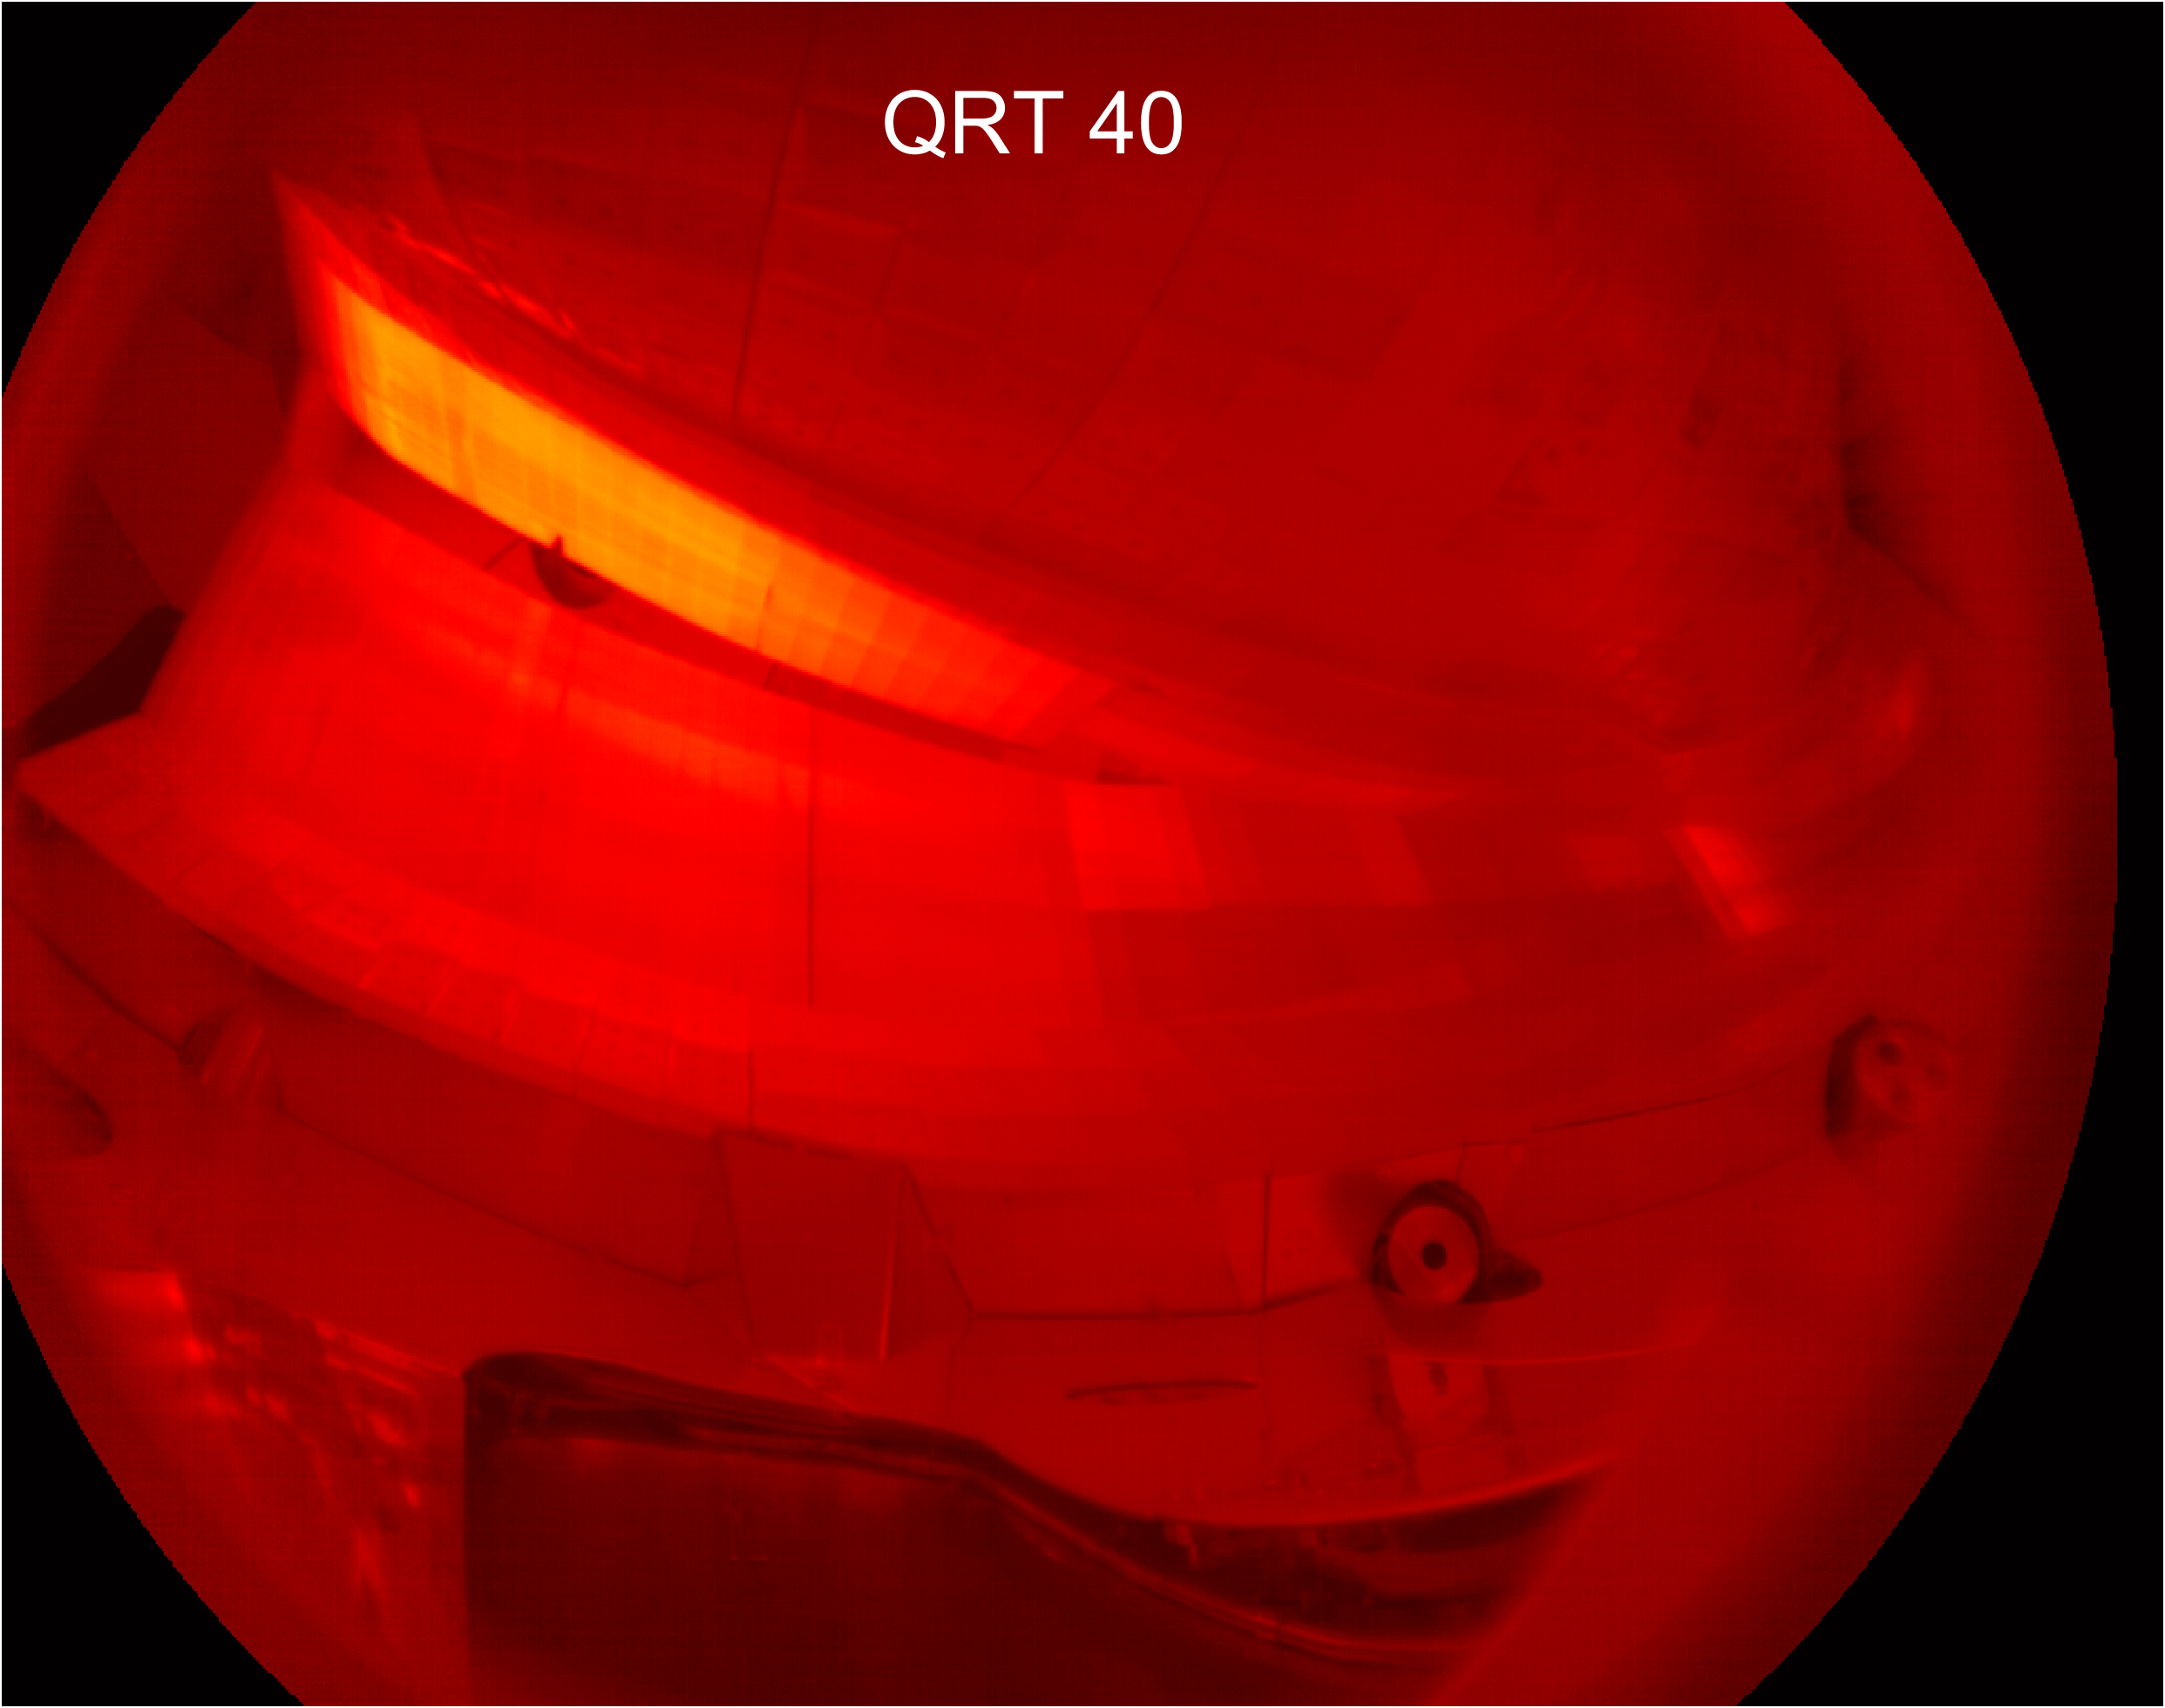
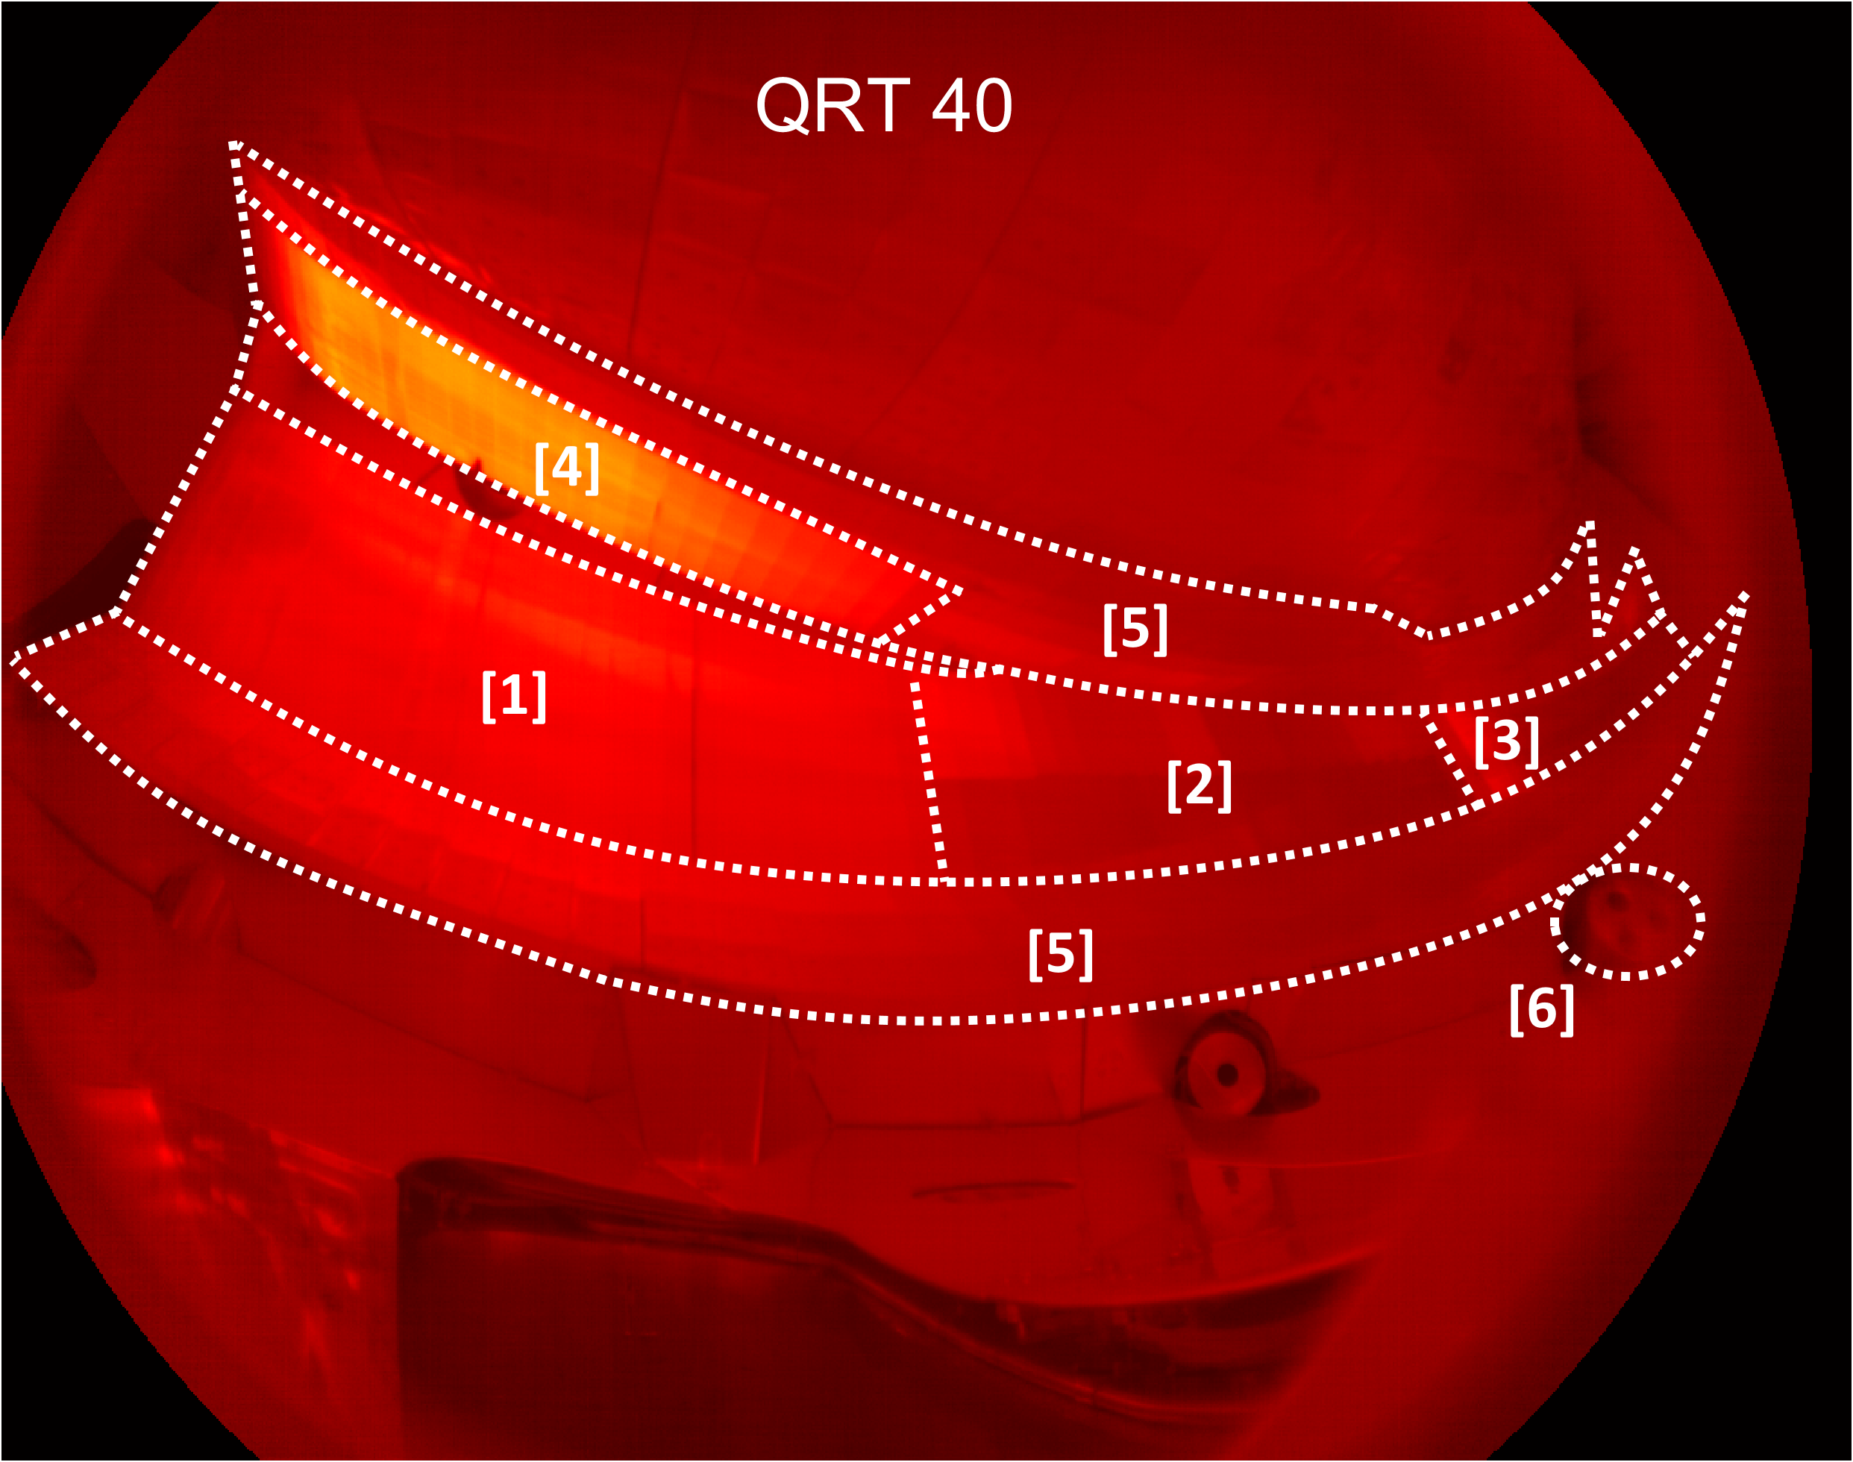
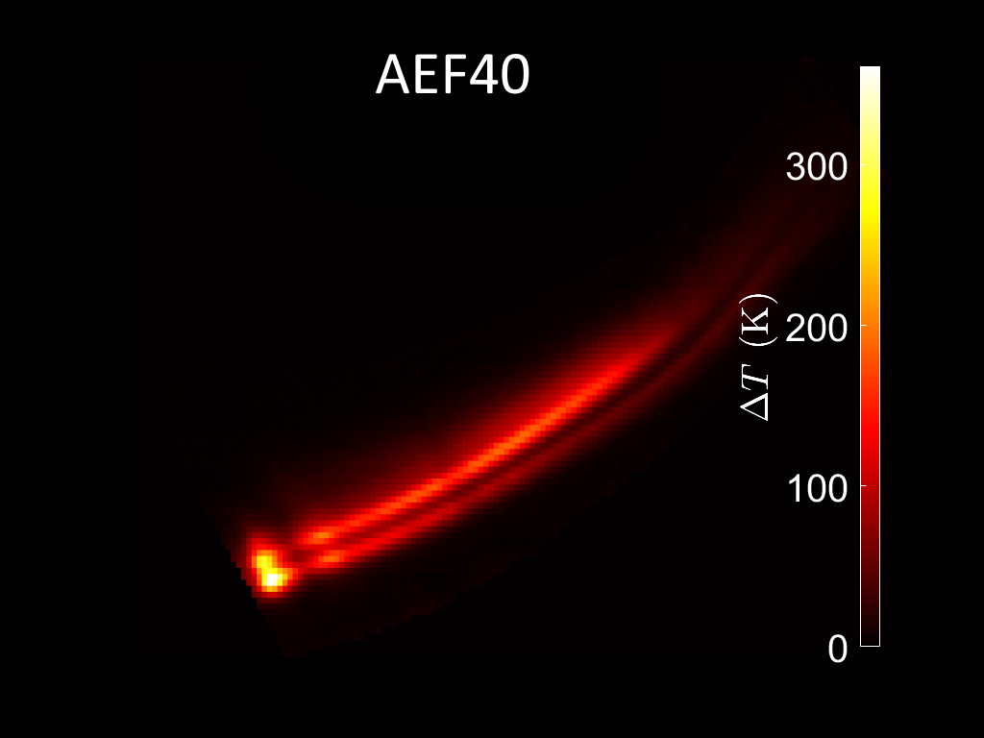
Second strike line is formed at high-iota target
Second strike is already
visible during solely
ECRH operation.
Heat distribution changes
drastically when NBI fires.
Difficult to disentangle
convective loads and fast
ion loads.
High-iota: 20180822.022
Fast ion wall loads in W7-X

Slide 23
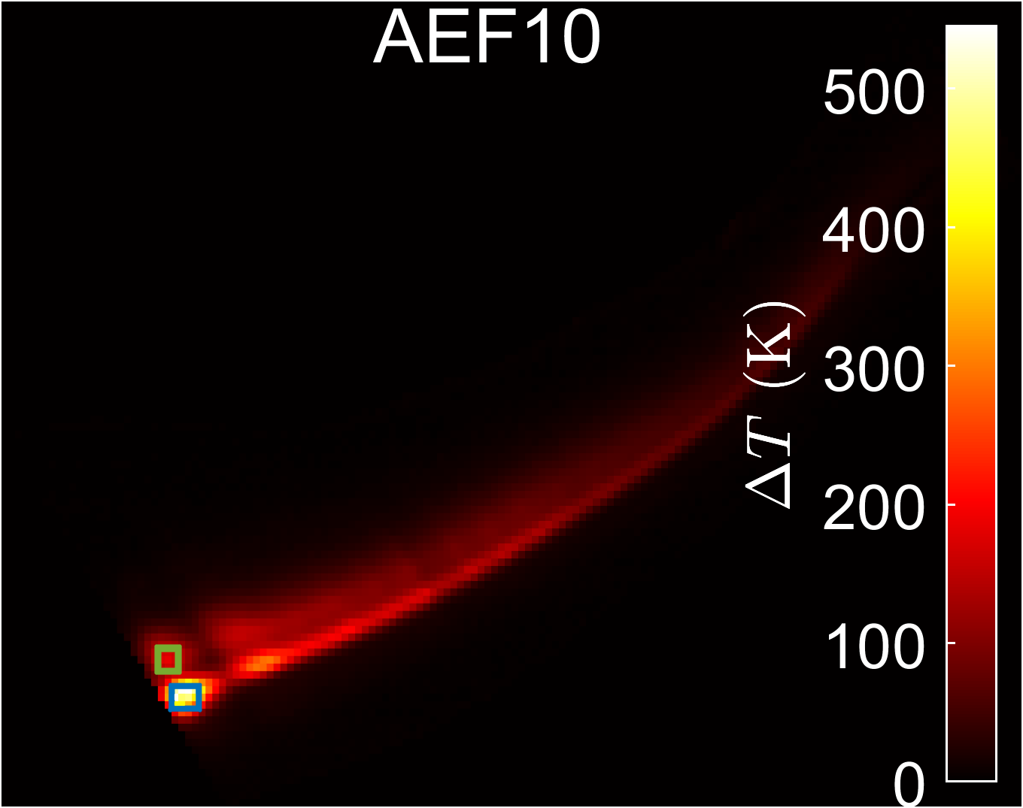
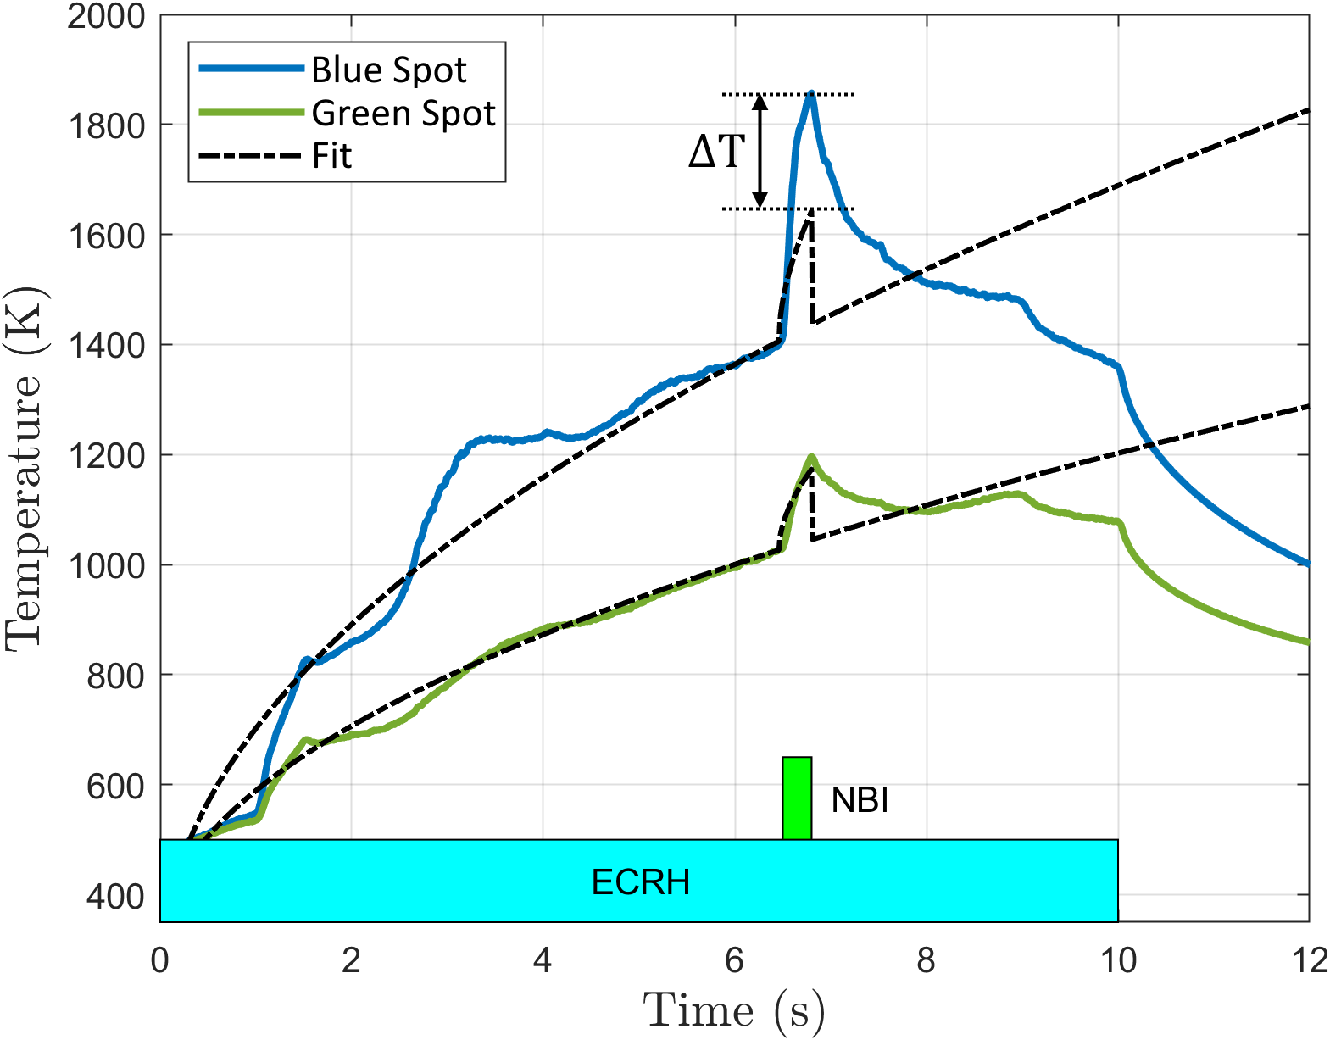




Method to obtain the anomalous loads
High-iota configuration
$$q_{NBI}=\frac{q_{ECRH}}{q_{ECRH}}q_{NBI}$$
$$q_{ECRH}$$
$$q_{NBI}$$
$$q_{ECRH}$$
High-iota: 20180822.012
Fast ion wall loads in W7-X

Slide 24
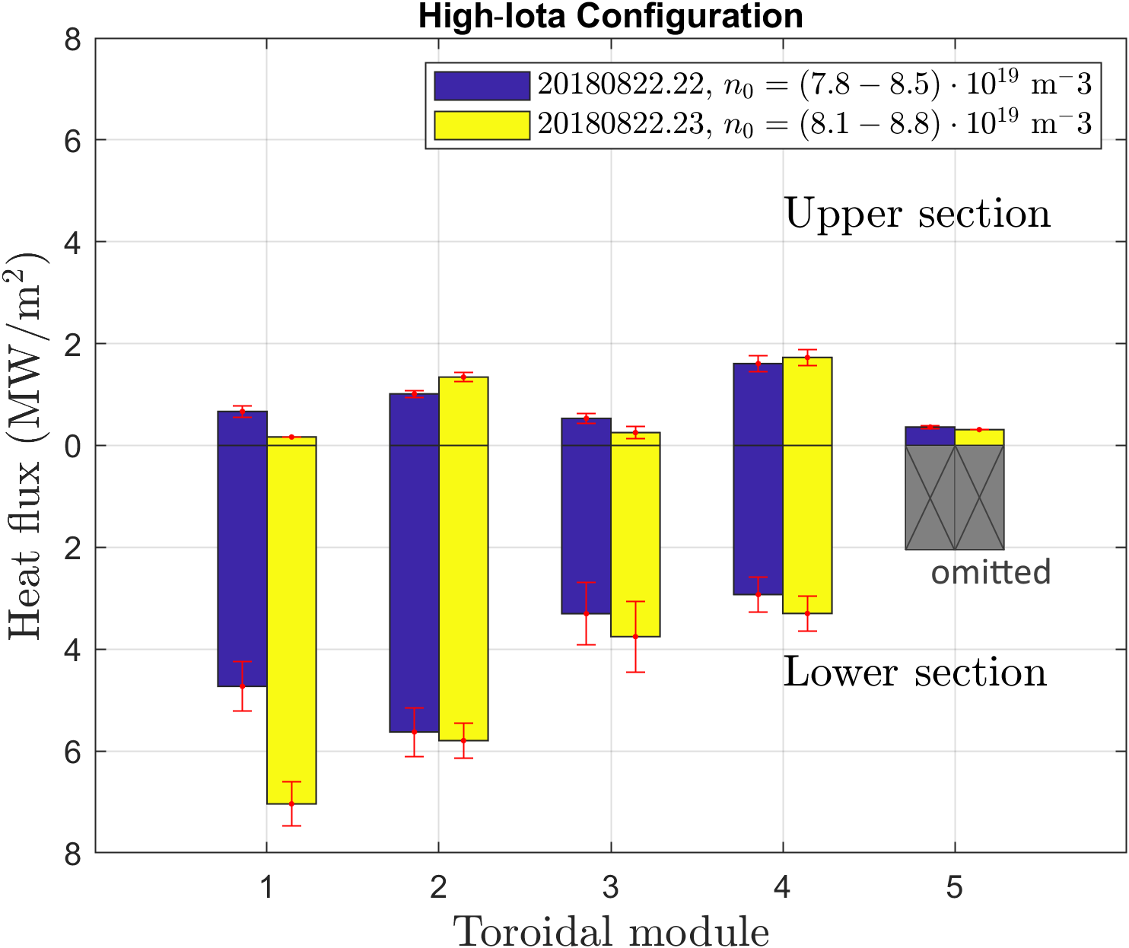
Origin of the anomalous loads
The convective loads redistribute
due to changing plasma parameters.
Toroidal and up-down asymmetry
suggest that the fast ions do
play a role.
Fast ion wall loads in W7-X

Slide 25
Conclusion
Anomalous loads are found at the high iota part of the divertor target.
The convective loads redistribute during the NBI operation due to changing plasma parameters.
The asymmetries suggest that the fast ions do play a role.
Fast ion wall loads in W7-X

Slide 26
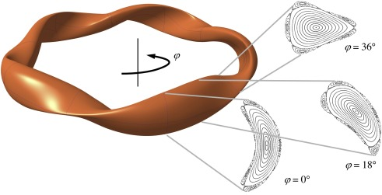

W7-X has toroidal variation in magnetic field
The bean-shaped cross-sections are positioned in the middle of each toroidal segment and have the highest magnetic field ($φ=0$)
Fast ion wall loads in W7-X

Slide 27
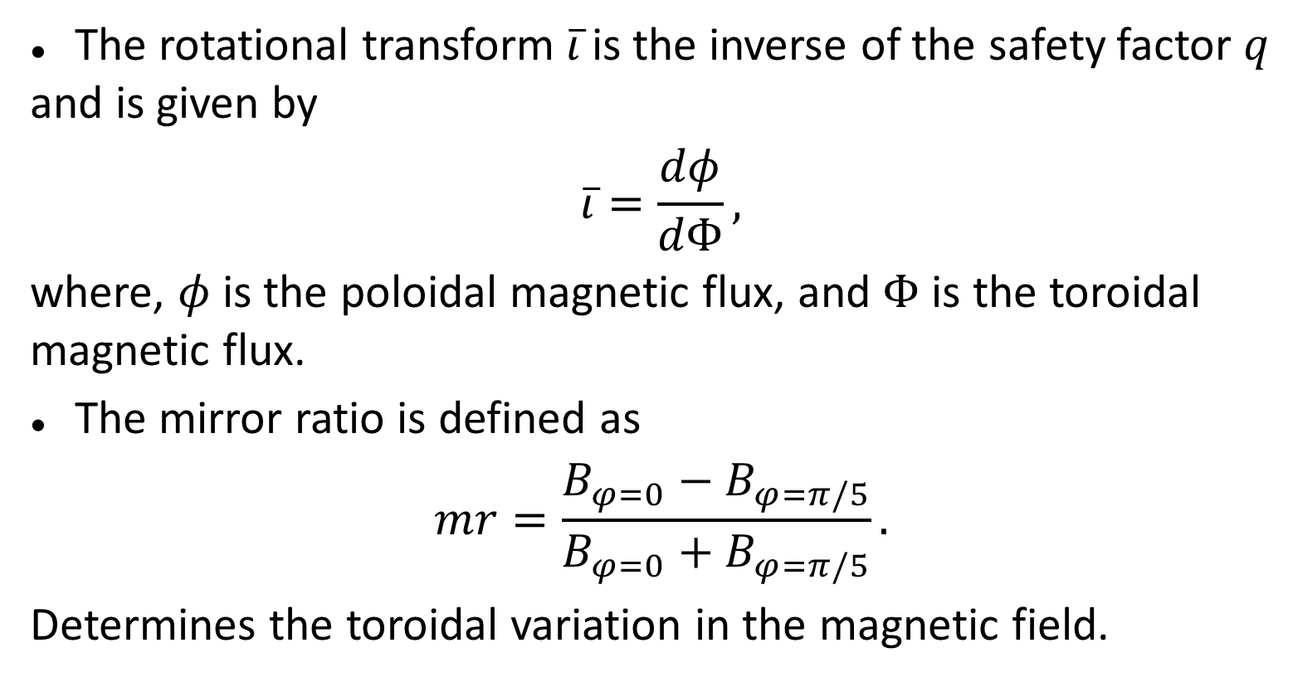
Fast ion loads depend on mag. configuration
The rotational transform $\overline{ι}$ is the inverse of the safety factor $q$ and is given by
$$\overline{ι}=\frac{dφ}{dΦ},$$
where, $φ$ is the poloidal magnetic flux, and $Φ$ is the toroidal magnetic flux.
The mirror ratio is defined as
$$mr=\frac{B_{φ=0}−B_{φ=π/5}}{B_{φ=0}+B_{φ=π/5}}.$$
Determines the toroidal variation in the magnetic field.
Fast ion wall loads in W7-X

Slide 28
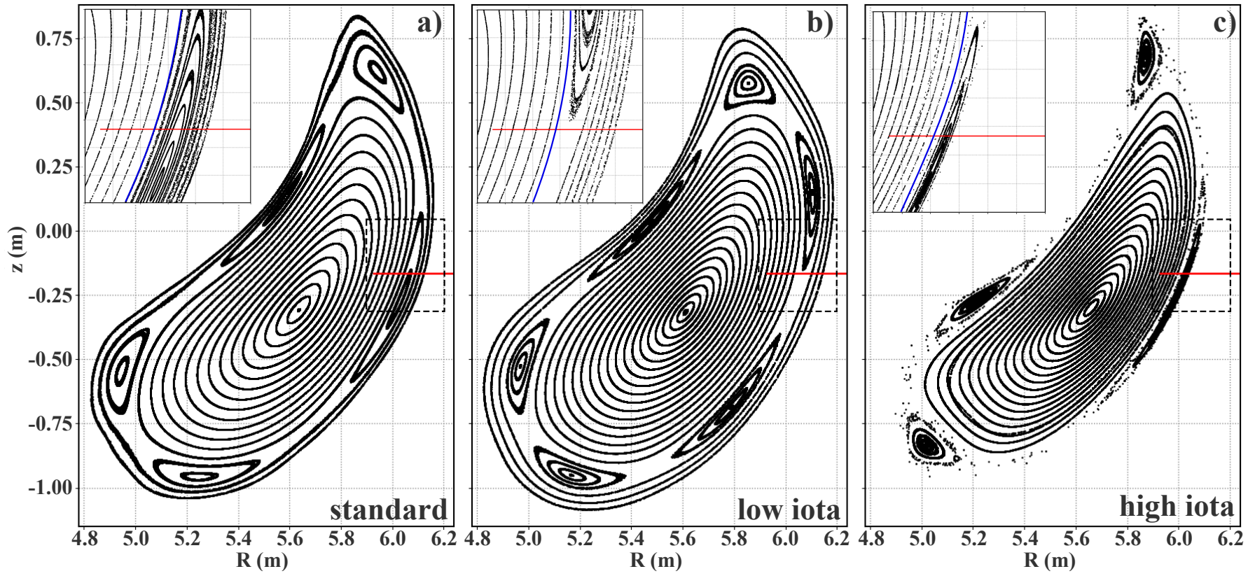

Fast ion loads depend on mag. configuration
Standard configuration ($ι_{e}=5/5$, $mr=5\%$)
High-mirror configuration ($ι_{e}=5/5$, $mr=10\%$)
High-iota configuration ($ι_{e}=5/4$, $mr=5\%$)
[3]
[3] S.Äkäslompolo et al. Fusion Eng. Des 146 (2019) 862-865
Fast ion wall loads in W7-X

Slide 29
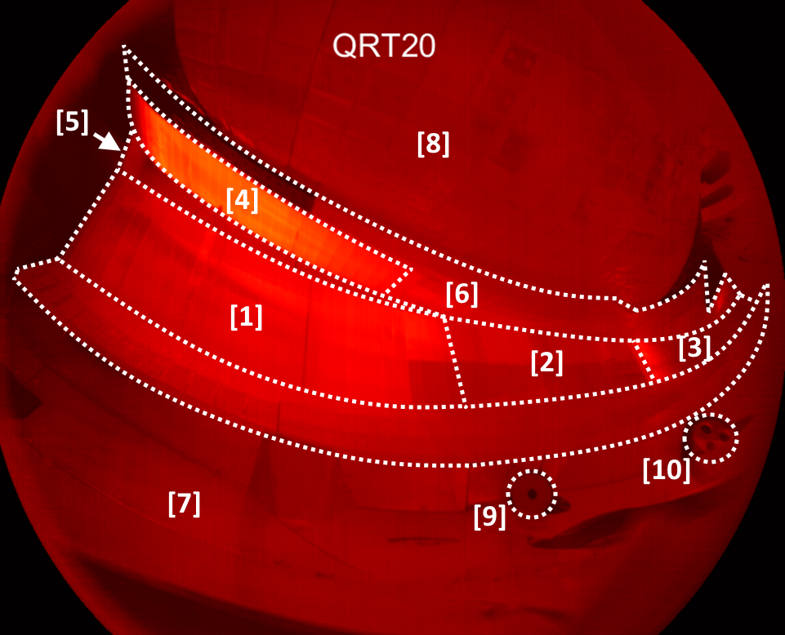
View of the IR camera
20180823.039
[1] Low iota divertor target
[2] Middle divertor target
[3] High iota divertor target
[4] Vertical divertor target
[5] Pumping gap
[6] Baffle
[7] Outer vessel wall (steel)
[8] Shield (graphite)
[9] AEA port
[10] AEF port
Fast ion wall loads in W7-X

Slide 30
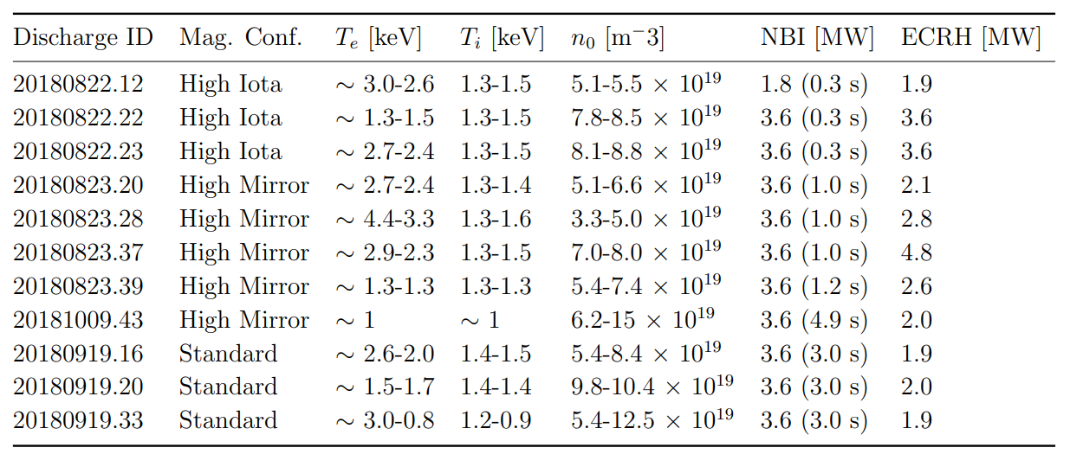
Discharges
Fast ion wall loads in W7-X

Slide 31
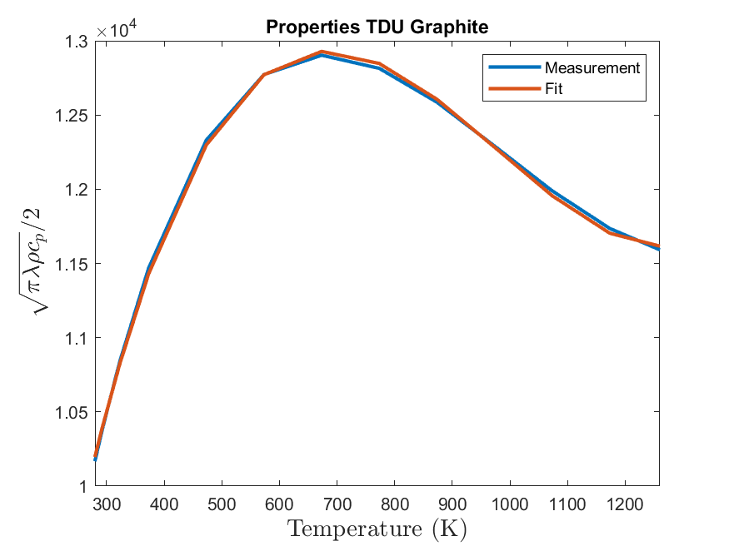
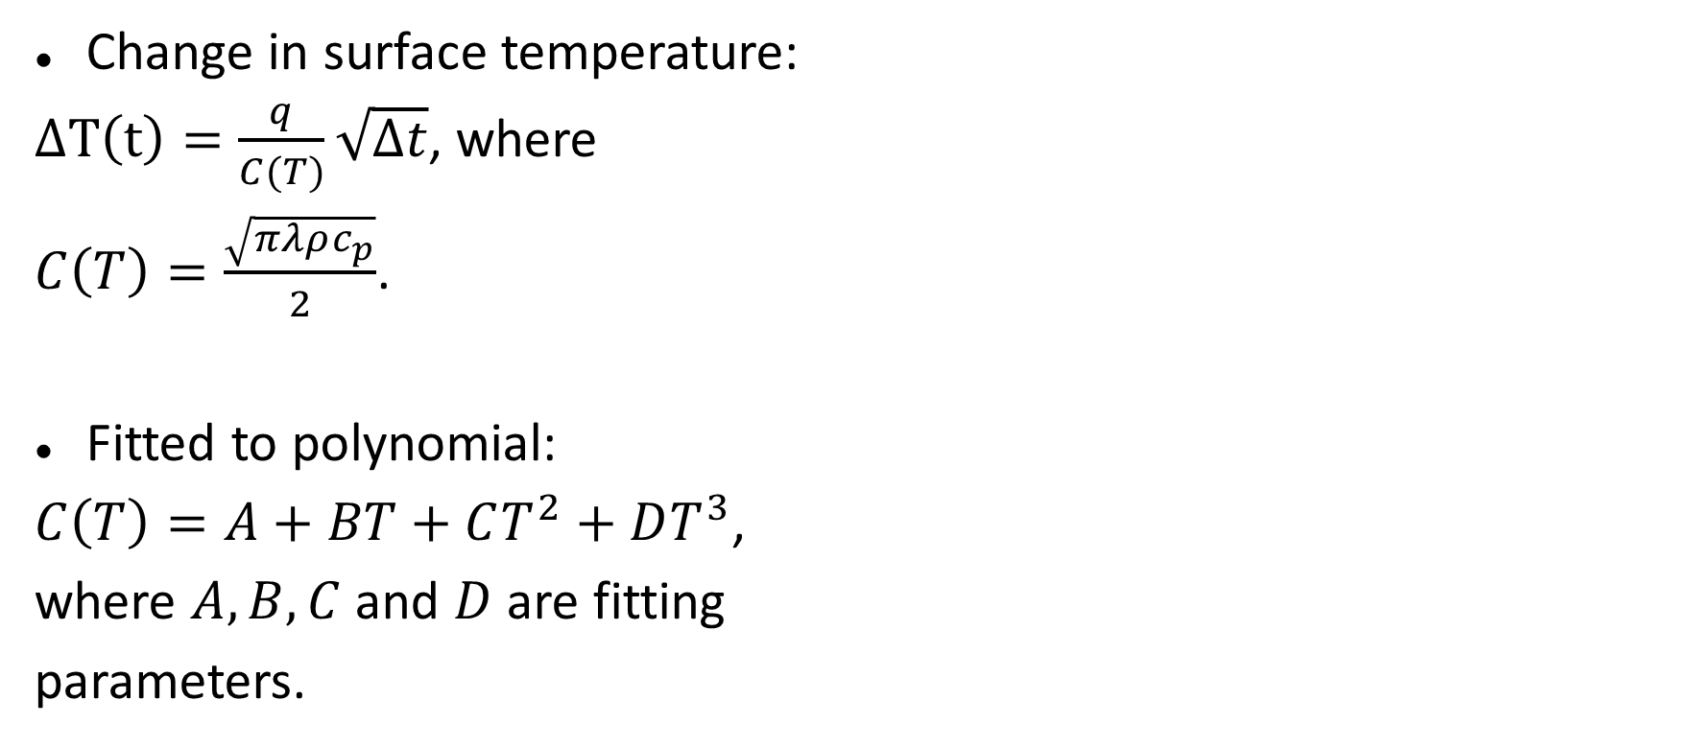
Temperature dependence of material properties
Change in surface temperature:
$ΔT\left(t\right)=\frac{q}{C(T)}\sqrt{Δt}$, where
$C\left(T\right)=\frac{\sqrt{πλρc_{p}}}{2}$.
Fitted to polynomial:
$C\left(T\right)=A+BT+CT^{2}+DT^{3}$,
where $A,B,C$ and $D$ are fitting
parameters.
Fast ion wall loads in W7-X

Slide 32
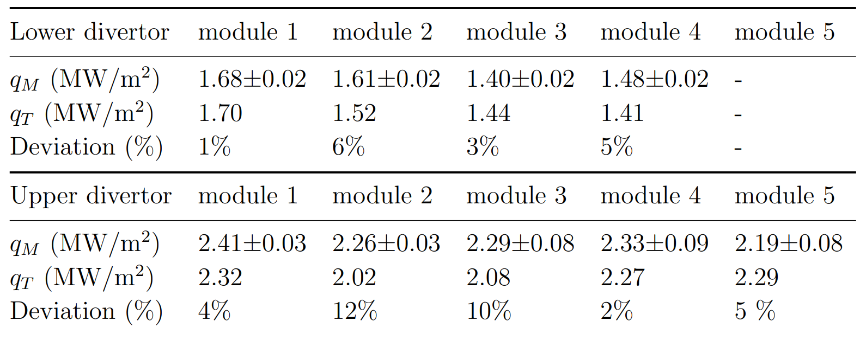
Verification with THEODOR
Discrepancies in magnitude of on average 5%, deemed acceptable.
Fast ion wall loads in W7-X

Slide 33
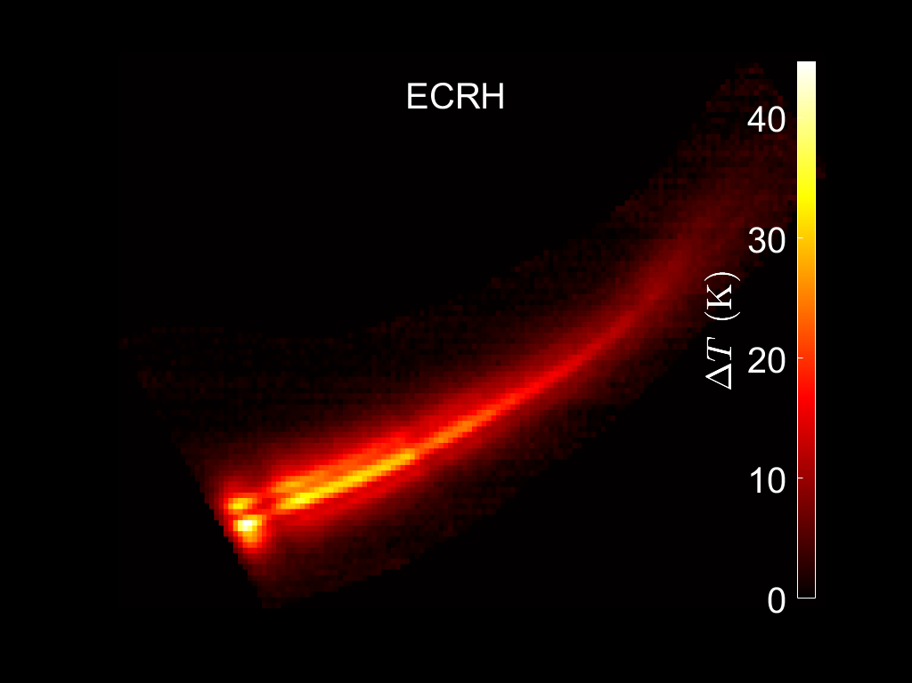
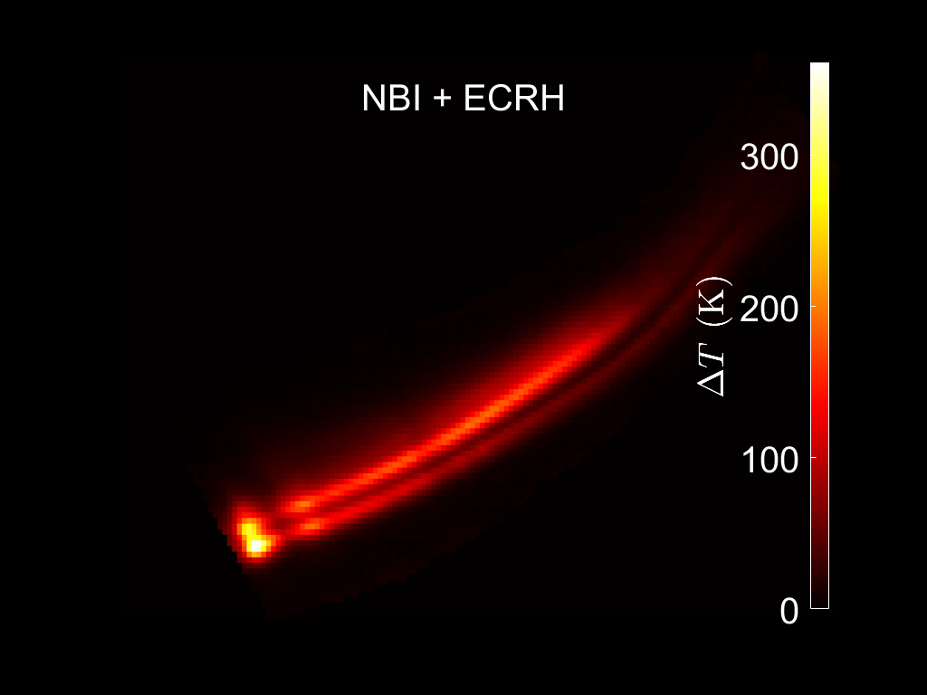
Second strike line (High iota configuration)
ECRH operation
ECRH + NBI operation
AEF40, High iota configuration: 20180822.22
Fast ion wall loads in W7-X

Slide 34
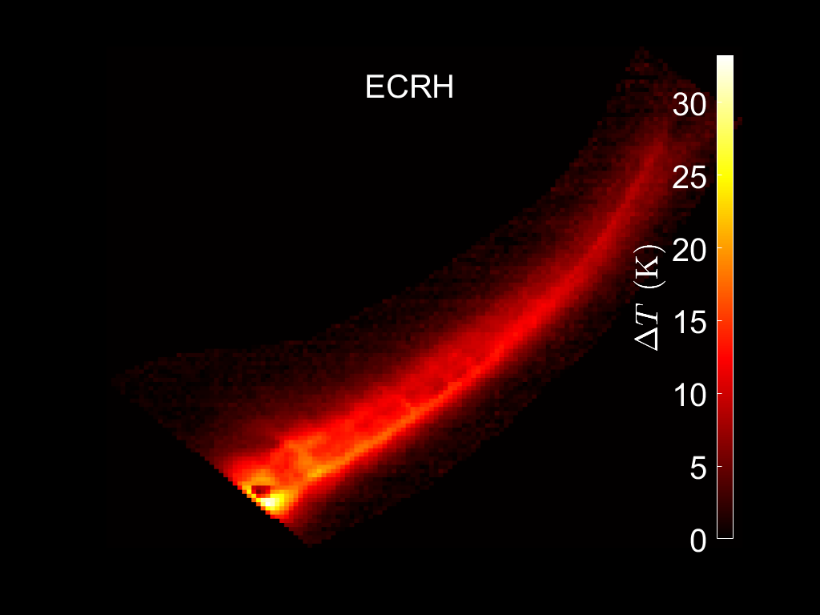
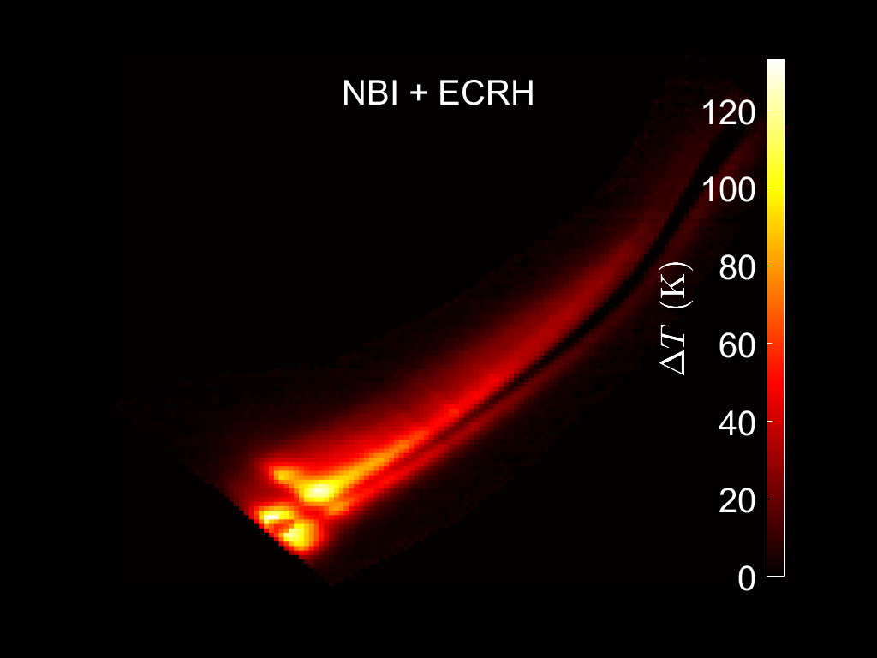
Second strike line (High iota configuraiton)
ECRH operation
ECR + NBI operation
AEF11, High iota configuration: 20180822.22
Fast ion wall loads in W7-X

Slide 35
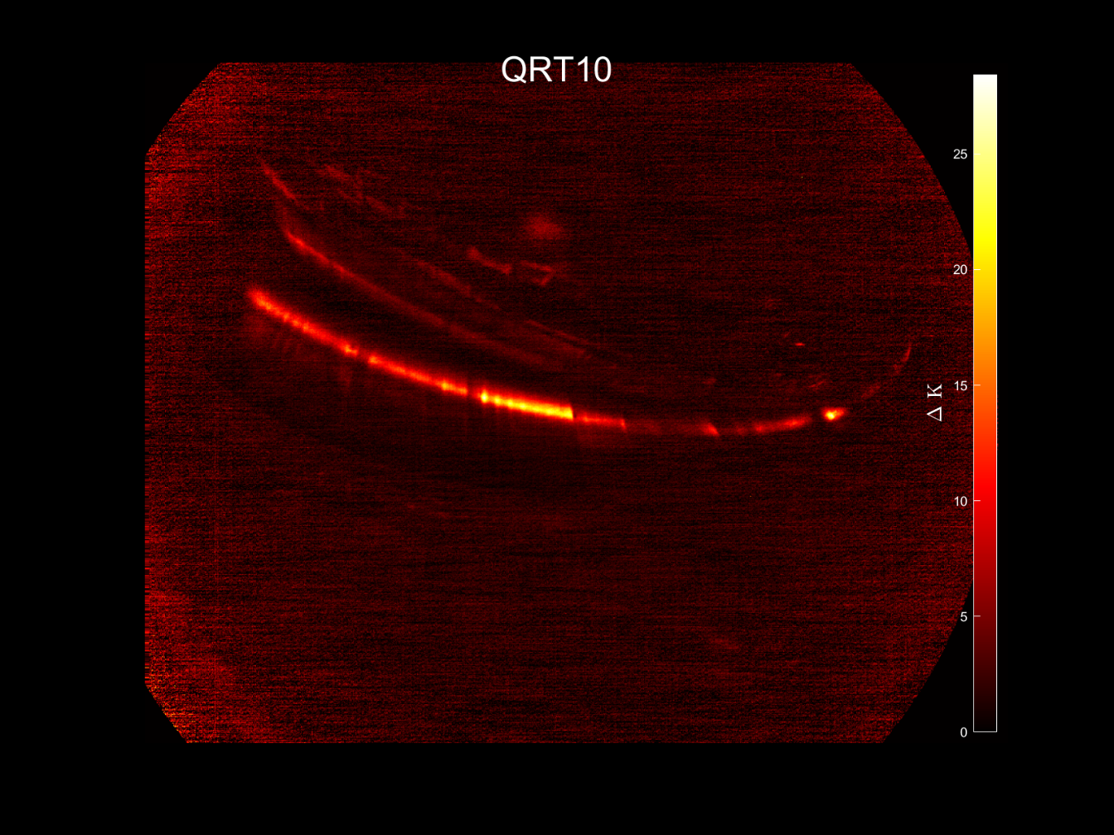
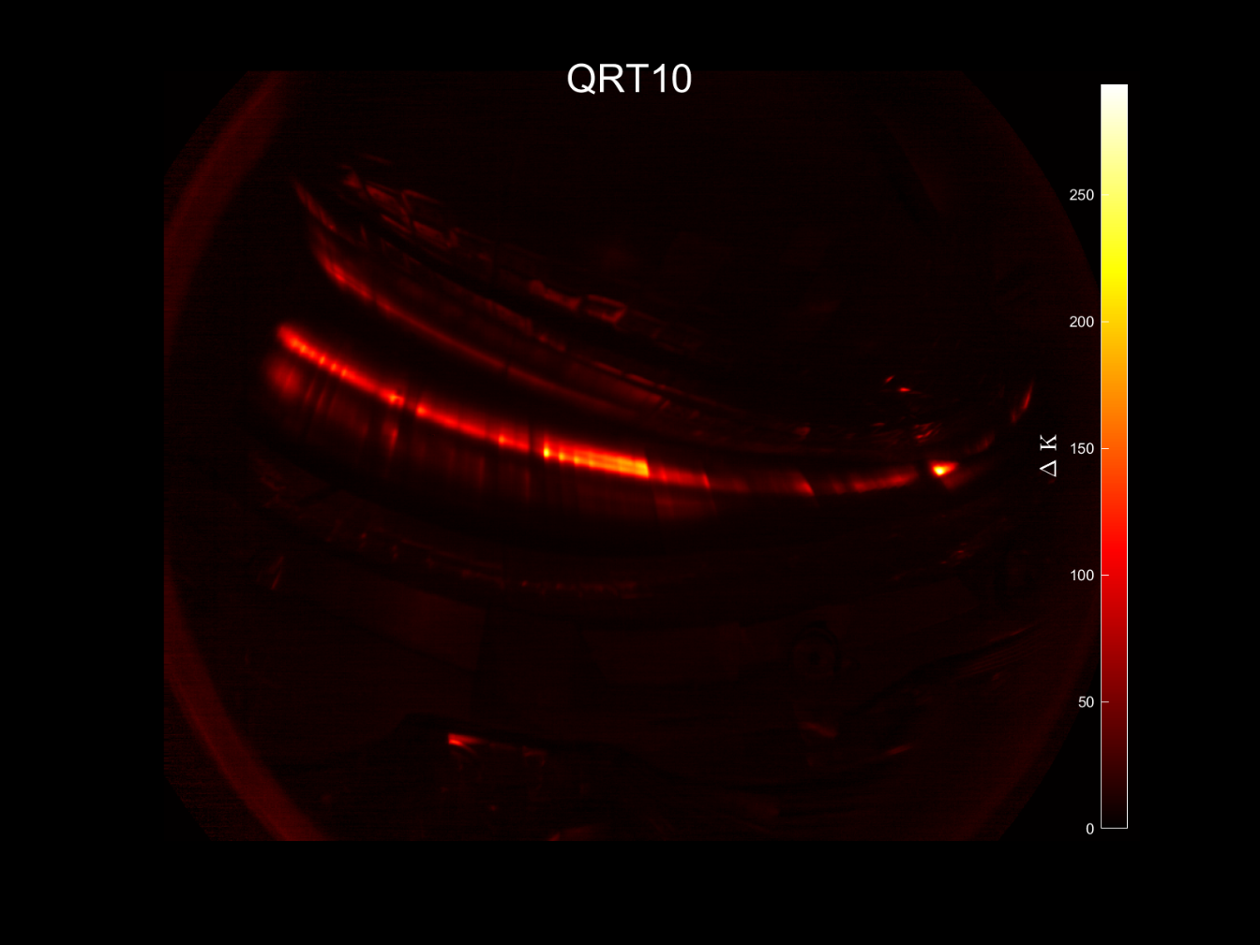
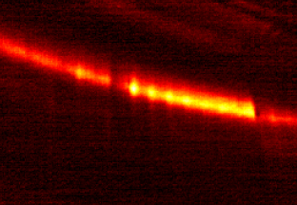

Second strike line (Standard configuration)
ECRH
Standard configuration 20180919.016
ECRH+NBI
Fast ion wall loads in W7-X

Slide 36
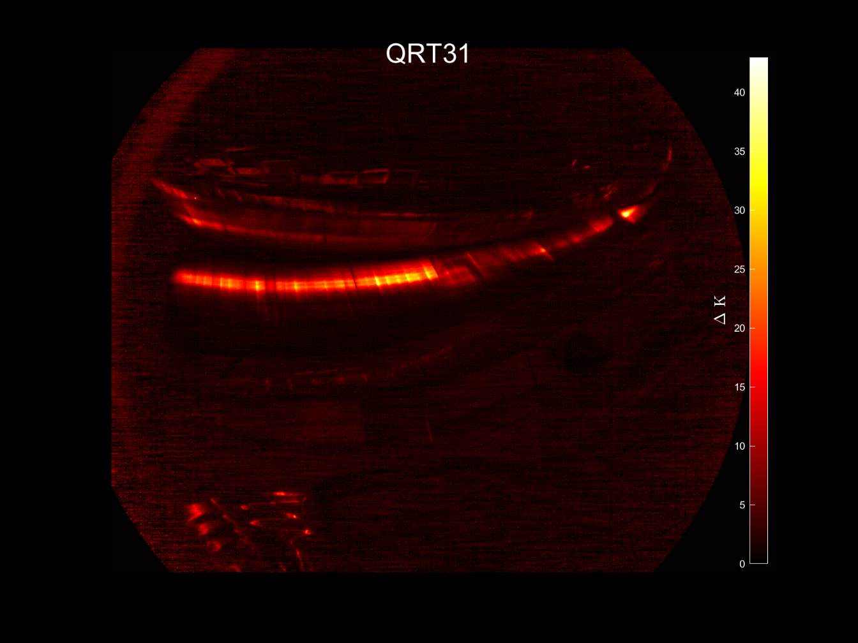
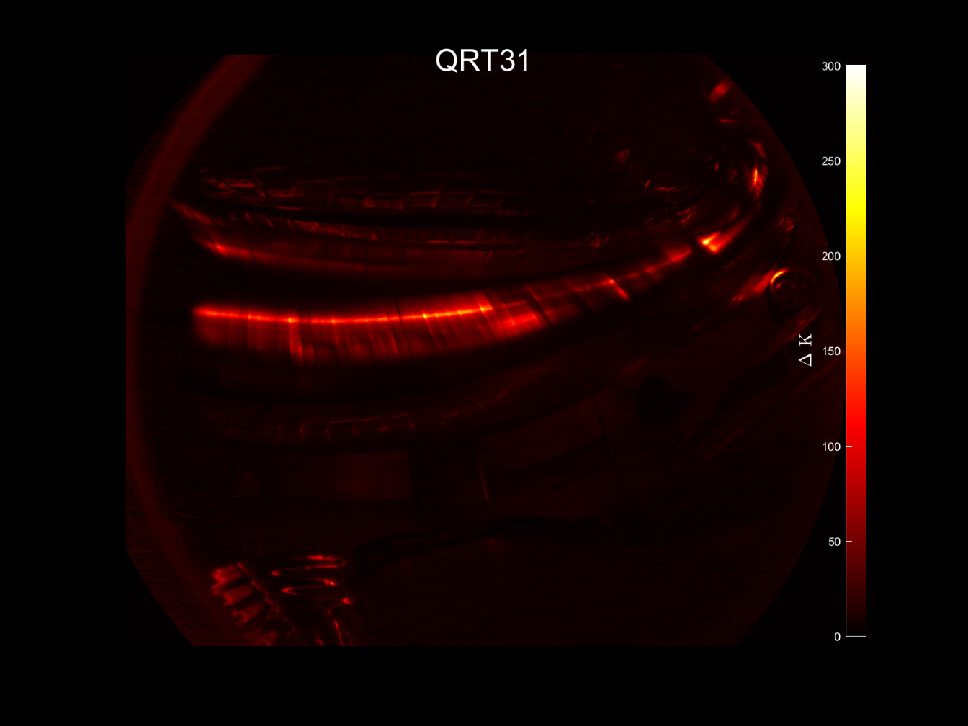


Second strike line (Standard configuration)
ECRH
Standard configuration 20180919.016
ECRH+NBI
Fast ion wall loads in W7-X

