Slide 1
First Closed Design of Island Divertor for W7-X
A. Kharwandikar, A. Menzel-Barbara

Slide 2
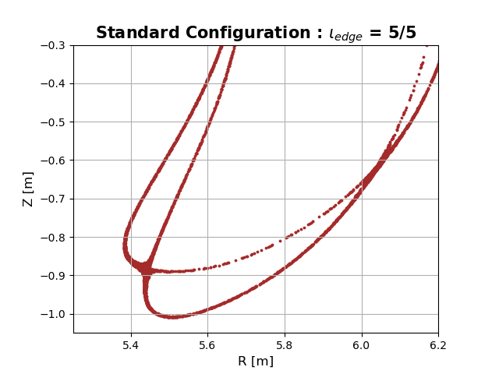
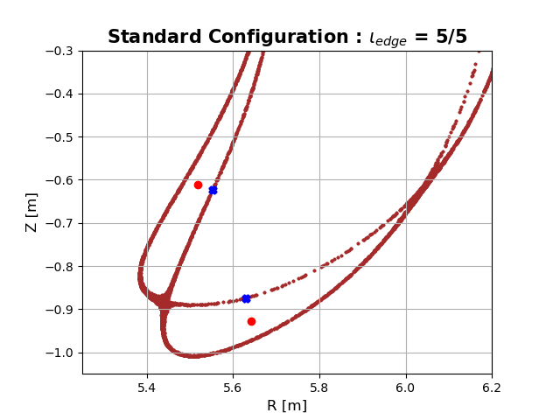
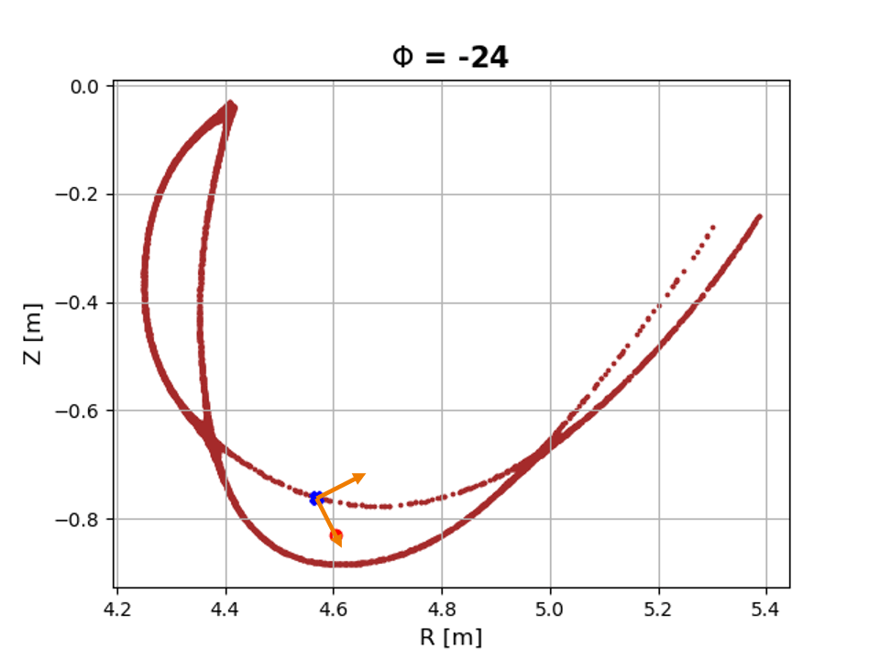
Divertor Design Where to Start?
Large 3D space $⇒$ Need general framework for divertor design and iteration!
Utilize spline of stationary points (O-points, X-points) of a given 3D magnetic topology
O-line divertors
Locate O-point and nearest LCMS point
Basis vector $⟹$ “Island” reference frame
Application:
2D shape superimposed on island frame
Stitch together different cross-sections
3D island divertor design guess
Notes:
Now lets jump into the next problem to be addressed : how to design a divertor
To not get lost in the large 3d design space, need a general framework
Leading idea is to leverage trajectories of stationary points of a given magnetic topology
Let’s take the example of the O-line class of divertors wherein we first locate the O-point and nearest LCMS point to build a basis vector
And eventually an island reference frame that moves with the island
Useful to create 3d shapes

Slide 3
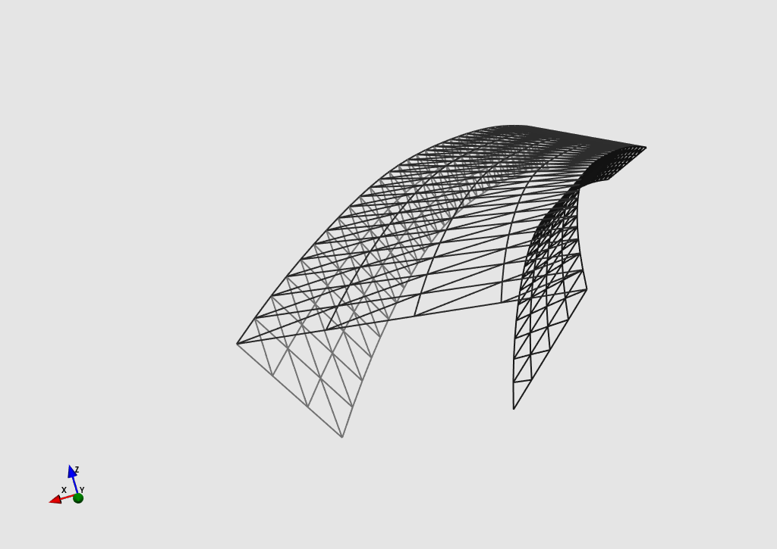
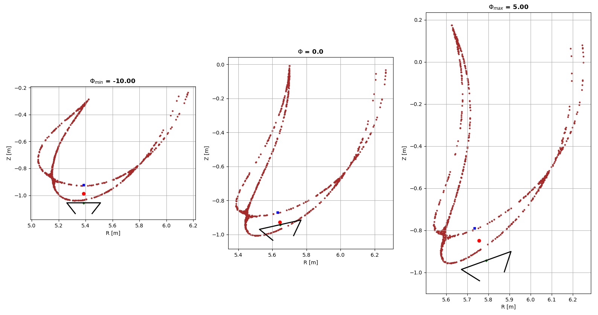
Divertor Design Example Implementation
Start with candidate 2D shape with potentially “improved” particle exhaust
2D Idea
3D Island Divertor Design guess
Design Parameters:
Dimensions
Offset from O -point
Tilt about basis vector
* Toroidal variation
Notes:
Let’s visualize this through an example of a 2d divertor shape that would potentially improve the partile exhaust
It looks like inverted trapezium and we have the following design parameters to play with
Dimensions, Offset from O-point and tilt about basis
Also possible to set toroidal variation of parameters
For arbitrary values of the parameters, we obtain this 3D ID design guess

Slide 4
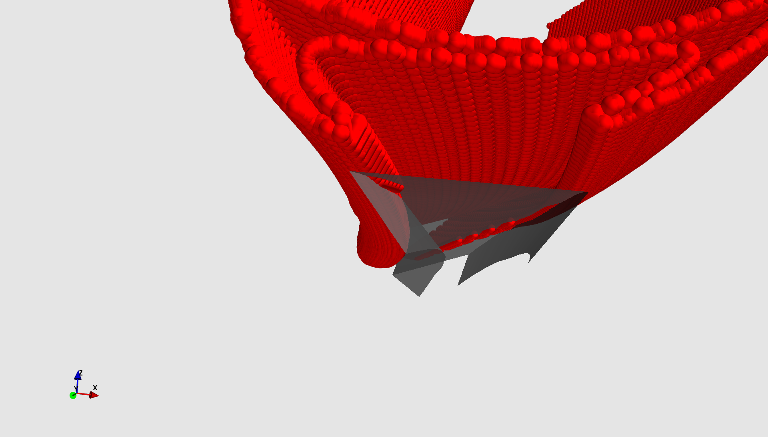
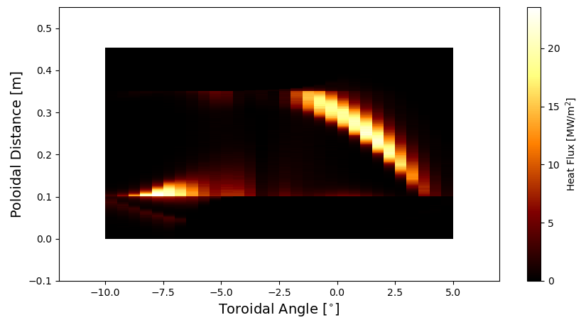
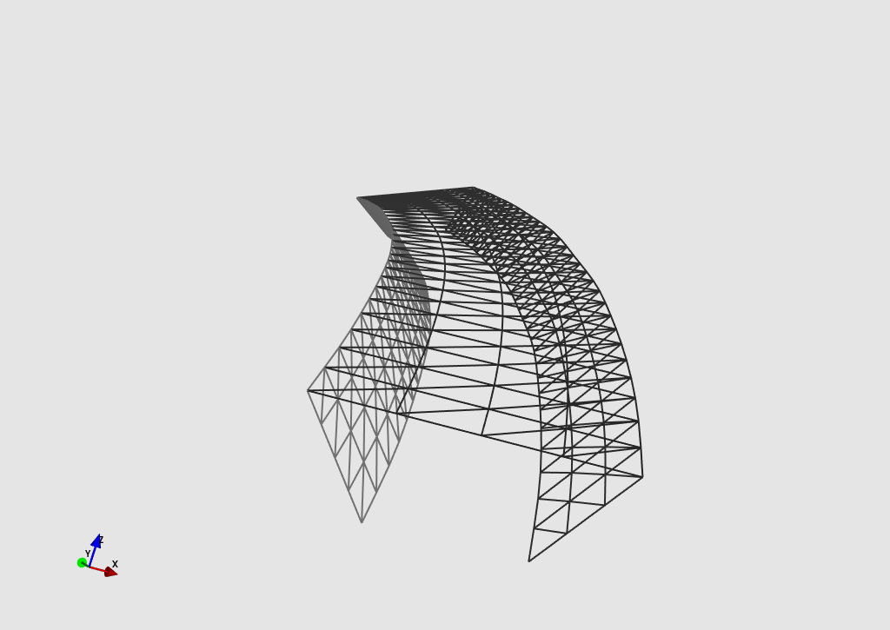
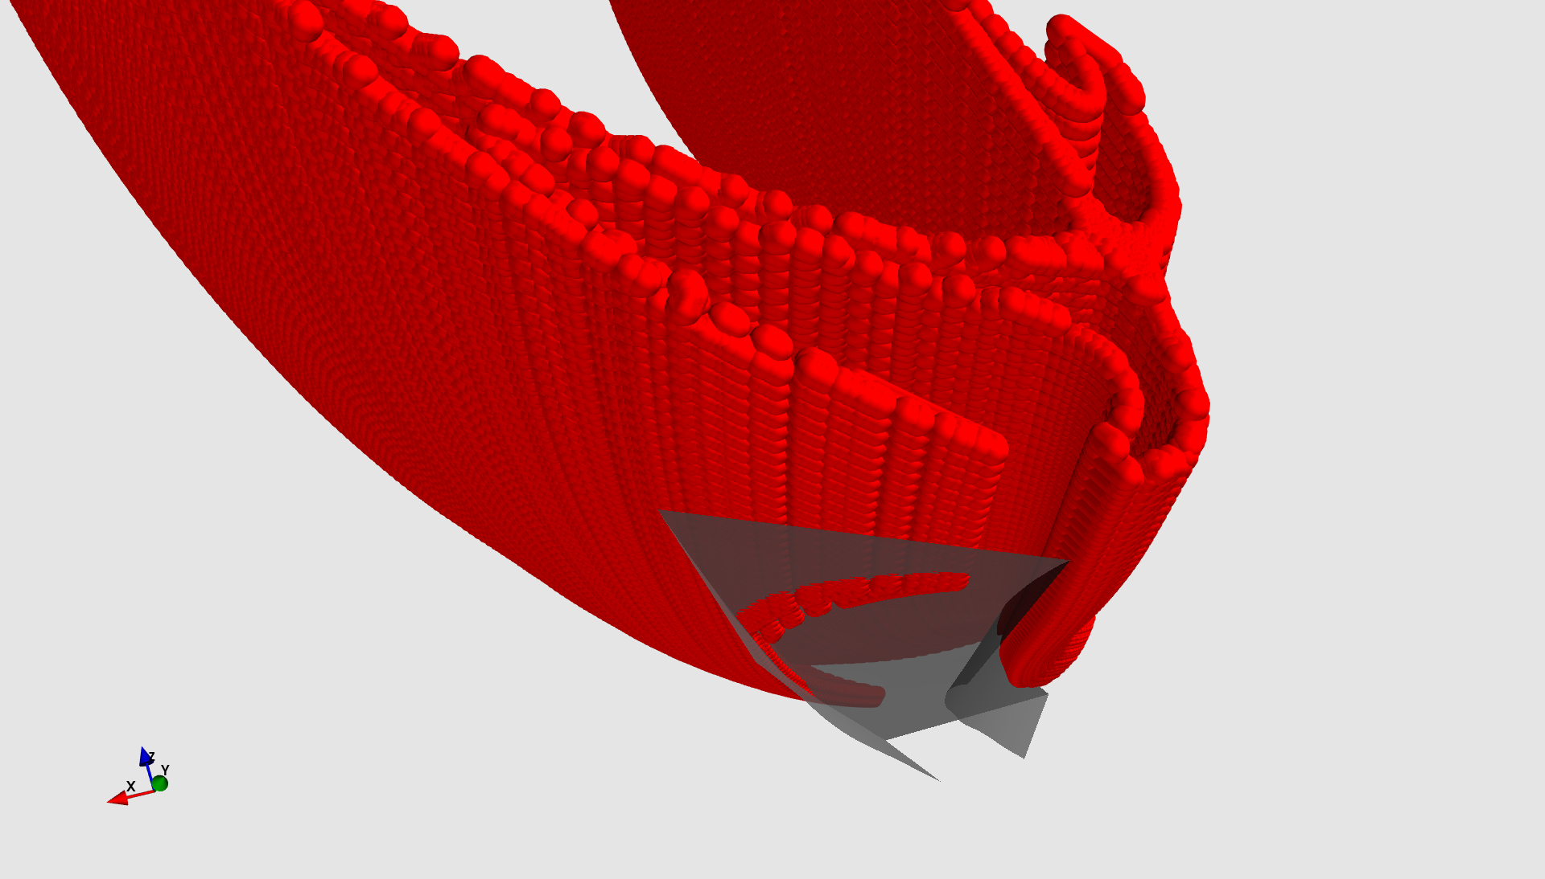
Divertor Design Heat Loads
EMC3-Lite: Psol = 10 MW, Chi = 2m^2/s, Power Balance shows only 0.12% lost
Not a good design $⟹$ peak > 10 MW/m^2 and loads only on top …. But WHY?
Outer Flap
Top
Top
Inner Flap
Inner Flap
Outer Flap

Slide 5
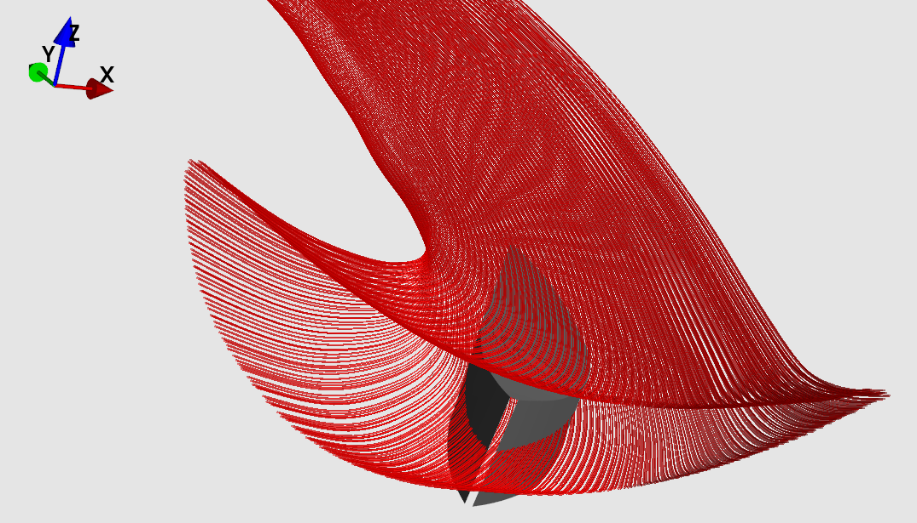
Paradigm Shift Divertor submerged in Islands?
Previous approach (dive in and out) not effective for loading side flaps
Keep divertor within islands and shadow the toroidal ends!
Basis of shadowing the ends:

Slide 6
Sketching the concept
Toroidal plane
X
X
Φ₁
Toroidal plane
X
X
Φ₂

Slide 7
Sketching the concept
Toroidal plane
X
X
Φ₁
Toroidal plane
X
X
Φ₂

Slide 8
Sketching the concept
Toroidal plane
X
X
Φ₁
Toroidal plane
X
X
Φ₂

Slide 9
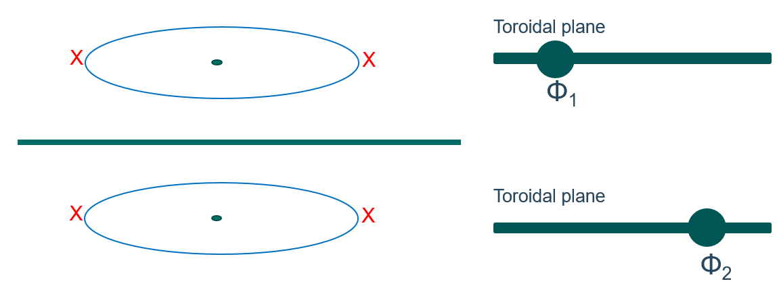
Plotting a flux surface
Measure of toroidal procession Φ
θ*
Measure of poloidal procession θ*

Slide 10
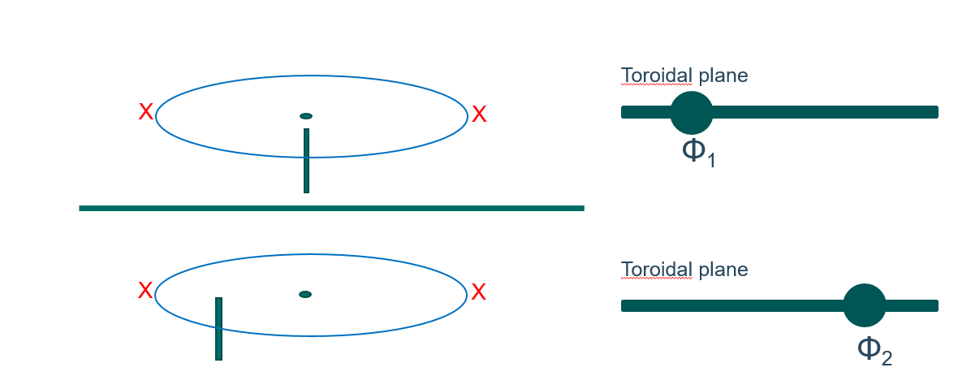
Plotting a flux surface, introducing the target
Φ₂
Measure of toroidal procession Φ
Φ₁
Measure of poloidal procession θ*

Slide 11
Plotting a flux surface, introducing a particle source
Measure of toroidal procession Φ
Measure of poloidal procession θ*

Slide 12
Plotting a flux surface, shadowing the toroidal end
Φ₂
Measure of toroidal procession Φ
Φ₁
Measure of poloidal procession θ*

Slide 13
Plotting a flux surface, shadowing the toroidal end
Φ₂
Measure of toroidal procession Φ
Tip is shadowed
Φ₁
Measure of poloidal procession θ*

Slide 14
Plotting a flux surface
Φ₂
Measure of toroidal procession Φ
Defines angle of incidence
Φ₁
Measure of poloidal procession θ*

Slide 15
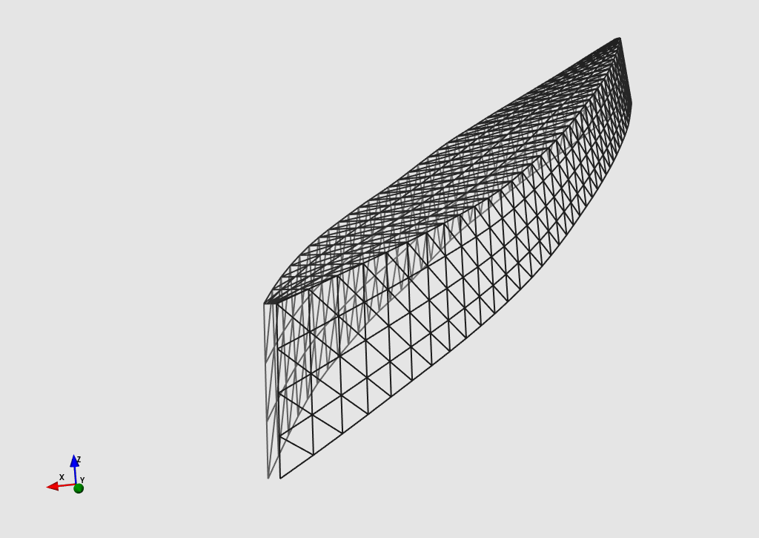
Approach 1 – Design 1 Inner Island Separatrix as Reference Frame
Basic requirement : Magnetic symmetry plane of an island
-> Radially closest point on a nearby LCMS?

Slide 16
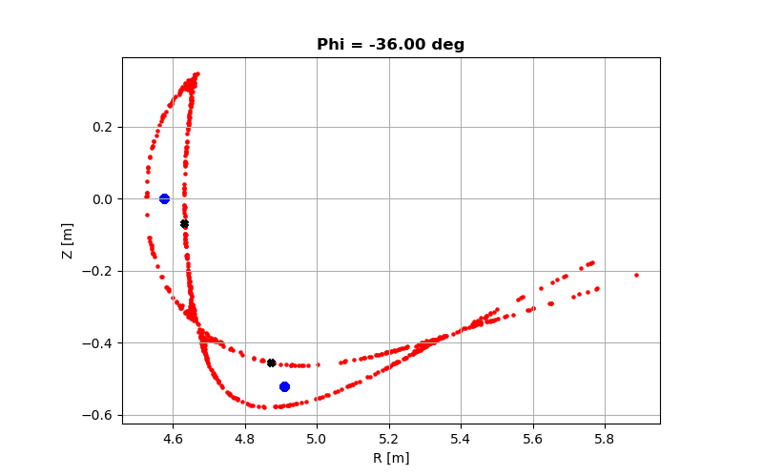
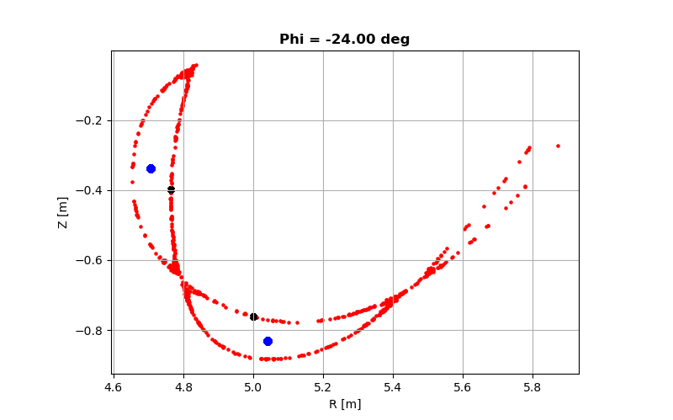
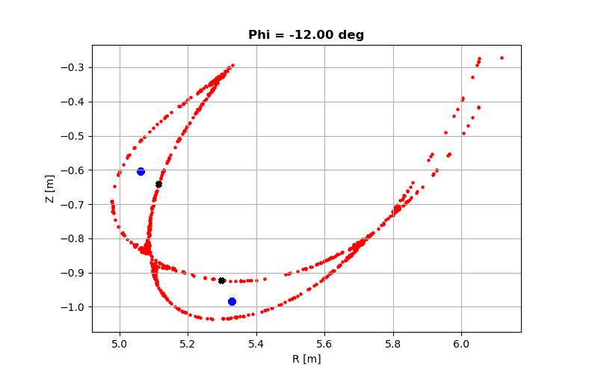
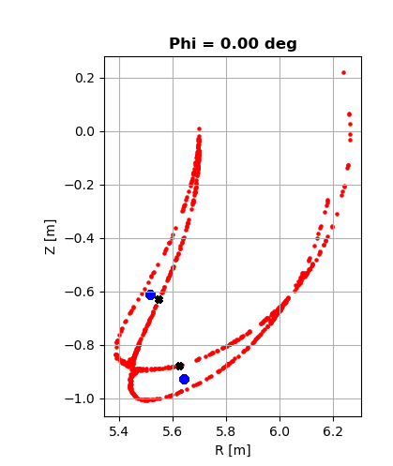
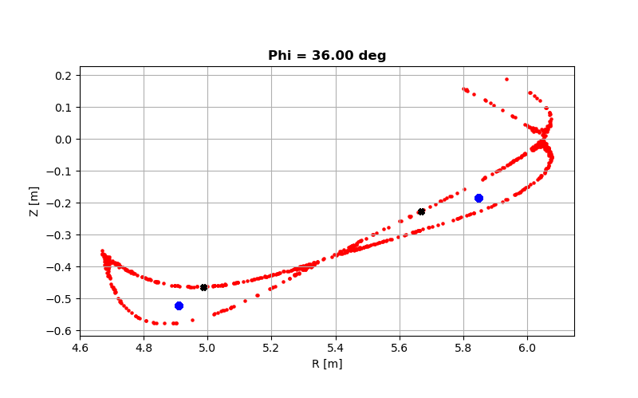
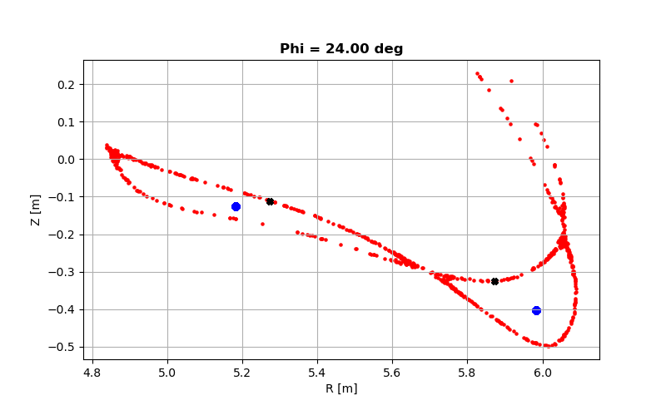
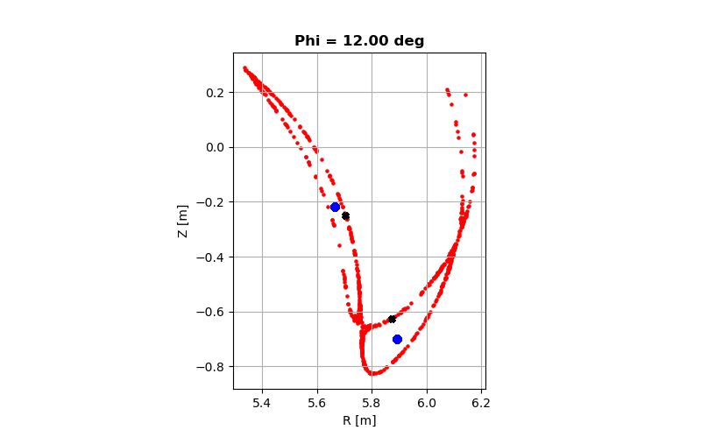
Chosen the island between -36 and 0 because its shape remains relatively unchanged!!

Slide 17
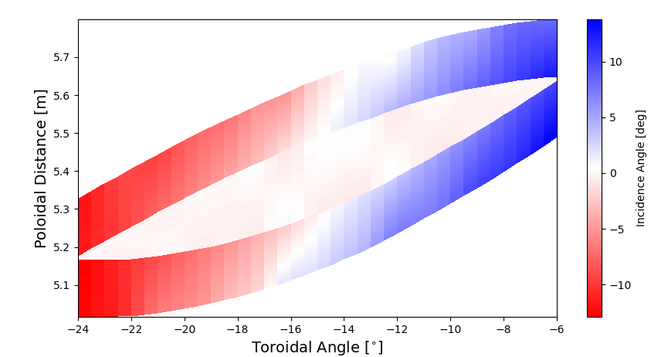
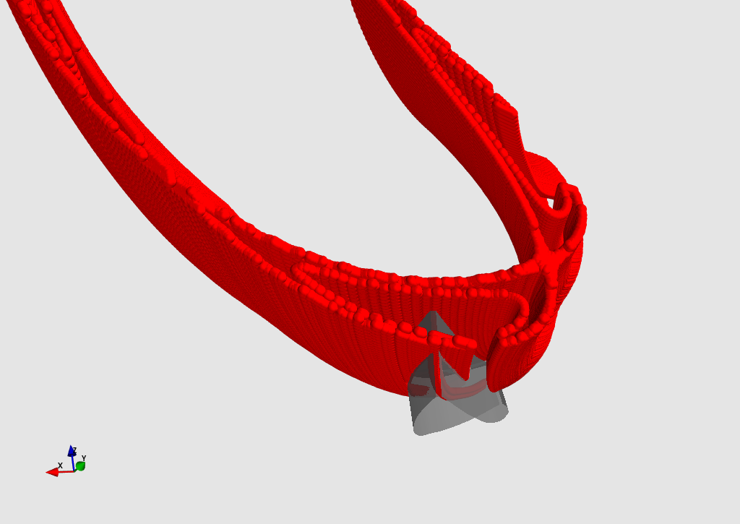
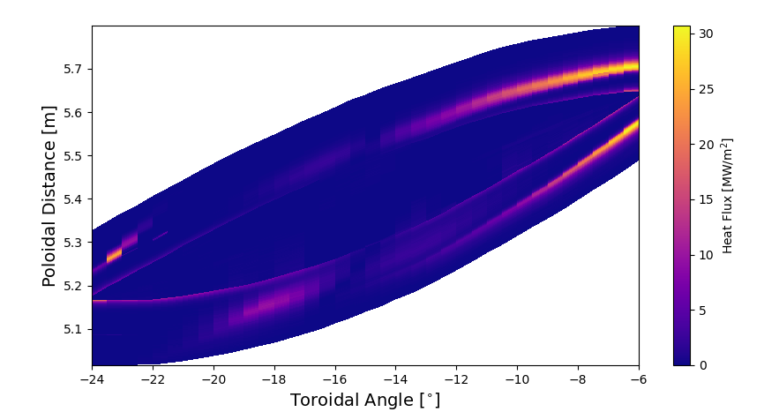
Approach 1 – Design 1 Power Shell
Take-aways:
Not following the island shape effectively
Incidence angles too large

Slide 18
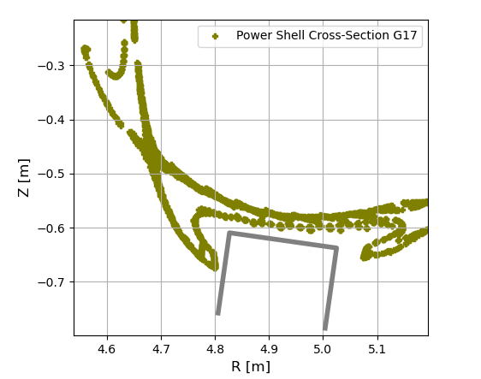
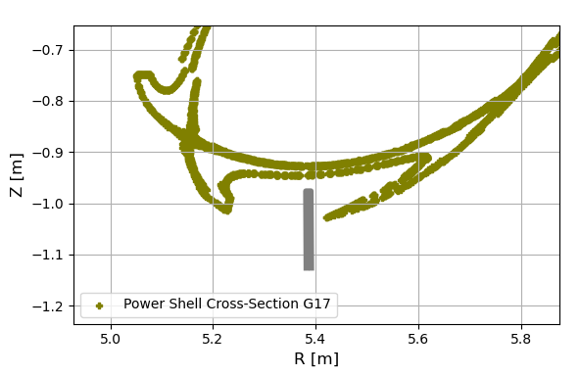
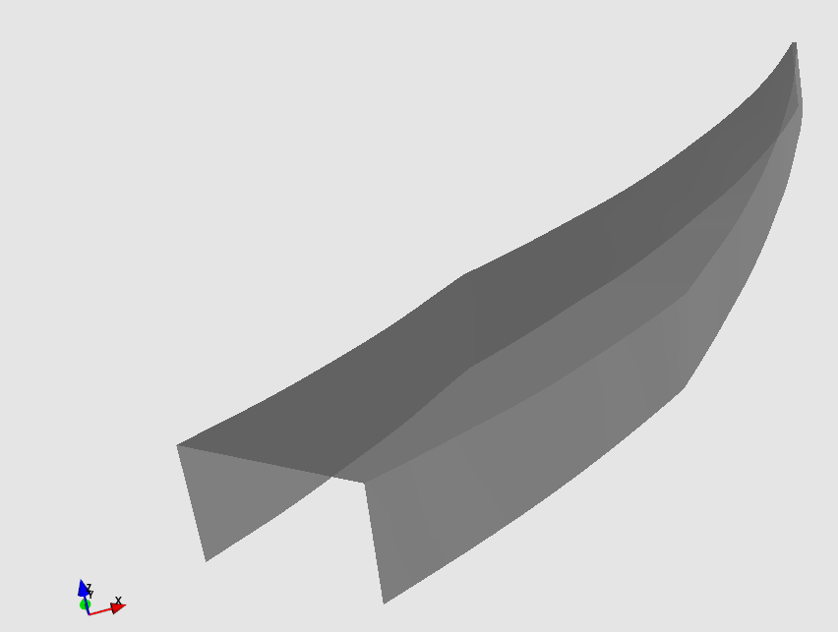
Approach 1 – Design 2 Inner Island Separatrix as Reference Frame
Not the best approach, but can be improvised!
Divertor width varied toroidally and module pushed more towards the triangular plane
Linear interpolation of divertor width to have a constant incidence angle (No bulge!)

Slide 19
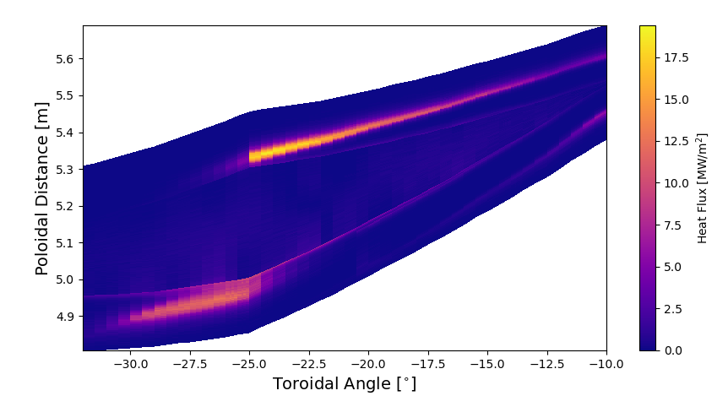
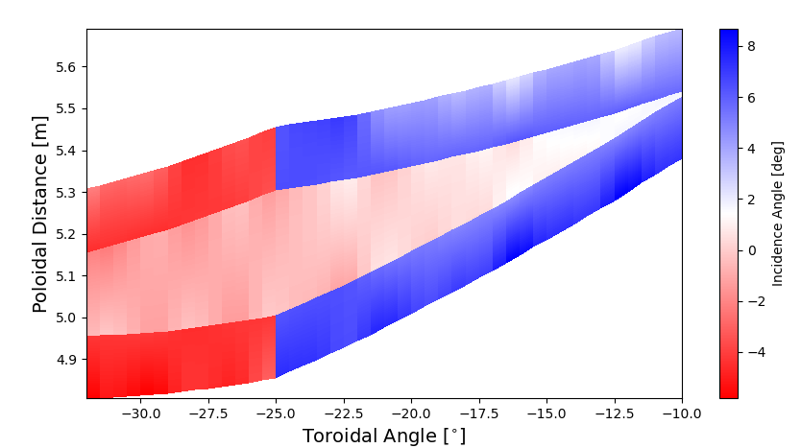
Approach 1 – Design 2 Heat Loads and Incidence Angles
Divertor width varied toroidally and pushed more towards the triangular plane
Linear interpolation of divertor width to have constant and controlled incidence angle
No bulge!

Slide 20
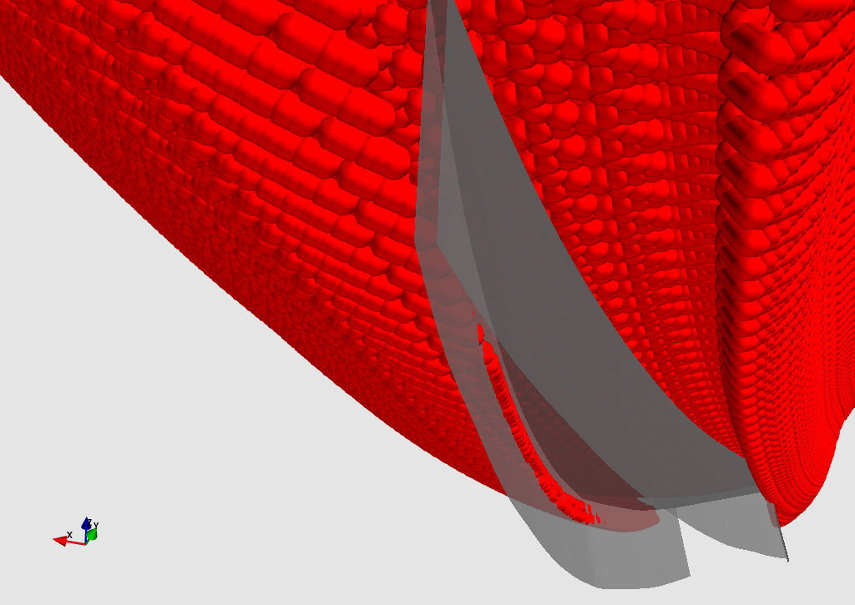
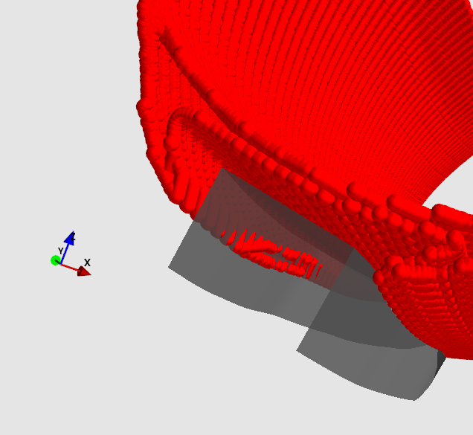
Approach 1 – Design 2 Accounting Heat Loads
All the strikelines can be visualized from power shell (except one)
Probably binormal transport followed by parallel transport towards
target

Slide 21
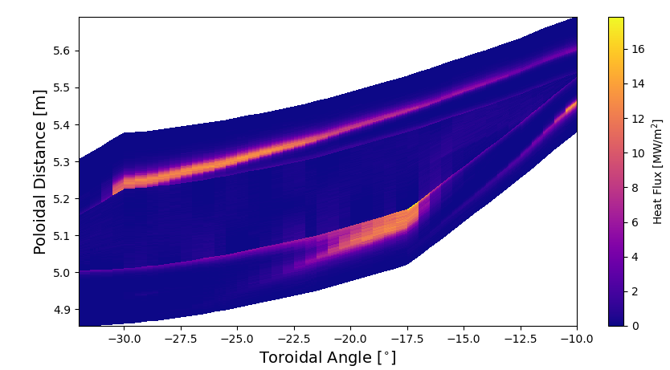
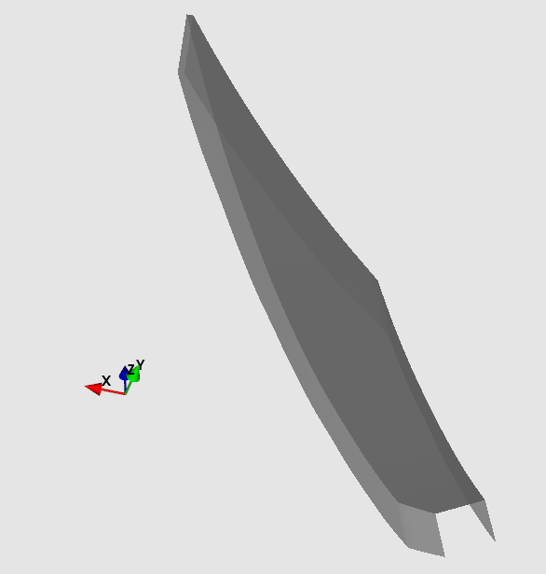
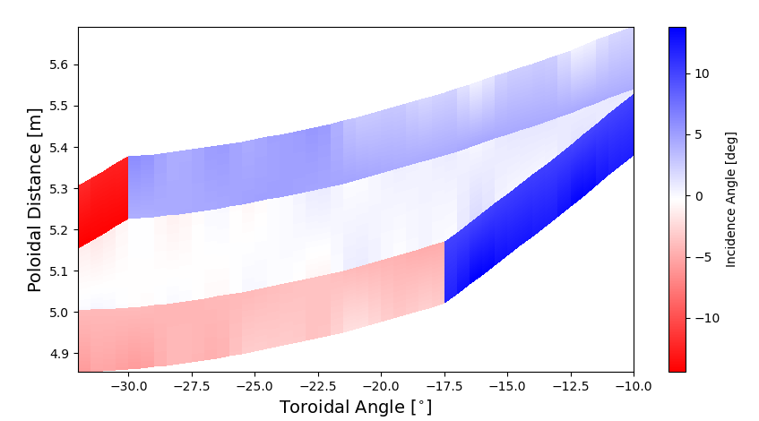
Approach 1 – Design 3 Heat Loads and Incidence Angles
Allowing for asymmetric widths to control load distribution on either flaps
Apart from leading edge, peak heat loads below 15 MW/m^2
Promising results, might even achieve acceptable loads with single target/period

Slide 22
Introducing a tilt for better pumping
Toroidal plane
X
X
Φ₁
Toroidal plane
X
X
Φ₂

Slide 23
Introducing a tilt for better pumping
Toroidal plane
X
X
Φ₁
Toroidal plane
X
X
Φ₂

Slide 24
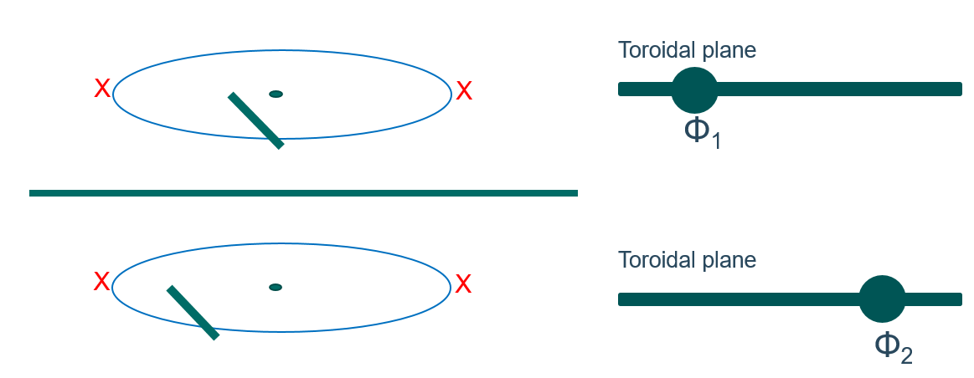
Introducing a tilt for better better pumping
Φ₂
Measure of toroidal procession
Φ₁
Measure of poloidal procession

Slide 25
Introducing a tilt for better better pumping
Toroidal plane
X
X
Φ₁
Toroidal plane
X
X
Φ₂

Slide 26
Introducing a tilt for better better pumping
Toroidal plane
X
X
Φ₁
Toroidal plane
X
X
Φ₂

Slide 27
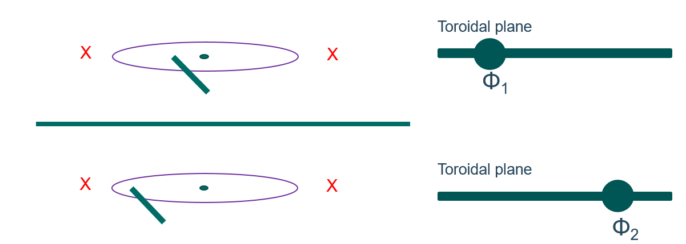
Introducing a tilt for better better pumping
Φ₂
Measure of toroidal procession
Φ₁
Defines angle of incidence
Measure of poloidal procession

Slide 28
Introducing a second plate
Toroidal plane
X
X
Φ₁
Toroidal plane
X
X
Φ₂
Toroidal plane
X
X
Φ₃
Toroidal plane
X
X
Φ₄

Slide 29
Introducing a second plate
Φ₂
Measure of toroidal procession
Φ₁
Φ₂
Φ₁
Measure of poloidal procession

Slide 30
Introducing a second plate
Measure of toroidal procession
Measure of poloidal procession

Slide 31
Pure speculation?
Measure of toroidal procession
Measure of poloidal procession
Second target shadowed by first target?

Slide 32
Open Questions and Discussion
Magnetic symmetry plane (flux coordinates) for islands?
Similar (transport relevant) connection lengths on either side
flux coordinates for islands
Following these coordinates probably better for efficient shadowing!
Future considerations:
Effect of target tilting
Configuration flexibility
Effect of toroidal current and finite beta
Framework for exploring new geometries!!!

