Slide 1
“Closed” O-Line Divertors: Preliminary Heat Load Results
Amit Kharwandikar

Slide 2
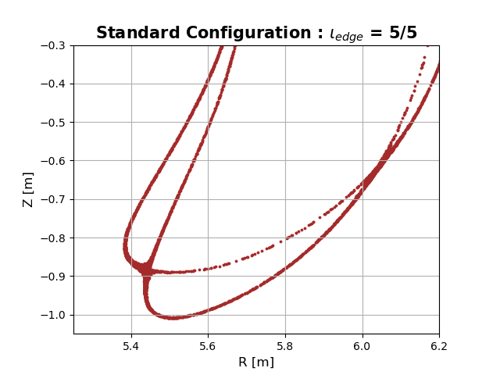
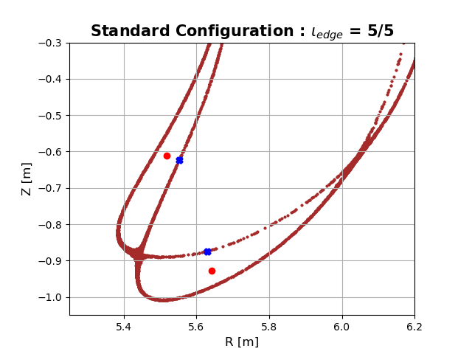
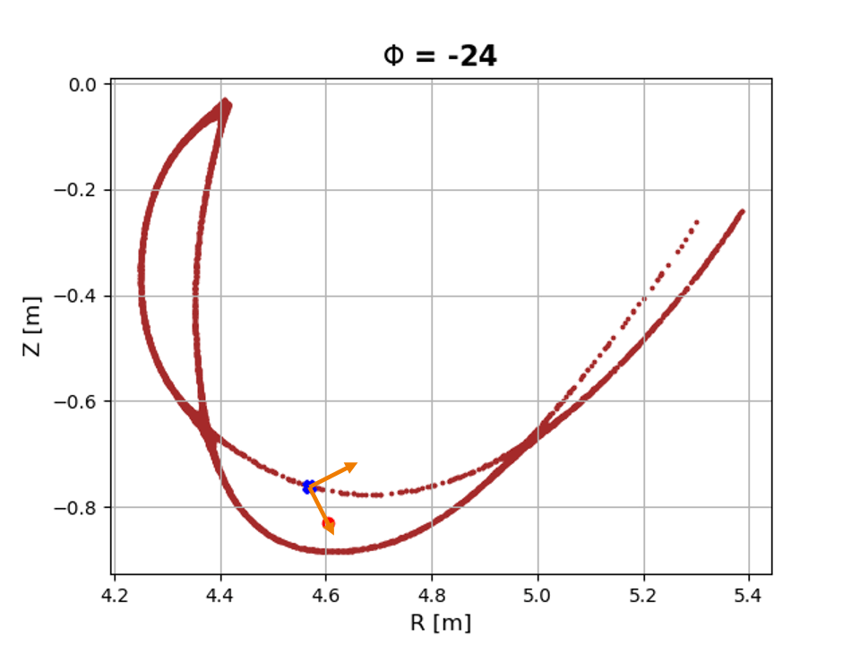
Divertor Design Where to Start?
Large 3D space $⇒$ Need general framework for divertor design and iteration!
Utilize spline of stationary points (O-points, X-points) of a given 3D magnetic topology
O-line divertors
Locate O-point and nearest LCMS point
Basis vector $⟹$ “Island” reference frame
Application:
2D shape superimposed on island frame
Stitch together different cross-sections
3D island divertor design guess
Notes:
Now lets jump into the next problem to be addressed : how to design a divertor
To not get lost in the large 3d design space, need a general framework
Leading idea is to leverage trajectories of stationary points of a given magnetic topology
Let’s take the example of the O-line class of divertors wherein we first locate the O-point and nearest LCMS point to build a basis vector
And eventually an island reference frame that moves with the island
Useful to create 3d shapes

Slide 3
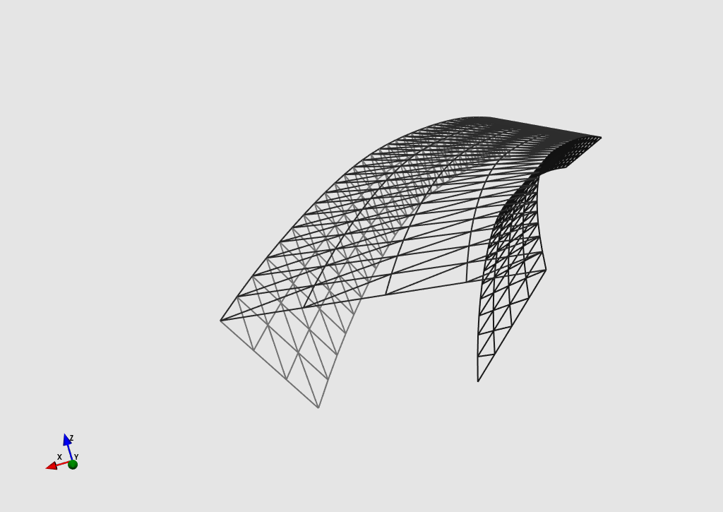
Divertor Design Example Implementation
Start with candidate 2D shape with potentially “improved” particle exhaust
2D Idea
3D Island Divertor Design guess
Design Parameters:
Dimensions
Offset from O -point
Tilt about basis vector
* Toroidal variation
Notes:
Let’s visualize this through an example of a 2d divertor shape that would potentially improve the partile exhaust
It looks like inverted trapezium and we have the following design parameters to play with
Dimensions, Offset from O-point and tilt about basis
Also possible to set toroidal variation of parameters
For arbitrary values of the parameters, we obtain this 3D ID design guess

Slide 4
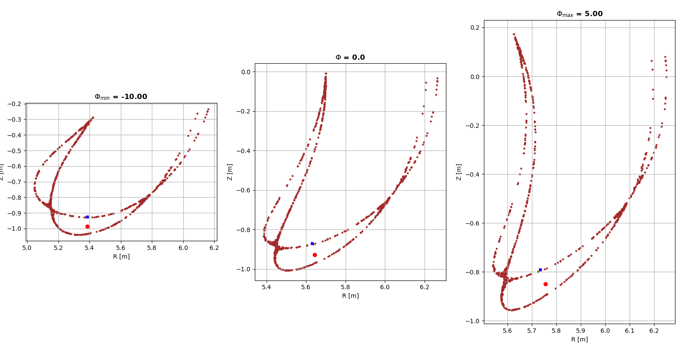
Divertor Design Spline of Helper Points
Let’s say we design between Phi_min = -10 and Phi_max = 5
Visualization:

Slide 5
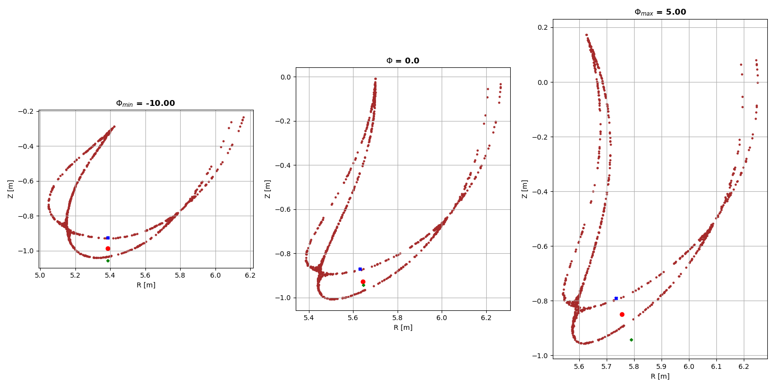
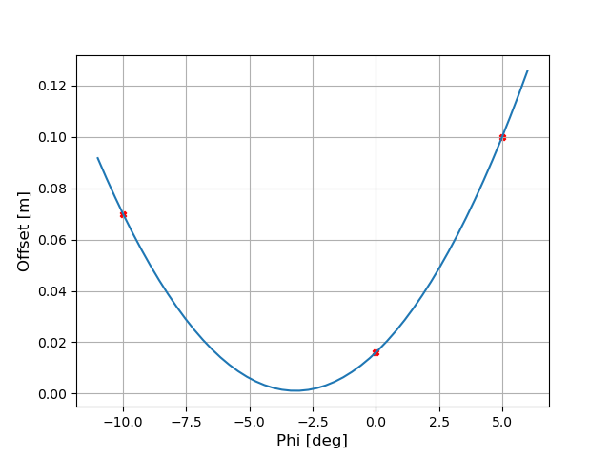
Divertor Design Offset Profile
Profile of Offset $⟹$ Set’s Target Shadowing
Lagrange interpolatation from 3 offset values at phi_min,0,phi_max $⟹$ Smooth shape
Here, island dives in and out of target:

Slide 6
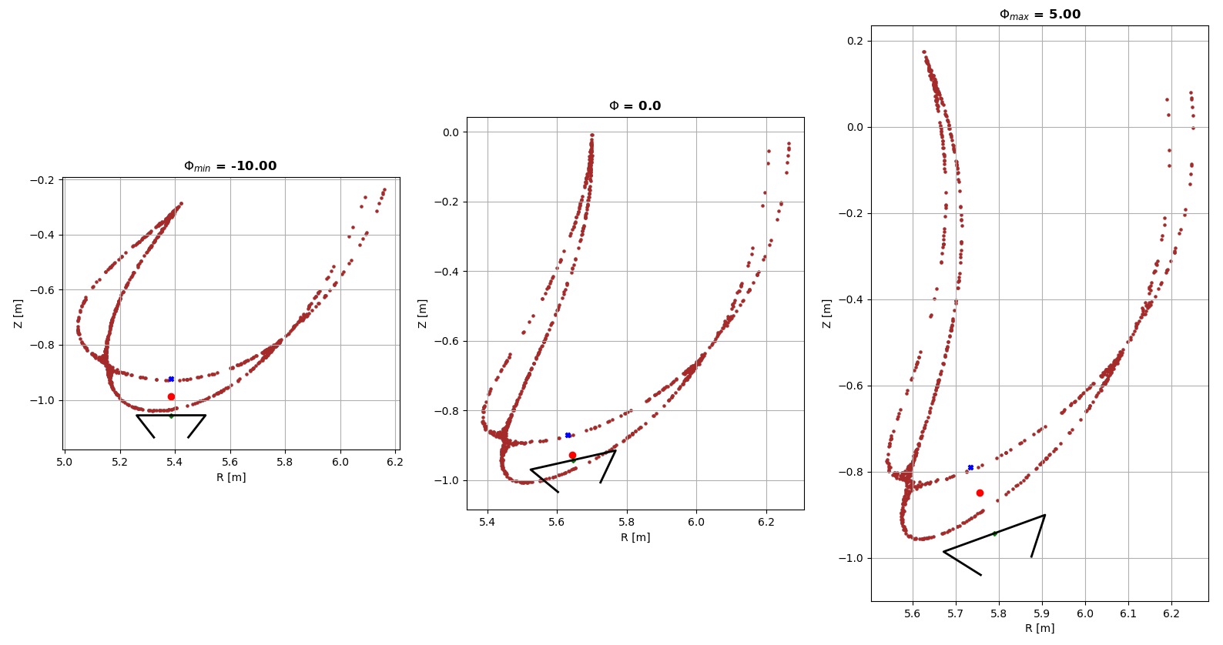
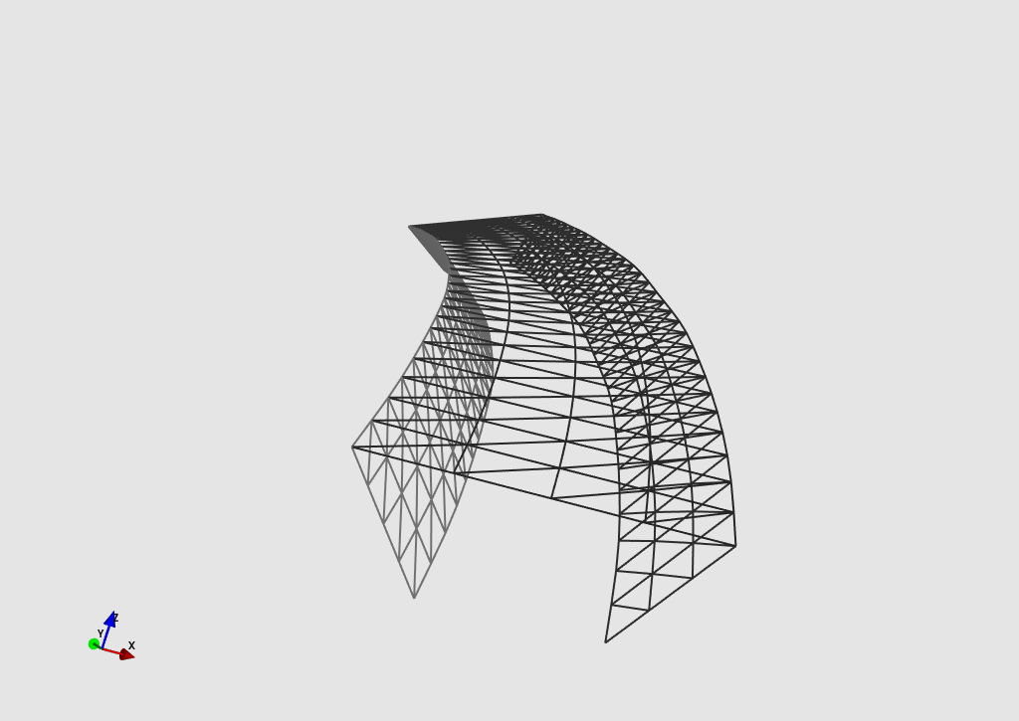
Divertor Design 3D Divertor
Prescribe dimensions of the closed divertor (Can also be varied toroidally)
Stitch together 2D cross-sections at different Phi $⟹$ Kisslinger format of 3D divertor

Slide 7
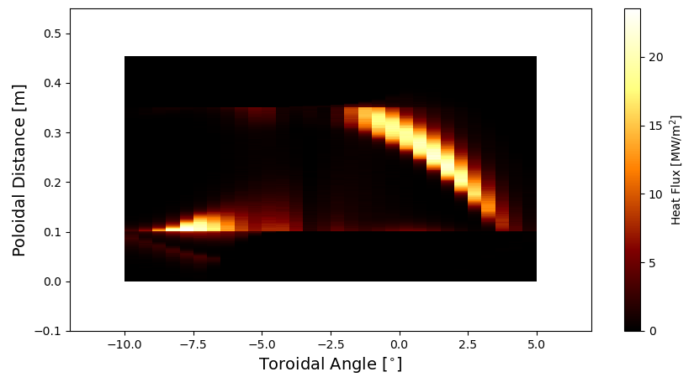
Divertor Design Heat Loads
EMC3-Lite heat load calculations for arbitrarily chosen design parameters
EMC3-Lite: Psol = 10 MW, Chi = 2m^2/s, Power Balance shows only 0.12% lost
Not a good design $⟹$ peak > 10 MW/m^2 and loads only on top …. But WHY?
Outer Flap
Top
Top
Inner Flap
Inner Flap
Outer Flap

Slide 8
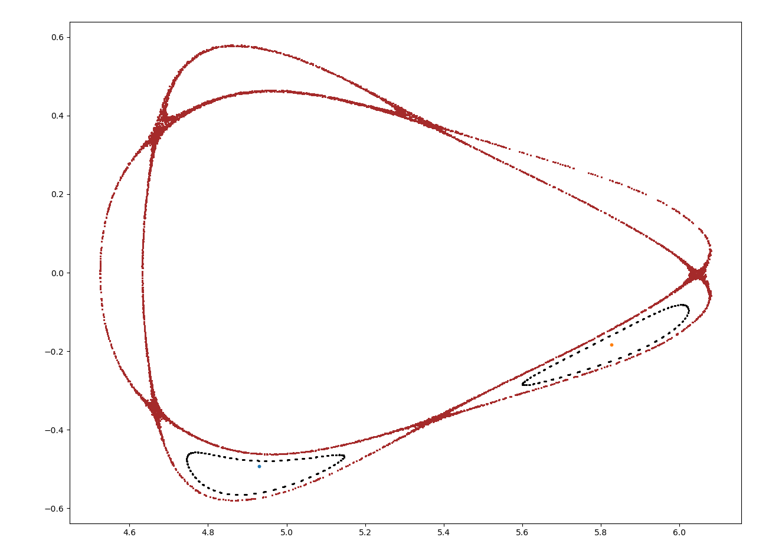
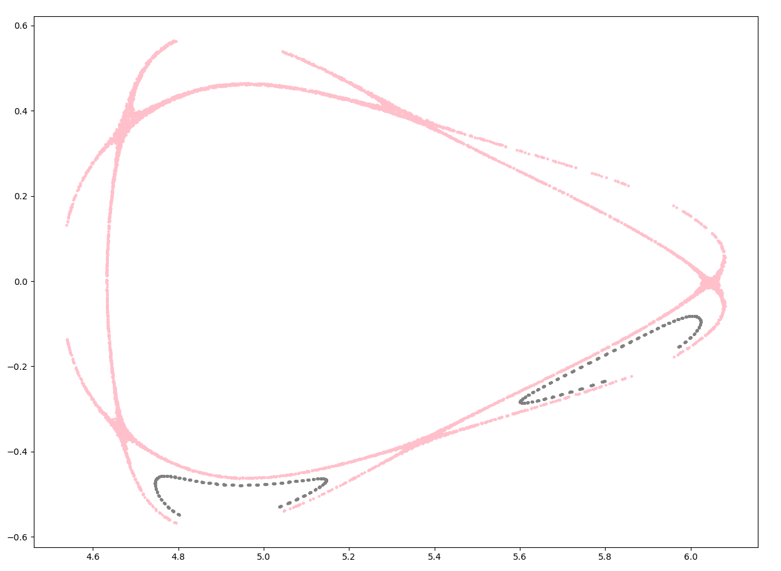
SMoLID – Simple model for Heat loads in ID But Generalized!
Start with Separatrix at Phi = -36 and relevant island flux surface (width w_u)
Remove shadowed field lines!

Slide 9
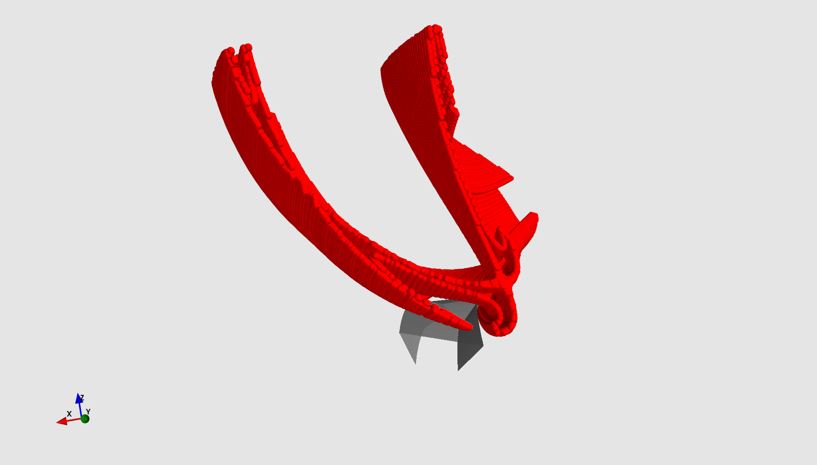
SMoLID 3D Power Shell
Choose relevant islands and that’s your 2D cross-section of power shell
Trace 2D surface (for. and rev.) from Phi = 36 and -36 to capture all relevant shadowing
3D Power Shell!

Slide 10
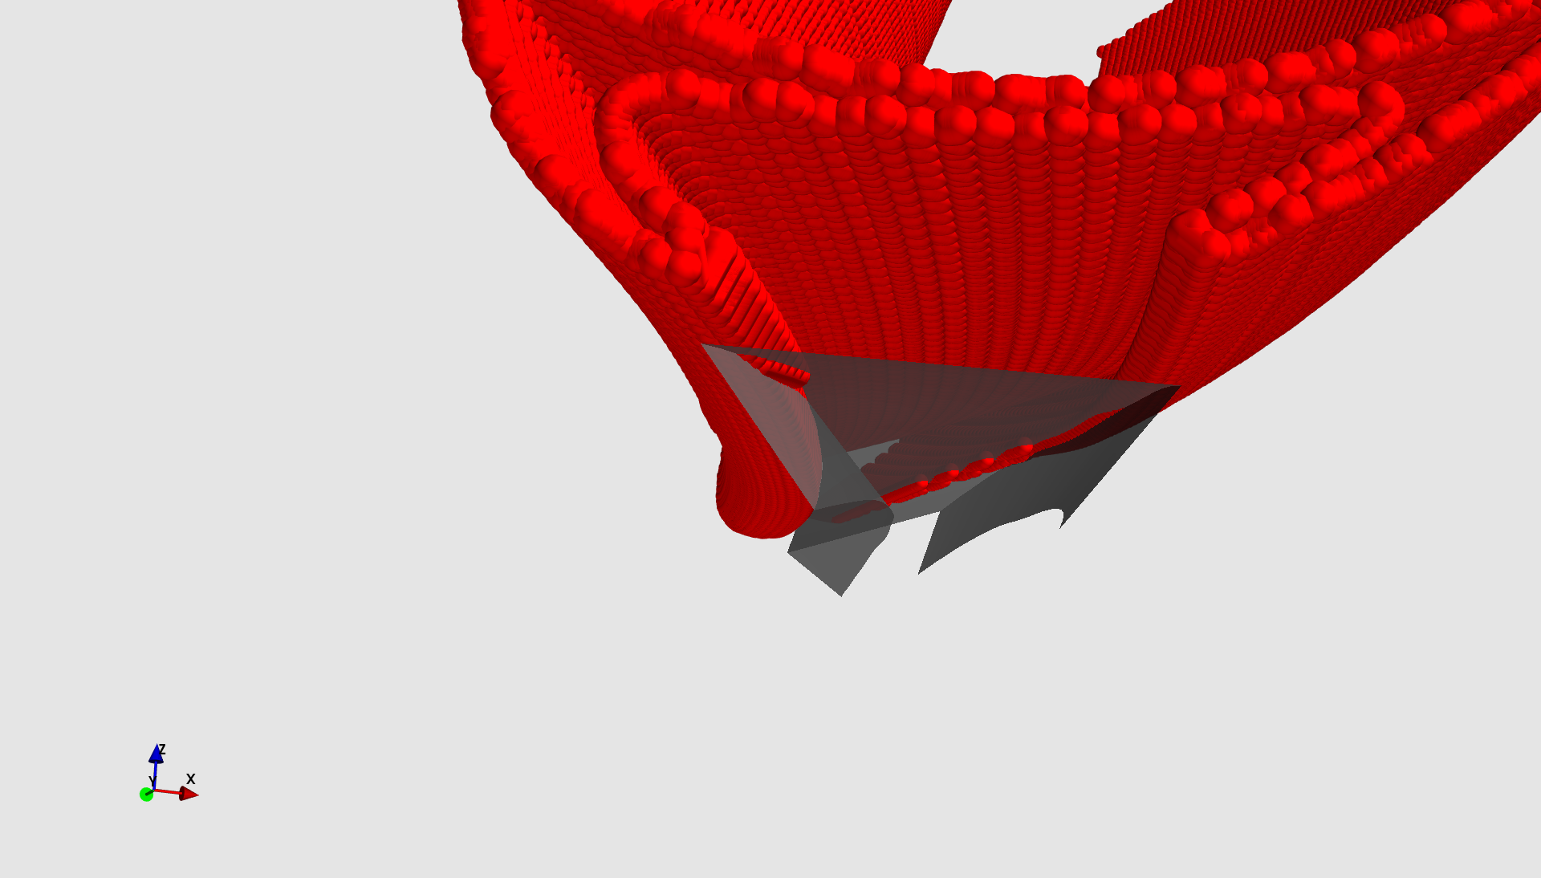
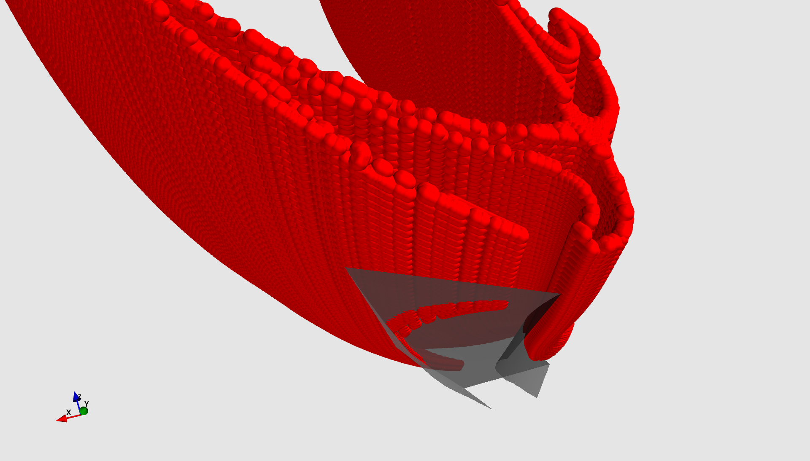
SMoLID Visualizing Vulnerable Regions of Divertor
Can visualize areas of the target which might be highly loaded

Slide 11
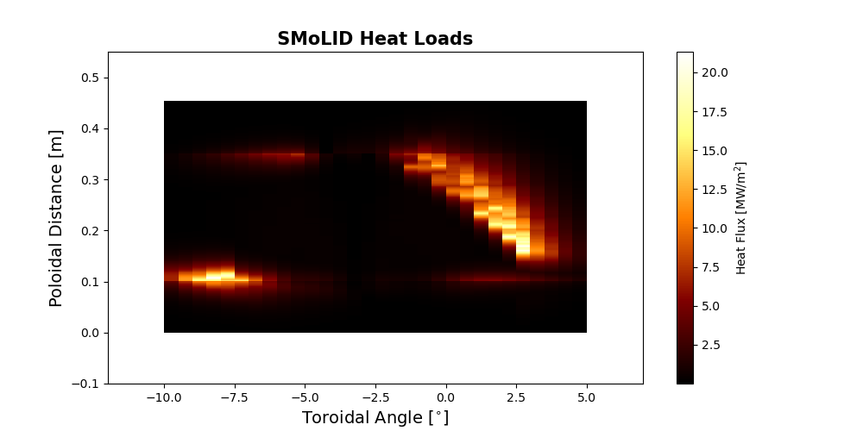
SMoLID Comparison with EMC3-Lite
Similar magnitude and strike line location

Slide 12
Summary and Next-Steps
Initial stage of tool chain development for 3D divertor exploration
Intricate balance between island orientation and offset dictates shadowing
Need to play more with available parameters to understand heat load distribution
Also need to explore other ways to design 3D shape
(Basis vector approach depends on LCMS)

