Slide 1
From HELIAS He production to a necessary exhaust efficiency
Thierry Kremeyer¹
¹ Max Planck Inst. for Plasma Physics, 17491 Greifswald, Germany

Slide 2
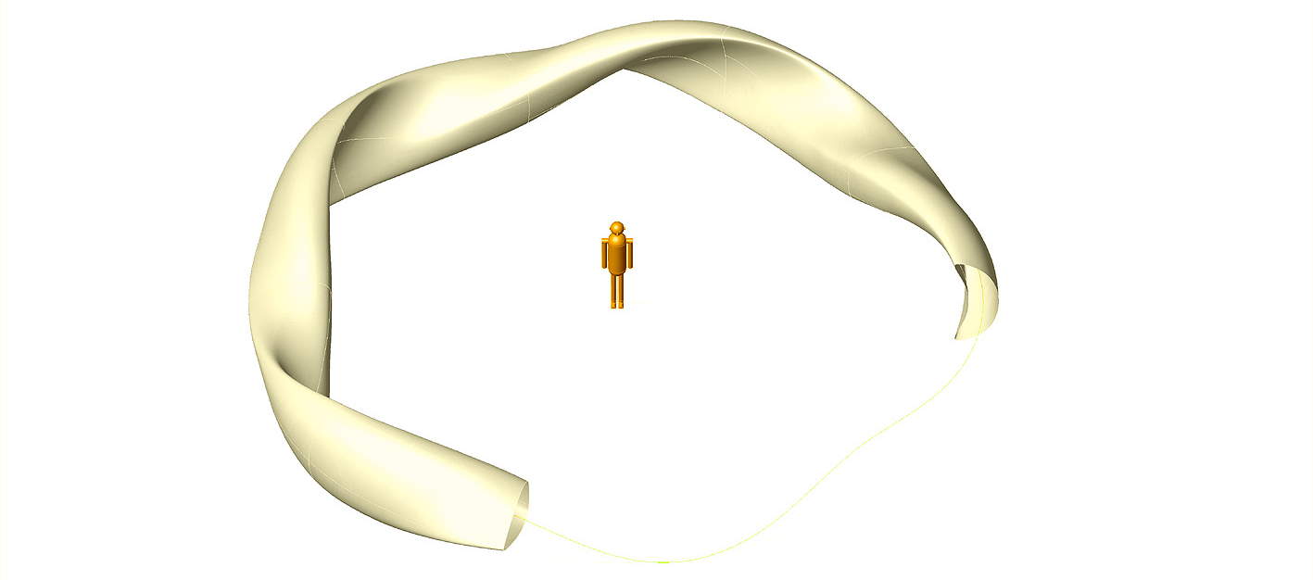
HELIAS HSR5/22 = 4x W7-X
P_{fusion} = 3 GW
P_{α} = 600 MW
Γ_{α,1} = 1.06 x 10²¹ s⁻¹
$\overline{ne}$ = 2.1 x 10²⁰ m⁻³
V_{LCFS} = 1407 m³
A_{LCFS} = 497 m²
P_{α}/V_{LCFS}= 0.43 MW/m³
P_{fusion} = 0 GW
P_{ECRH} = 14 MW (2030)
Γ_{α,1} = 0 s⁻¹
$\overline{ne}$ = 1.1 x 10²⁰ m⁻³
V_{LCFS} = 28.6 m³
A_{LCFS} = 34.6 m²
P_{ECRH}/V_{LCFS}= 0.49 MW/m³
HSR5/22
Beidler, C. D., et al. "The HELIAS reactor." 16th Int. Conf. Fusion Energy. Vol. 3. 1997
Beidler, C. D., et al. "The helias reactor HSR4/18." Nuclear Fusion 41.12 (2001): 1759.

Slide 3
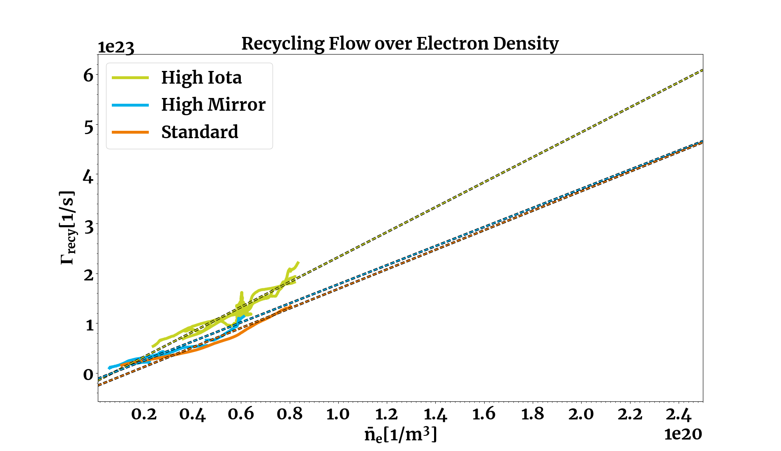
Assumption 1: Extrapolation of $Γ_{LCFS}$for W7-X
Best case / Necessary requirement
Negligible exhaust at W7-X η_{exhaust}<1%
Therefore: $Γ_{ion,div}$ = $Γ_{0,div}$= $Γ_{recy}$
Upper limit: $Γ_{ion,div}$ = 7.5 E+23 s⁻¹
$Γ_{LCFS}$ = 5.3 E+22 s⁻¹
Expected case
Extrapolation: $Γ_{ion,div}$ = 5.0 E+23 s⁻¹
$Γ_{LCFS}$ = 3.5 E+22 s⁻¹
upper uncertainty
Worst case / Sufficient requirement
Lower limit: $Γ_{ion,div}$ = 1.0 E+23 s⁻¹
$Γ_{LCFS}$ = 7.0 E+21 s⁻¹
lower uncertainty
HSR5/22
$$Γ_{LCFS}=7\% Γ_{ion,div}$$
for low f_{rad}
Feng Y. et al 2021 Nucl. Fusion 61 086012
No carbon in reactor, assume no seeded impurities:
Extrapolation of linear fit for attached plasmas
Notes:
mean squared displacement perpendicular to the surface (⟨Δx⊥2⟩⟨Δx⊥2​⟩) can be estimated as the average area covered by the particles during their random motion

Slide 4
Assumption 2: ${Γ_{LCFS,W7−X}}/{A_{LCFS,W7−X}}={Γ_{LCFS,HELIAS}}/{A_{LCFS,HELIAS}}$
$${\left(\frac{Ions}{m^{2}s}\right)}_{W7−X}={\left(\frac{Ions}{m^{2}s}\right)}_{HELIAS}$$
HSR5/22
Transport across LCFS is dominated by micro turbulences <<< A_{LCFS}
Assume that particle flux density at LCFS is the same for W7-X and HELIAS at the same $\overline{ne}$
$$Γ_{LCFS,HELIAS}=Γ_{LCFS,W7−X}\frac{A_{LCFS,HELIAS}}{A_{LCFS,W7−X}}=Γ_{LCFS,W7−X}\frac{497}{34.6}$$
$$Γ_{LCFS,HELIAS}=\text{5}\text{.}\text{3} \text{E}\text{+22 }\text{s}\text{−1}×14.36=7.6 E+23$$
$$Γ_{LCFS,HELIAS}=\text{3.5 }\text{E}\text{+22 }\text{s}\text{-1}×14.36=5.0 E+23$$
$$Γ_{LCFS,HELIAS}=\text{7.0 }\text{E}\text{+21 }\text{s}\text{-1} ×14.36=1.0 E+23$$

Slide 5
Assumption 3: Particle confinement for H ≈ He
HELIAS Helium production rate:
Γ_{α,1} = 1.06 x 10²¹ s⁻¹
Helium concentration $C_{He,main}= \frac{\text{Γ}\text{α}\text{,1}}{\text{Γ}LCFS}$
$$Γ_{LCFS,HELIAS}=7.6 E+23$$
$$Γ_{LCFS,HELIAS}=5.0 E+23$$
$$Γ_{LCFS,HELIAS}=1.0 E+23$$
$C_{He,main}=0.14 \%$
$C_{He,main}=0.21 \%$
$C_{He,main}=\text{1}\text{.}\text{0}\text{6}\text{ \%}$
Reiter, D et al. "Burn condition, helium particle confinement and exhaust efficiency." Nuclear Fusion 30.10 (1990): 2141.
Pütterich, Thomas, et al. "Determination of the tolerable impurity concentrations in a fusion reactor using a consistent set of cooling factors." Nuclear Fusion 59.5 (2019): 056013.

Slide 6
Assumption 4: Recycling assumptions
Atomic processes stay at the same lengths, but the system size in increased by factor 4
Assume (for now) no de-enrichment: $η_{He}=\frac{C_{He,div}}{C_{He, main}}=1$ Exhaust efficiency $η_{exhaust}=\frac{Γ_{exhaust}}{Γ_{ion,div}}$
Best case / Necessary requirement
$Γ_{LCFS, HELIAS}=7.6$ E+23 s⁻¹ $C_{He,main}=0.14 \%$
$Γ_{ion,div, HELIAS}=$ ? s⁻¹ $η_{exhaust}=\frac{Γ_{α,1}}{C_{He}Γ_{ion,div,}}=$ ? %
$Γ_{LCFS, HELIAS}=5.0$ E+23 s⁻¹ $C_{He,main}=0.21\%$
$Γ_{ion,div, HELIAS}=2.9$ E+25 s⁻¹ $η_{exhaust}=\frac{Γ_{α,1}}{C_{He}Γ_{ion,div,}}=1.7$ %
$Γ_{LCFS, HELIAS}=1.0$ E+23 s⁻¹ $C_{He,main}=\text{1}\text{.}\text{06}\text{ \%}$
$Γ_{ion,div, HELIAS}=1.4$ E+24 s⁻¹ $η_{exhaust}=\frac{Γ_{α,1}}{C_{He}Γ_{ion,div,}}=7.1$ %
Upper limit?
$$Γ_{LCFS}=? Γ_{ion,div}$$
Expected case
Extrapolation: W7-X / 4
$$Γ_{LCFS}=1.75\% Γ_{ion,div}$$
Worst case / Sufficient requirement
Lower limit: Same as W7-X
$$Γ_{LCFS}=7\% Γ_{ion,div}$$

Slide 7
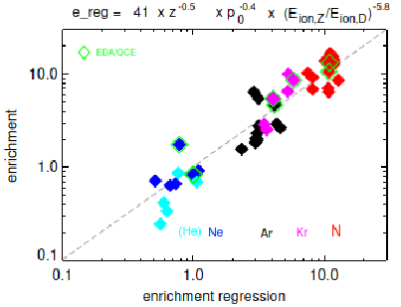
Assumption 5: AUG like enrichment
HELIAS Helium production rate:
Γ_{α,1} = 1.06 x 10²¹ s⁻¹
$Γ_{LCFS, HELIAS}=7.6$ E+23 s⁻¹ $C_{He,main}=0.14\%$
$Γ_{ion,div, HELIAS}=$ ? s⁻¹ $η_{He}=0.8$
$η_{exhaust}=\frac{Γ_{α,1}}{{η_{He}C}_{He,main}Γ_{ion,div,}}=$ ? %
$Γ_{LCFS, HELIAS}=5.0$ E+23 s⁻¹ $C_{He,main}=0.21\%$
$Γ_{ion,div, HELIAS}=2.9$ E+25 s⁻¹ $η_{He}=0.5$
$η_{exhaust}=\frac{Γ_{α,1}}{η_{He}C_{He,main}Γ_{ion,div,}}=$ 3.5%
$Γ_{LCFS, HELIAS}=1.0$ E+23 s⁻¹ $C_{He,main}=\text{1.}\text{06}\text{ \%}$
$Γ_{ion,div, HELIAS}=1.4$ E+24 s⁻¹ $η_{He}=0.25$
$η_{exhaust}=\frac{Γ_{α,1}}{{η_{He}C}_{He,main}Γ_{ion,div,}}=$ 28.6%
Enrichment:
$η_{He}=\frac{C_{He,div}}{C_{He, main}}$
$0.25<η_{He}<0.8$
A. Kallenbach et al. IAEA FEC23 Poster ID: 1750

Slide 8
What kind of recycling is necessary to meet current exhaust efficiency 0.04 % ≤ η_{exhaust} ≤ 0.6 %
$Γ_{LCFS, HELIAS}=7.5$ E+23 s⁻¹ $C_{He,main}=0.14 \%$
$Γ_{ion,div, HELIAS}=$ ? s⁻¹ $η_{He}=0.8$
Assume maximum W7-X exhaust efficiency $η_{exhaust}=0.6\%$
$Γ_{ion,div}=\frac{Γ_{α,1}}{{η_{He}C}_{He,main}η_{exhaust}}=1.6$E+26 s⁻¹
Upper limit?
$$Γ_{LCFS}=0.5\% Γ_{ion,div}$$

Slide 9
Summary
Assumption 1: Extrapolation of $Γ_{LCFS}$ for W7-X
Assumption 2: ${Γ_{LCFS,W7−X}}/{A_{LCFS,W7−X}}={Γ_{LCFS,HELIAS}}/{A_{LCFS,HELIAS}}$ at same $\overline{ne}$
Assumption 3: Particle confinement for H ≈ He
Assumption 4: Recycling assumptions
Assumption 5: AUG like enrichment
$Γ_{LCFS, HELIAS}=7.6$ E+23 s⁻¹ $C_{He,main}=0.14 \%$
$Γ_{ion,div, HELIAS}=$ ? s⁻¹ $η_{He}=0.8$
$η_{exhaust}=\frac{Γ_{α,1}}{{η_{He}C}_{He,main}Γ_{ion,div,}}=$ ? % Assume $η_{exhaust}=0.6\%$
$Γ_{LCFS, HELIAS}=5.0$ E+23 s⁻¹ $C_{He,main}=0.21\%$
$Γ_{ion,div, HELIAS}=2.9$ E+25 s⁻¹ $η_{He}=0.5$
$η_{exhaust}=\frac{Γ_{α,1}}{η_{He}C_{He,main}Γ_{ion,div,}}=$ 3.5%
$Γ_{LCFS, HELIAS}=1.0$ E+22 s⁻¹ $C_{He,main}=\text{1.}\text{06}\text{ \%}$
$Γ_{ion,div, HELIAS}=1.4$ E+24 s⁻¹ $η_{He}=0.25$
$η_{exhaust}=\frac{Γ_{α,1}}{{η_{He}C}_{He,main}Γ_{ion,div,}}=$ 28.6%
$$Γ_{LCFS}=0.5\% Γ_{ion,div}$$
Necessary to meet current $η_{exhaust}$
Expected case
Extrapolation: W7-X / 4
$$Γ_{LCFS}=1.75\% Γ_{ion,div}$$
Worst case / Sufficient requirement
Lower limit: Same as W7-X
$$Γ_{LCFS}=7\% Γ_{ion,div}$$

Slide 10
Appendix

Slide 11
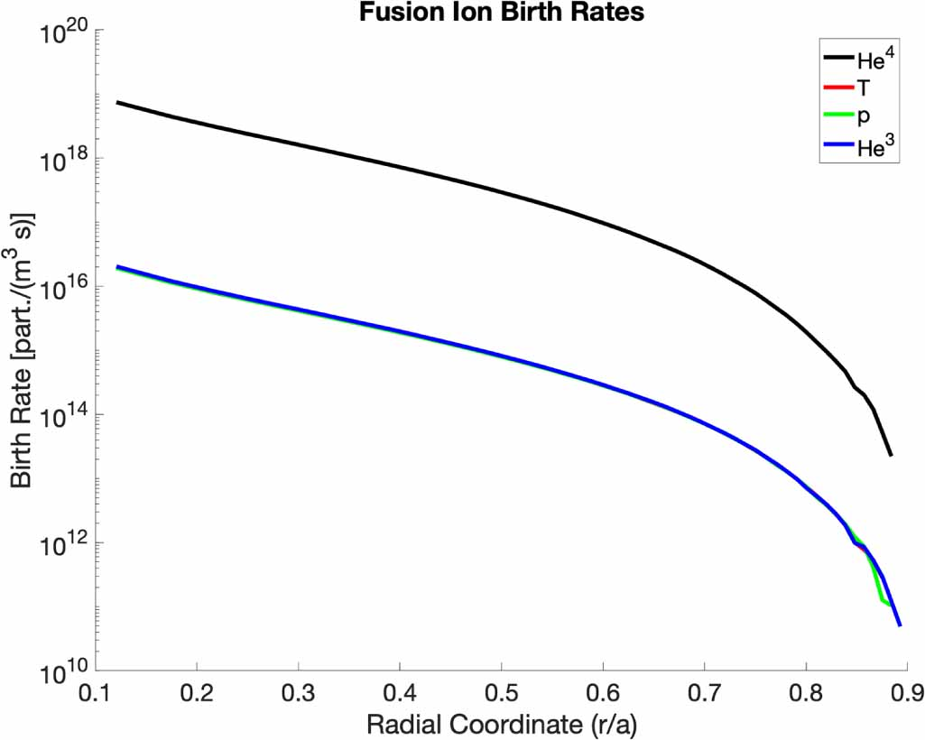
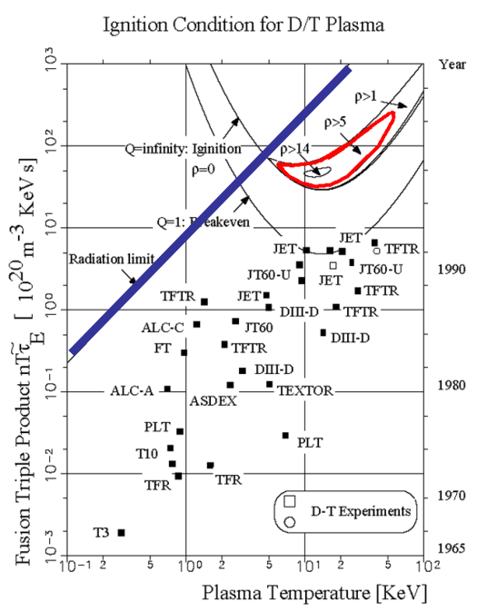
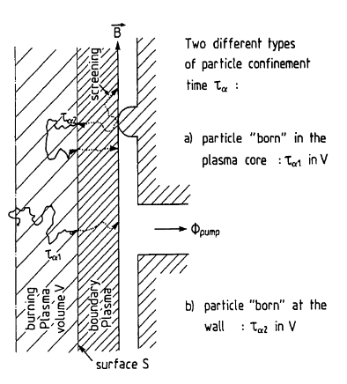
Reactor performance requirements
Γ_{He,exhaust} = Γ_{α,1}
Minimize R_{eff} for impurities
n_{e} = 2 E+20 m⁻³
Scale with A_{LCFS}
$$Γ_{Recy, reac}=\frac{A_{LCFS, reac}}{A_{LCFS,W7X}}Γ_{Recy, W7X}$$
$$ρ=\frac{τ_{α}^{∗}}{τ_{E}}$$
[S. Lazerson PPCF 2021]
W7-X
$$τ_{α}^{∗}= τ_{α1}+\frac{R_{eff}}{(1−R_{eff})}τ_{α2}$$
[Reiter NF 1990]
[S. Dräger]

Slide 12
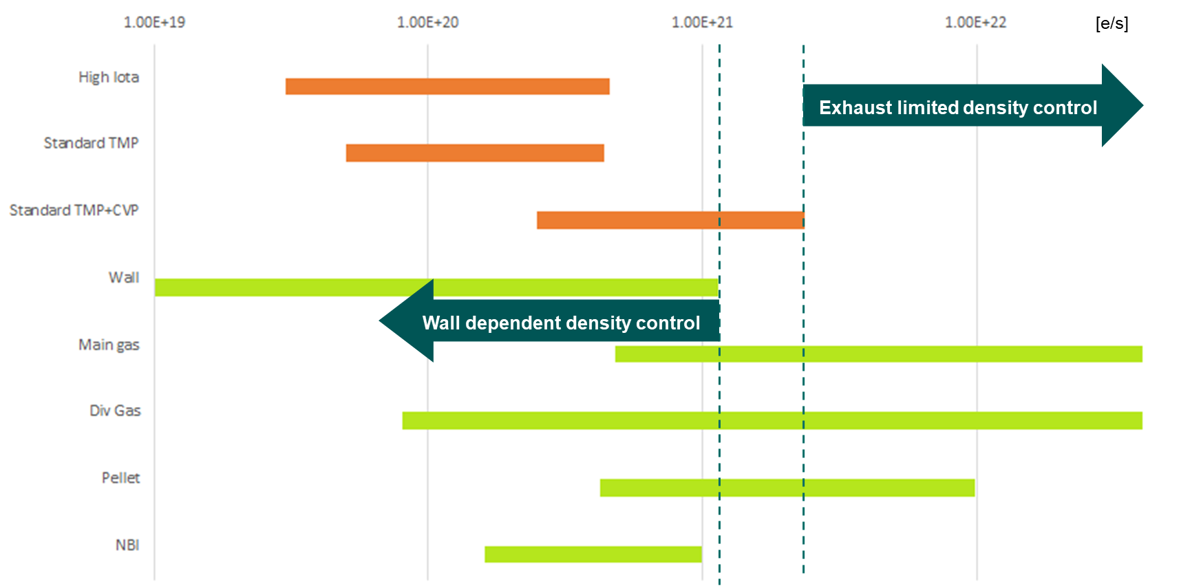
Opertational performance requirements
Stable density in equilibrium
Γ_{exhaust} = Γ_{source}
Wall independent density control
Γ_{exhaust} > Γ_{wall}
Γ_{exhaust} > 1.1E+21 e/s
Exhaust limited density control
Γ_{exhaust} < Γ_{wall} + Γ_{NBI} + Γ_{pellet} (+Γ_{Gas})
Γ_{exhaust} < 1.4E+22 e/s (4.1E+23)
Fueling limited density control
Γ_{exhaust} > Γ_{wall} + Γ_{NBI} + Γ_{pellet} (+Γ_{Gas})

Slide 13
Guarantee requirements
Survive P_{div} = P_{rec,surf}(Γ_{ion,div}) + P_{rec,vol,div}(Γ_{ion,div}) + P_{rad,div} + P_{n,div}
q_{div} ≤ 10 MW/m² (q_{max} ≤ 20 MW/m²)
Survive neutron dpa (ITER 0.14 - 2.5dpa; DEMO 70 – 80 dpa)
T_{e,t} < 10 eV (< 5 eV W sputtering; < 1.5 eV volume recomb.)
Objective: Optimize performance metrics
Maximize Γ_{exhaust} combined with throttle
Minimize R_{eff}

Slide 14
Particle exhaust metrics and efficiencies
Unfavorable particles Favorable particles
Γ_{loss, sub-div}
Γ_{recy, edge}
Γ_{recy, div}
Γ_{exhaust}
R_{eff}*Γ_{Neutral}
Γ_{ion,div}
Γ_{pumpgap}
Γ_{ion,core}
Γ_{ion,edge}
Γ_{neutral}
pump gap
Core Edge Divertor Sub-divertor
(Burning plasma) (Plasma) (Plasma + Neutrals) (Neutrals)
Exhaust efficiencies
Particle collection Particle removal
η_{collection} = Γ_{pumpgap} / Γ_{neutral} η_{removal} = Γ_{exhaust} / Γ_{pumpgap}
= 4 % - 10 % = 2 %
Particle plugging Particle exhaust efficiency
η_{plugging} = Γ_{recy, div} / (Γ_{neutral} – Γ_{exhaust}) η_{exhaust} = Γ_{exhaust} / Γ_{neutral} = η_{collection} η_{removal}
= 75 % - 97 % = 0.04% - 0.6 %

Slide 15
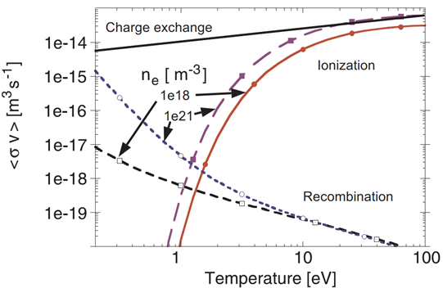
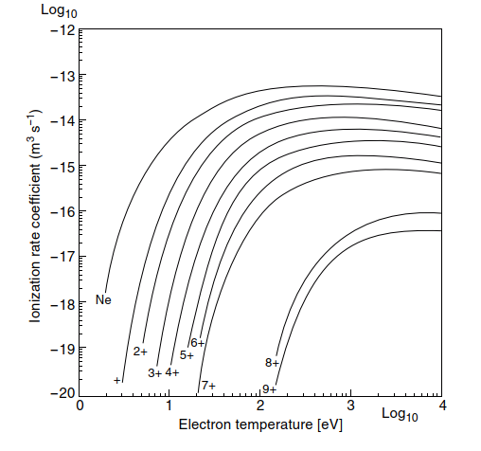
A priori first principles
Limiter
Divert – $grad$ B = 0
Closed surfaces, meet at x points, rotational transform visualize
Visualize super x, snowflake, single null, double null,
3D plot tripple product rho
Tripple product density temperature confinement
Neutralization Γ_{ion,div} Γ_{Neutral}
– Only neutral particles can be exhausted
Surface recombination on target, P_{rec,surf} = Γ_{ion,div} ((γT_{e})+(½m_{ion}v_{ion}²)+ε_{i})
Volume recombination, preferred, T_{e,t} < 1.5 eV, MAR ~n_{e},n₀, EIR ~ n_{e}³
$q_{div}= \frac{P_{rec, surf}}{A_{wetted}}+P_{rad,div}$
$q_{div}\left(P_{in}=12.5 MW\right)≤10 \frac{MW}{m²}$ for A_{wetted,max}
Minimize R_{eff} for impurities
– Keep recycling particles outside of core
Ionize outside of LCFS, minimize λ_{iz,He}, T_{e} ≥ 100 eV, ~ n_{e}
Minimize inward impurity transport
Minimize sputtering source, T_{e,t} < 5 eV
R_{eff,H}(f_{rad}=0.85) = 7 % R_{eff,H}(f_{rad}=0.90) = 30 %
Helium?
MAR
[Ralf Schneider]
[Stangeby 2000]

Slide 16
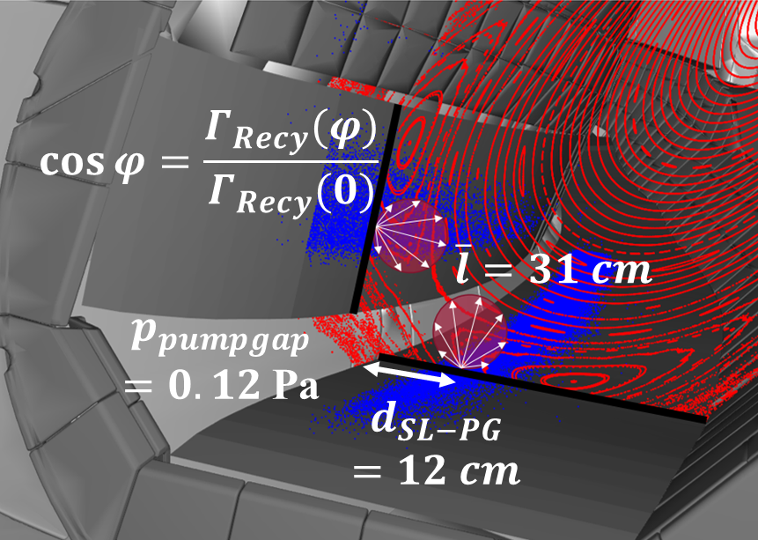
A priori first principles
Particle collection η_{collection} = 4% - 10%
– Maximize favorable particles
Direct collection Only if d_{SL-PG} < $\overline{l}$
Optimize $\cos{φ_{pumpgap}}$
Indirect collection Build up neutral pressure,
Keep favorable neutrals neutral,
Optimize $1−cos{φ_{LCFS}}$
Continous flow Driven by pressure gradient
Sub-divertor removal η_{removal} = 2%
– Decrease Γ_{sub-div} _{loss}
– Turn pumpgap into one-way
Molecular flow Directed reflections, Funnel
Continuos flow at pumpgap Minimize $Kn= \frac{\overline{l}}{d}$

Slide 17
A priori first principles
Plugging η_{plugging} = 75 % – 97 %
– Block escaping neutrals
– Relevance decreases as η_{exhaust} increases
Hardware (Baffles): Thermal loads
Re-Ionization: Weakend by detachment?
Survive heat loads
– Exhaust heat necessary for particle exhaust
– Radiate rest
Surface recombination on target
Volume recombination in front of target
Radiated power Radiation location and stability:
X-Point vs homogenous island radiation
Neutron power

Slide 18
2D Target cross section of „standardized“ sections
Build up neutral pressure
Optimize $1−cos{φ_{LCFS}}$
Block escaping neutrals
Hardware (Baffles) !Thermal loads!
Re-Ionization
Direct collection
Optimize $\cos{φ_{pumpgap}}$
CVP ideally normal to target
Baffle
Targets
CVP
Smallest possible angle?
L
Smallest possible radius?
Baffle
L_{min}= 2*λ_{iz} or 2*$\overline{l}$
Dome/ Double Baffle
Targets
Notes:
Only one configuration
Moveable baffle / target

