Slide 1
Validation of the surrogate assisted Bayesian inference equilibrium reconstruction approach on Wendelstein 7-X
R. Köberl, R. Babin, C.G. Albert, K. Rahbarnia and the W7-X Team

Slide 2
Motivation
Equilibrium reconstruction
Equilibrium reconstruction tries to solve fixed-point problem
Model and measurements are affected by uncertainty
Often solved via optimisation
Evaluation of high-fidelity forward models can be computationally prohibitive
Goal
Propagate uncertainties to reconstructed parameters
Utilise Bayesian formalism
Data driven methods for faster inference
Validate on experimental data and compare to established approaches
equilibrium parameters
forward model
equilibrium solver
synthetic diagnostics
inference criterion,
e.g. best fit
measured data
$$D$$

Slide 3
Surrogate assisted Bayesian inference equilibrium reconstruction (surroBIER)
Create data-base of equilibria and corresponding synthetic diagnostic measurements
Utilise dimensionality reduction to find low-dimensional representation of equilibria (latent space)
Approximate the mapping from latent-space to the synthetic diagnostics via surrogate models
Equilibrium data-set
dim. reduction
latent space $π(c)$
surro. models $f(c)$
syn. diag. data-set
Use latent-space data distribution as prior in Bayesian inference:
$$p\left(c | D\right)∝L\left(D | c\right)π(c)$$
measured data$D$
likelihood $L(D|c)$
surro. models $f(c)$
prior $π(c)$
posterior $p(c|D)$

Slide 4
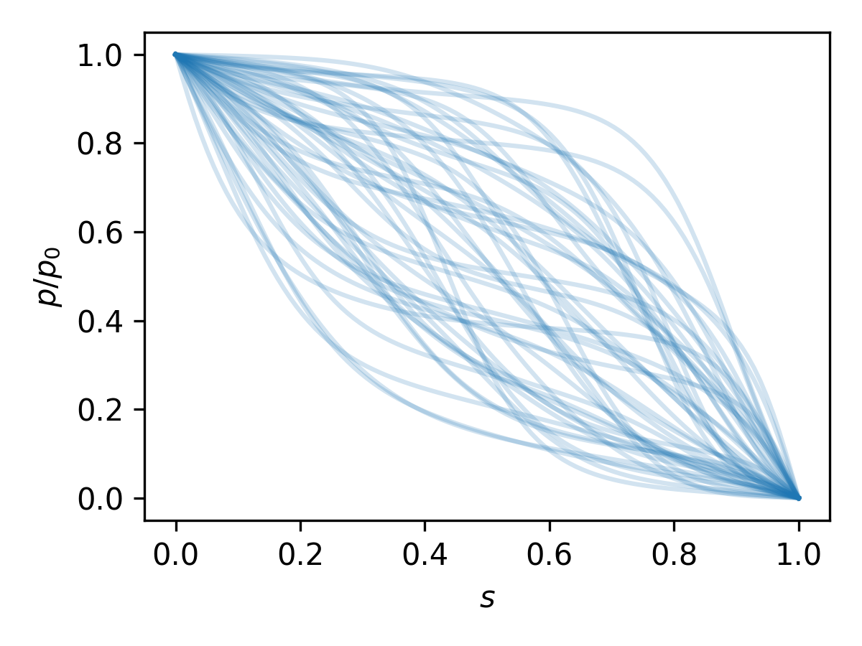
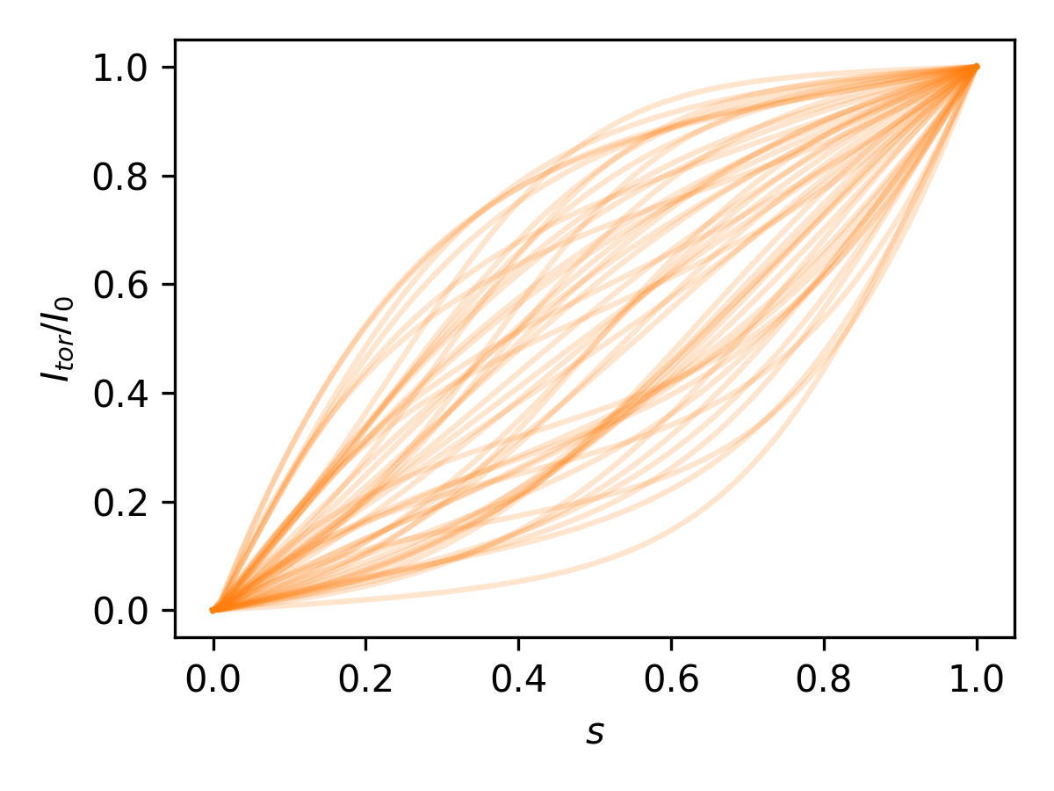
W7-X equilibrium data-set for fixed coil currents
Equilibrium data-set
Sampling equilibrium defining parameters
radial pressure profile (dim.=7):
$p\left(s\right)=\frac{p_{0}}{\int_{0}^{1}{\exp\left(\tilde{p}\right)ds^{′}}}\int_{s}^{1}{exp⁡(\tilde{p})}ds^{′}$, $\tilde{p}∼PCA_{6}\left(GP_{Minerva}\right)$, $p_{0}\sim 𝒰\left(0,200\right)$ kPa
toroidal current profile (dim.=4):
$I\left(s\right)=\frac{I_{0}}{\int_{0}^{1}{\exp{\tilde{I}}ds^{′}}}\int_{s}^{1}{exp⁡(\tilde{I})}ds^{′}$´, $\tilde{I}∼PCA_{3}\left(GP_{RQ}\right)$, $I_{0}\sim 𝒰\left(−10,10\right)$ kA
total toroidal flux (dim.=1):
$ψ_{0}\sim 𝒰\left(−2.5,−1.6\right)$ Wb
$s=\frac{ψ}{ψ_{0}}, ψ …$toroidal flux, $PCA_{i} …$principal component analysis truncated at $i$

Slide 5
W7-X equilibrium data-set for fixed coil currents
Equilibrium data-set
dim. reduction
latent space $π(c)$
surro. models $f(c)$
syn. diag. data-set
Evaluate VMEC for sampled parameters
$$\{p,I,ψ_{0}\} →\{R\left(s,θ^{∗},ζ\right),Z\left(s,θ^{∗},ζ\right),λ\left(s,θ^{∗},ζ\right),ψ_{0},ι\left(s\right)\}$$
VMEC solution described by more than 80k parameters (Fourier coefficients, iota-points,…)
Apply dimensionality reduction on VMEC data
$$\left\{R\left(s,θ^{∗},ζ\right),Z\left(s,θ^{∗},ζ\right),λ\left(s,θ^{∗},ζ\right),ψ_{0},ι\left(s\right)\right\}→\left\{c_{0} …c_{i}\right\}$$
Straight forward and fast method → $PCA_{12}$ maintains more than 99% of explained variance
Linear projection from high dim. space $h=\left\{R_{s,m,n},Z_{s,m,n},λ_{s,m,n},ι_{s},ψ_{0}\right\}$ to latent space $l=\{c_{i}\}$
$$l=\left(h−μ_{samples}\right)M^{T}, \tilde{h}=Ml+μ_{samples}$$
Dimensionality reduction introduces some error
$h−\tilde{h}≠0$

Slide 6
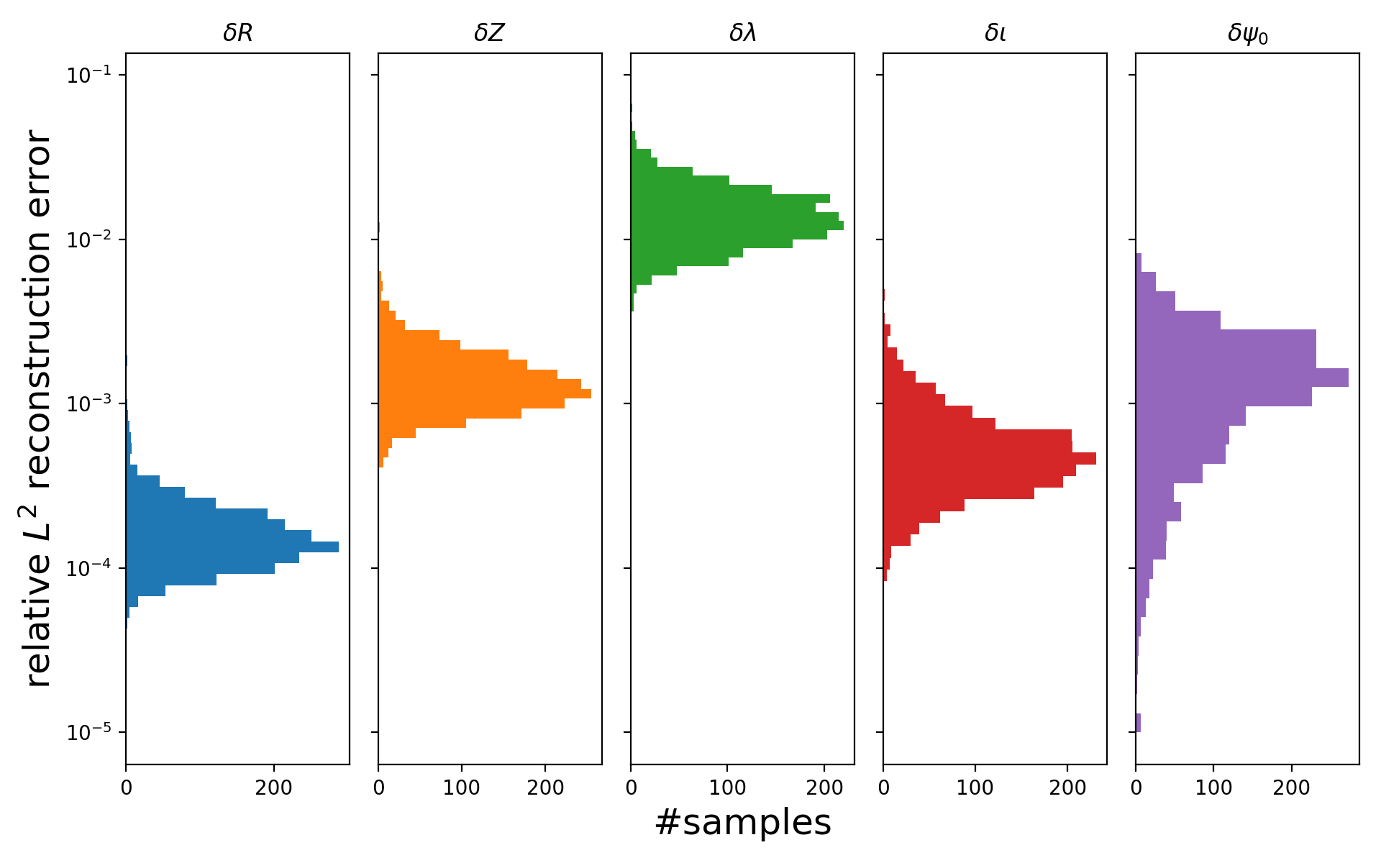
W7-X equilibrium data-set for fixed coil currents
Equilibrium data-set
dim. reduction
latent space $π(c)$
$$\left(δX=\sqrt{\sum_{i}^{N}{\frac{{\left(X_{ vmec,i}^{m,n,ρ}−X_{pca,i}^{m,n,ρ} \right)}^{2}}{\sum_{m,n,ρ}{{\left(X_{vmec,i}^{m,n,ρ}\right)}^{2}}}}}\right)$$
Dimensionality reduction introduces some error

Slide 7
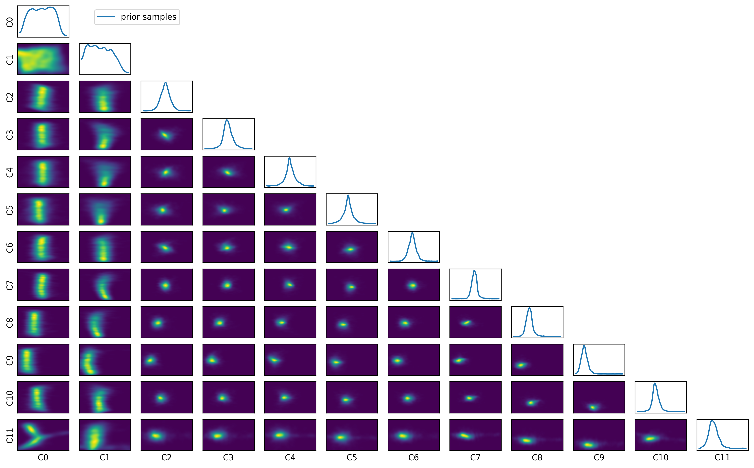
Equilibrium prior
Equilibrium data-set
dim. reduction
prior $π(c)$
surro. models $f(c)$
syn. diag. data-set
Create a prior distribution over 12 dim. latent-space representation of equilibria
Use Bayesian Gaussian mixture model for density estimation (see e.g. here)

Slide 8
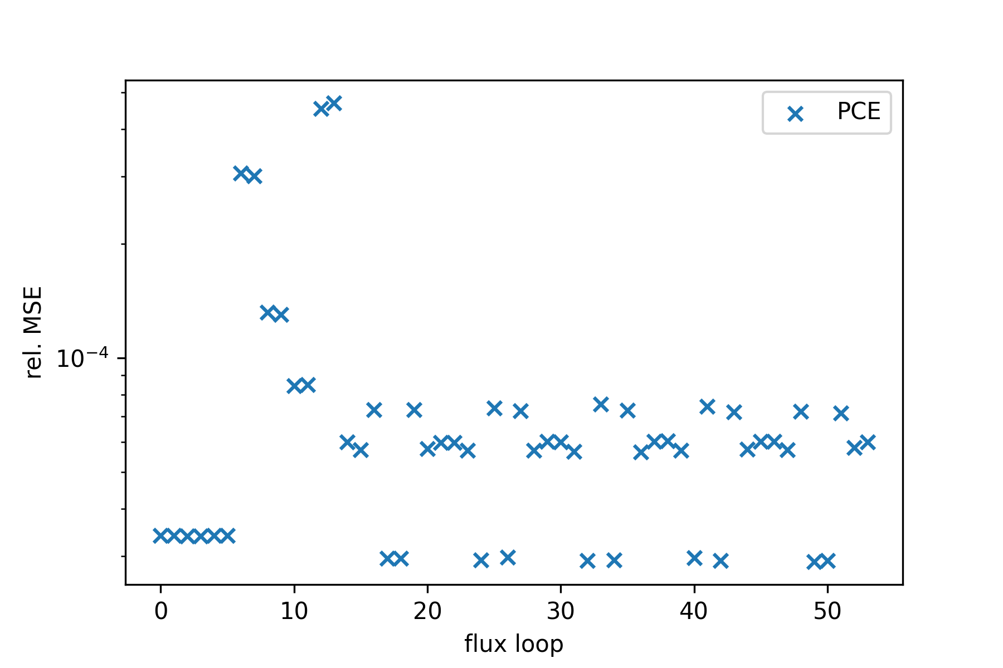
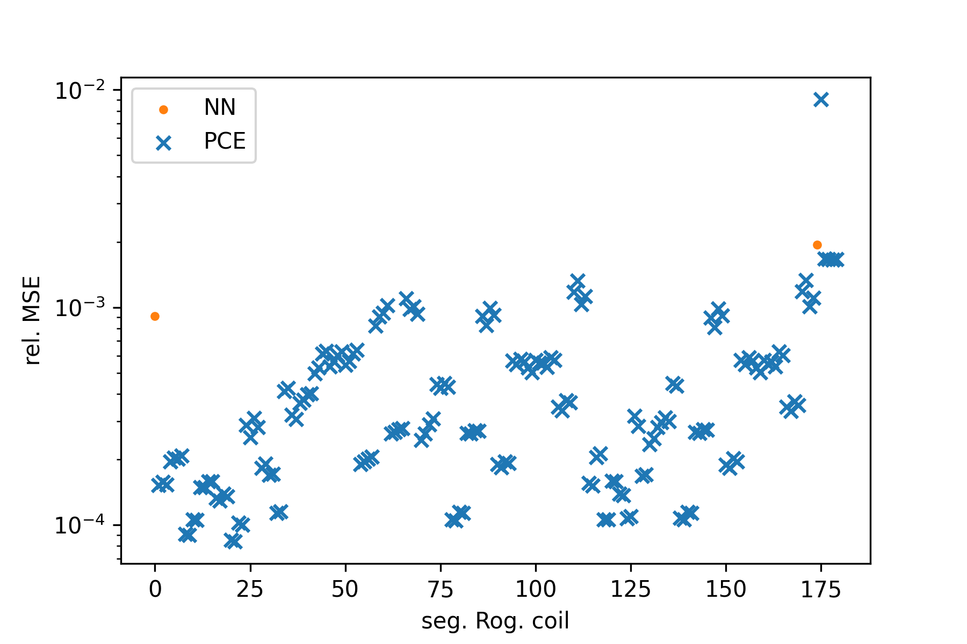
Surrogate models for synthetic magnetic diagnostics
Equilibrium data-set
dim. reduction
prior $π(c)$
surro. models $f(c)$
syn. diag. data-set
Calculate synthetic diagnostic signal from VMEC dataset via DIAGNO
Map latent space representation of VMEC equilibria (principal values $c$) to synthetic signals
Polynomial regression (PCE) or fully connected feed forward neural-networks

Slide 9
Inference on latent parameters from measurements
measured data$D$
likelihood $L(D|Q)$
surro. models $f(Q)$
prior $π(c)$
posterior $p(Q|D)$
measured data$D$
surro. error $ε$
likelihood $L(D|Q)$
$$Π_{i}^{N_{D}}𝒩_{i}(D_{i};f\left(c\right),σ_{i})$$
prior $π_{σ_{i}}$
$Inv.Gamma$ with $μ=|0.05⋅D_{i}|$
surro. models $f(c)$
prior $π(c)$
$$GMM(c)$$
M$CMC:NUTS$
posterior $p(Q|D)$

Slide 10
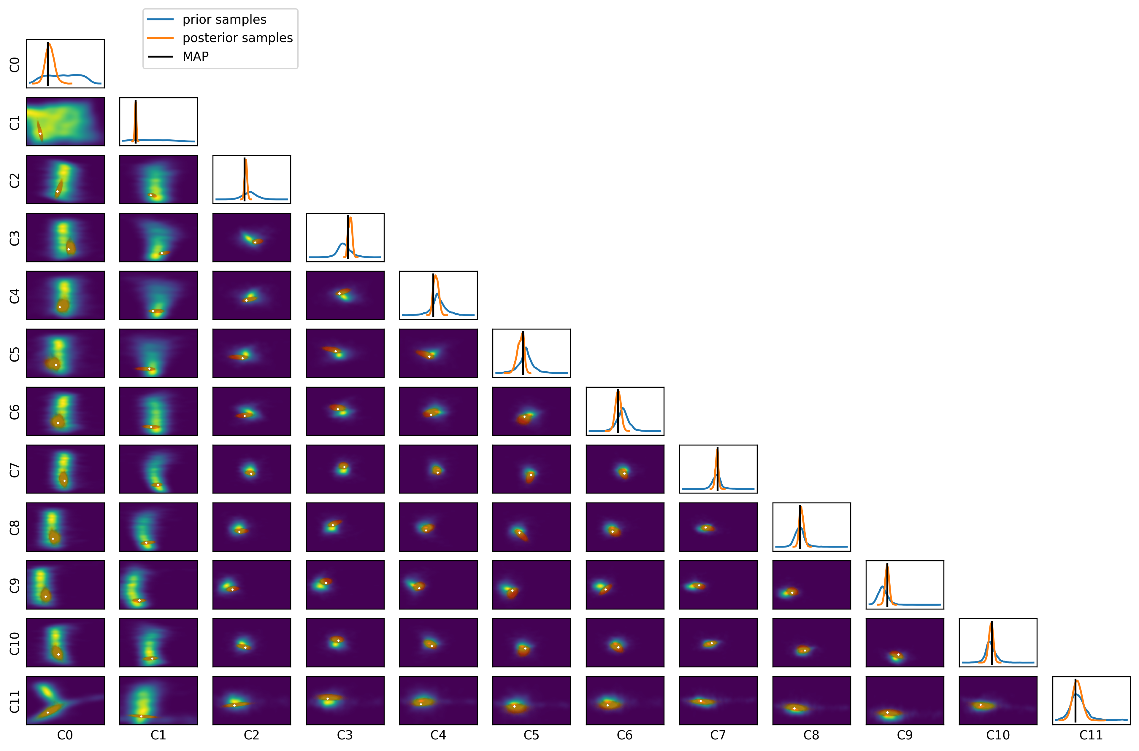
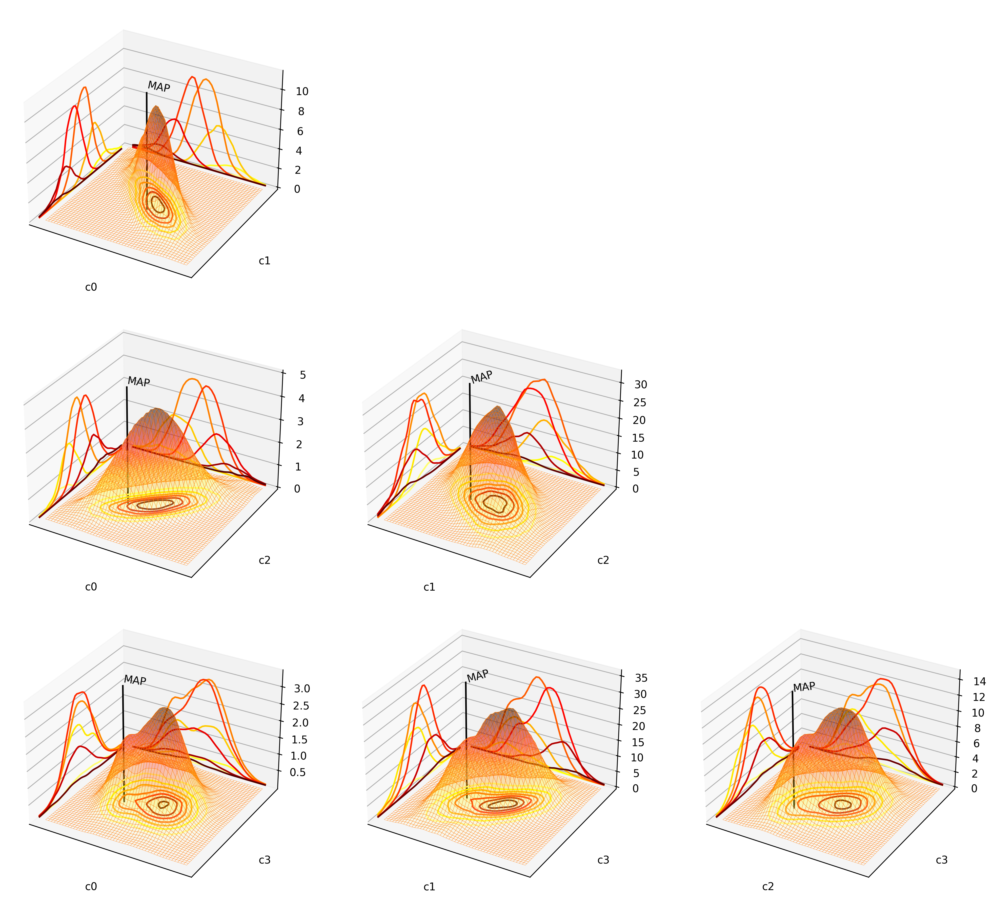
Inference for 20180821.12@5100: latent space
MAP … maximum a posteriori estimation

Slide 11
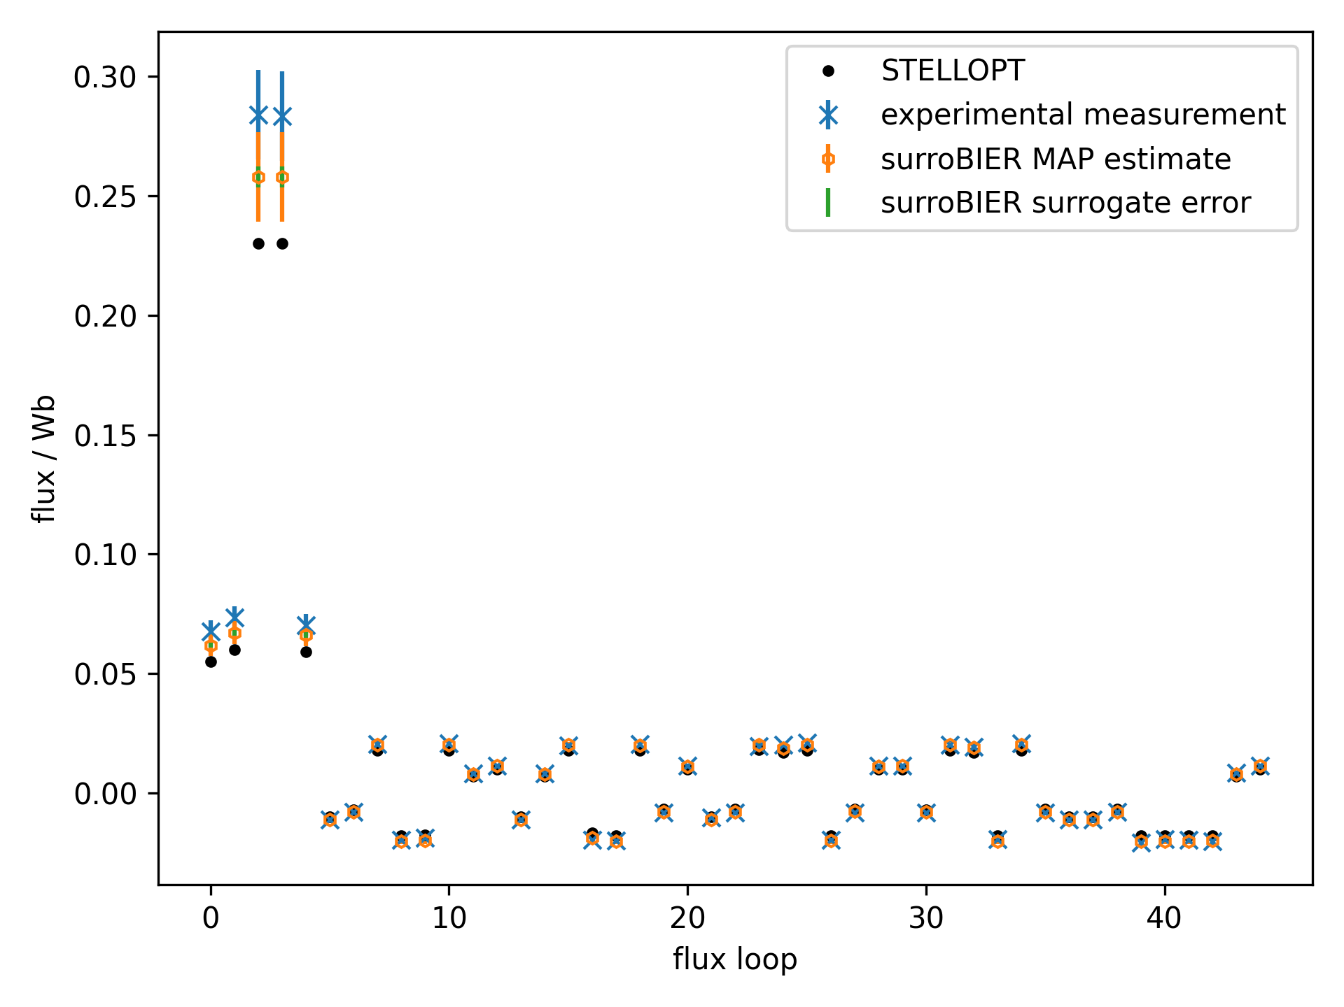
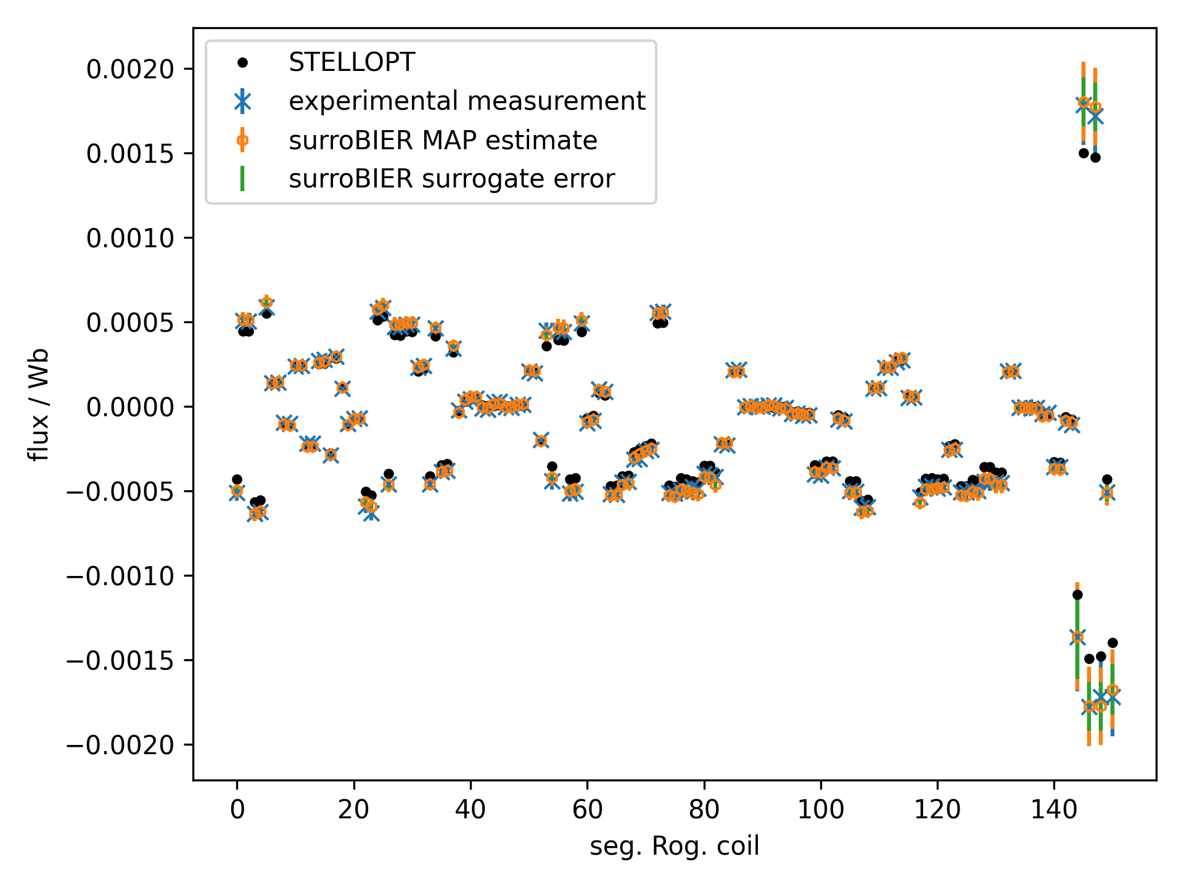
Inference for 20180821.12@5100: comparison to high-fidelity model
Compare result to similar STELLOPT optimization with same signals and $σ_{i}=|0.05⋅D_{i}|$
Optimize VMEC free boundary $P\left(s\right)−$profile (two power), $ι\left(s\right)−$profile (polynomial), $ψ_{0}$
Initialization of VMEC close to surroBIER MAP (boundary, axis, $ι\left(s\right)$, $P\left(s\right)$)
STELLOPT runtime ca. 6h on 7 COBRA nodes, surroBIER MAP few minutes on single laptop core

Slide 12
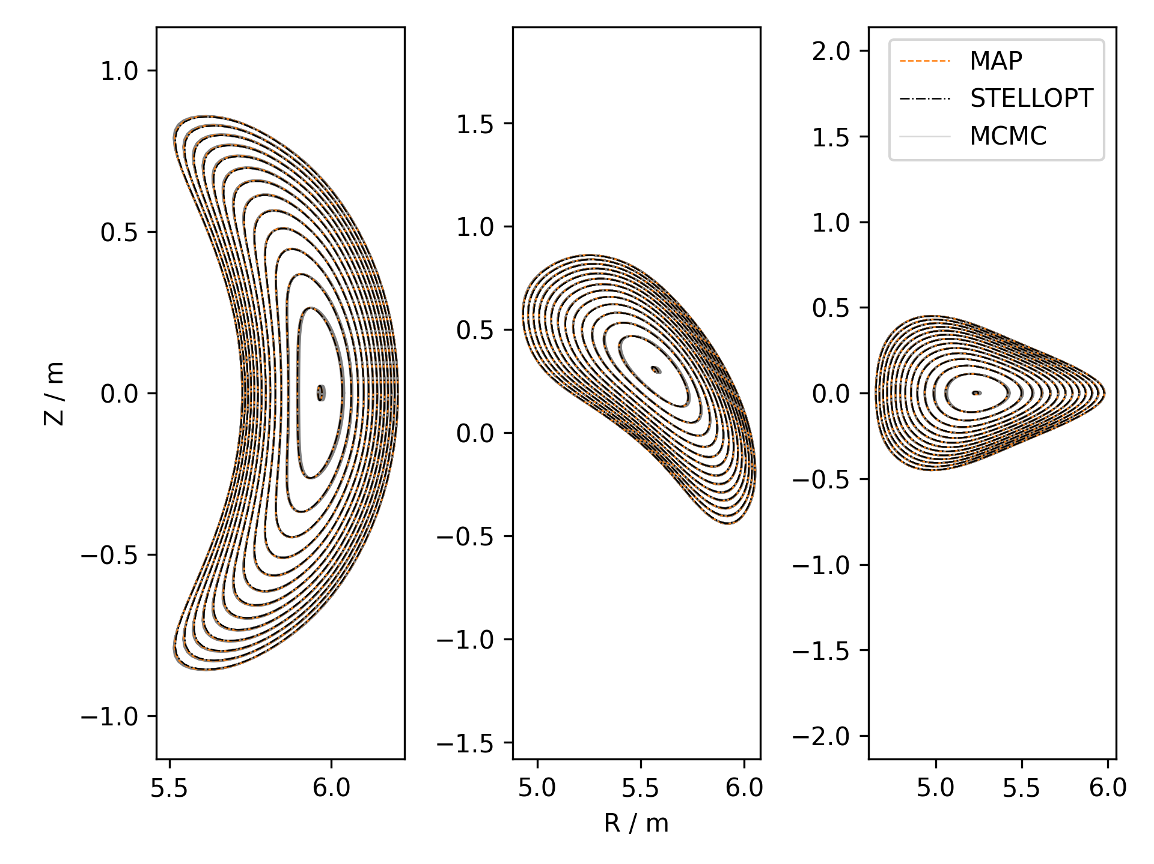
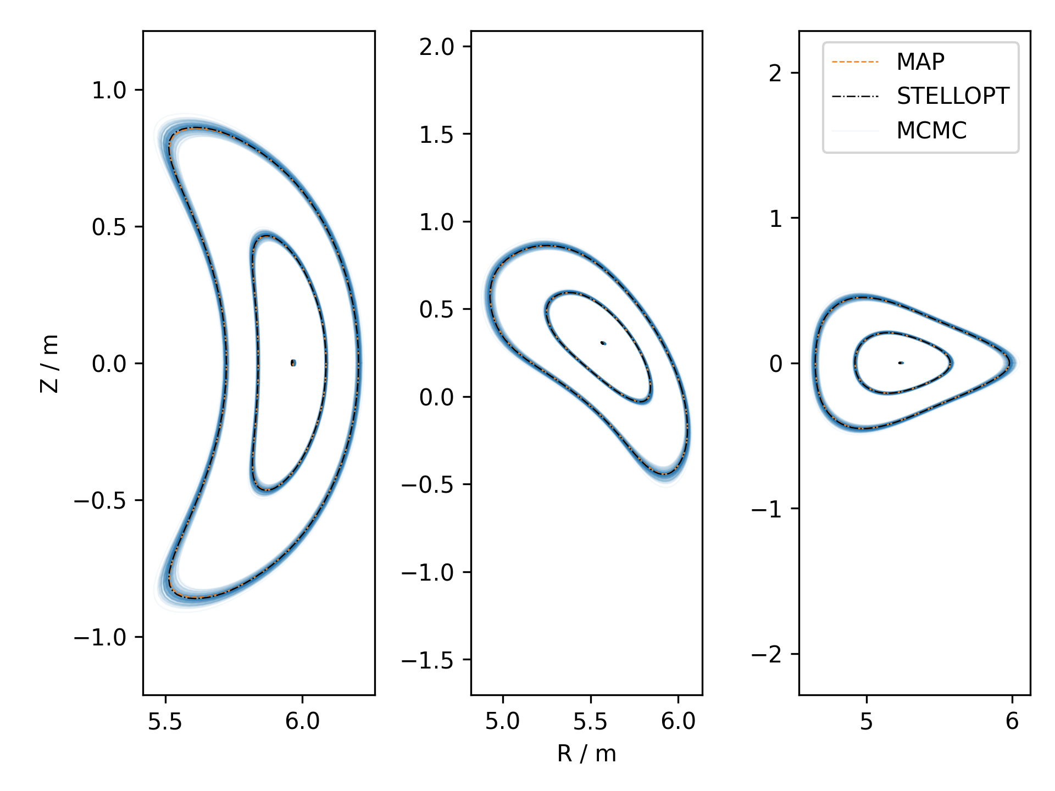
Inference for 20180821.12@5100: flux surfaces
$$ψ=const.$$
$$ρ=const.$$
low uncertainty on flux surface position
good agreement with STELLOPT
higher uncertainty for the last closed flux surface due to uncertainty in $ψ_{0}$
uncertainty in $ψ_{0}$ introduces uncertainty in $ρ=\sqrt{\frac{ψ}{ψ_{0}}}$

Slide 13
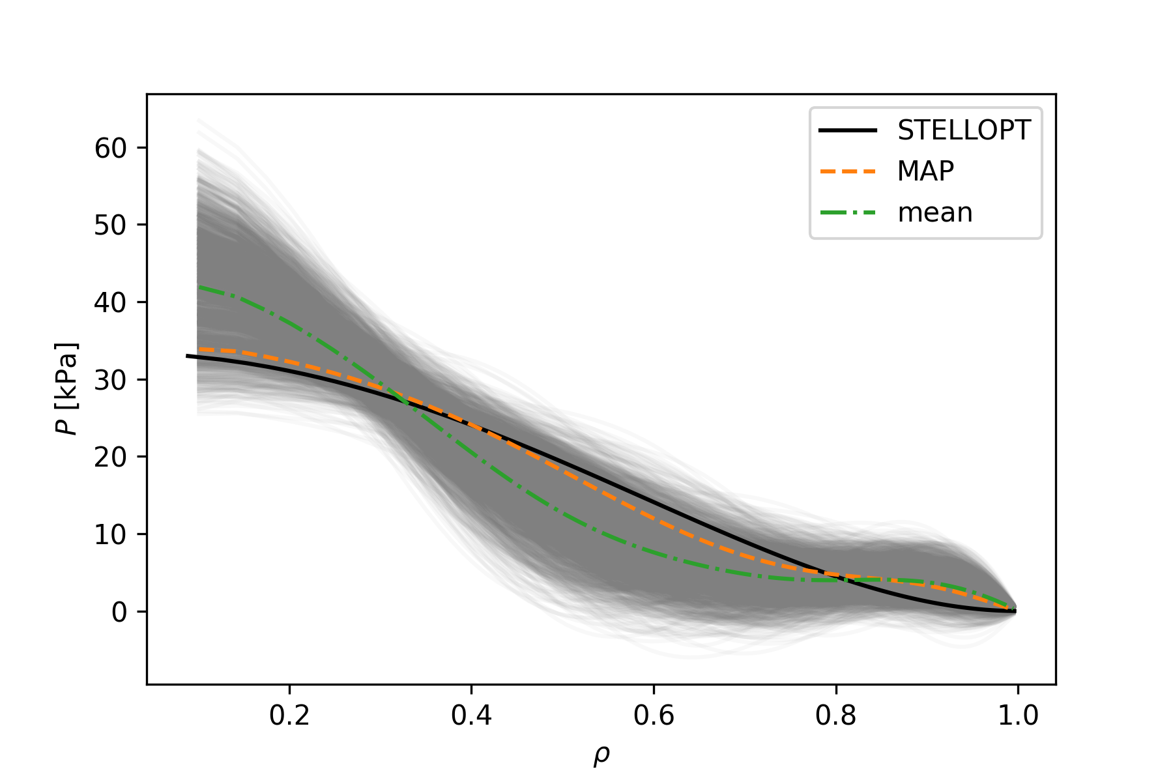
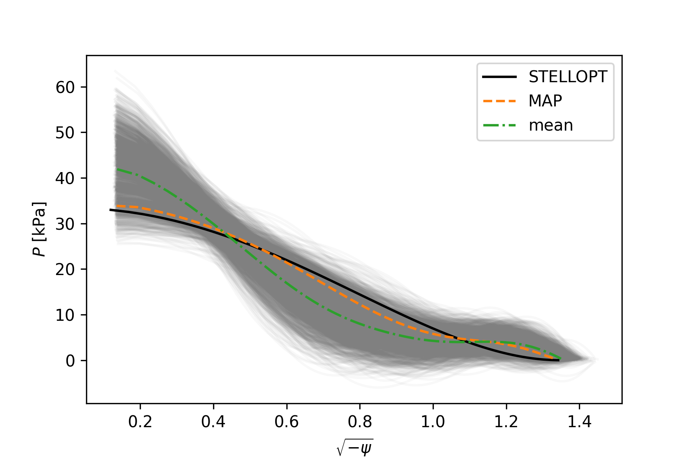
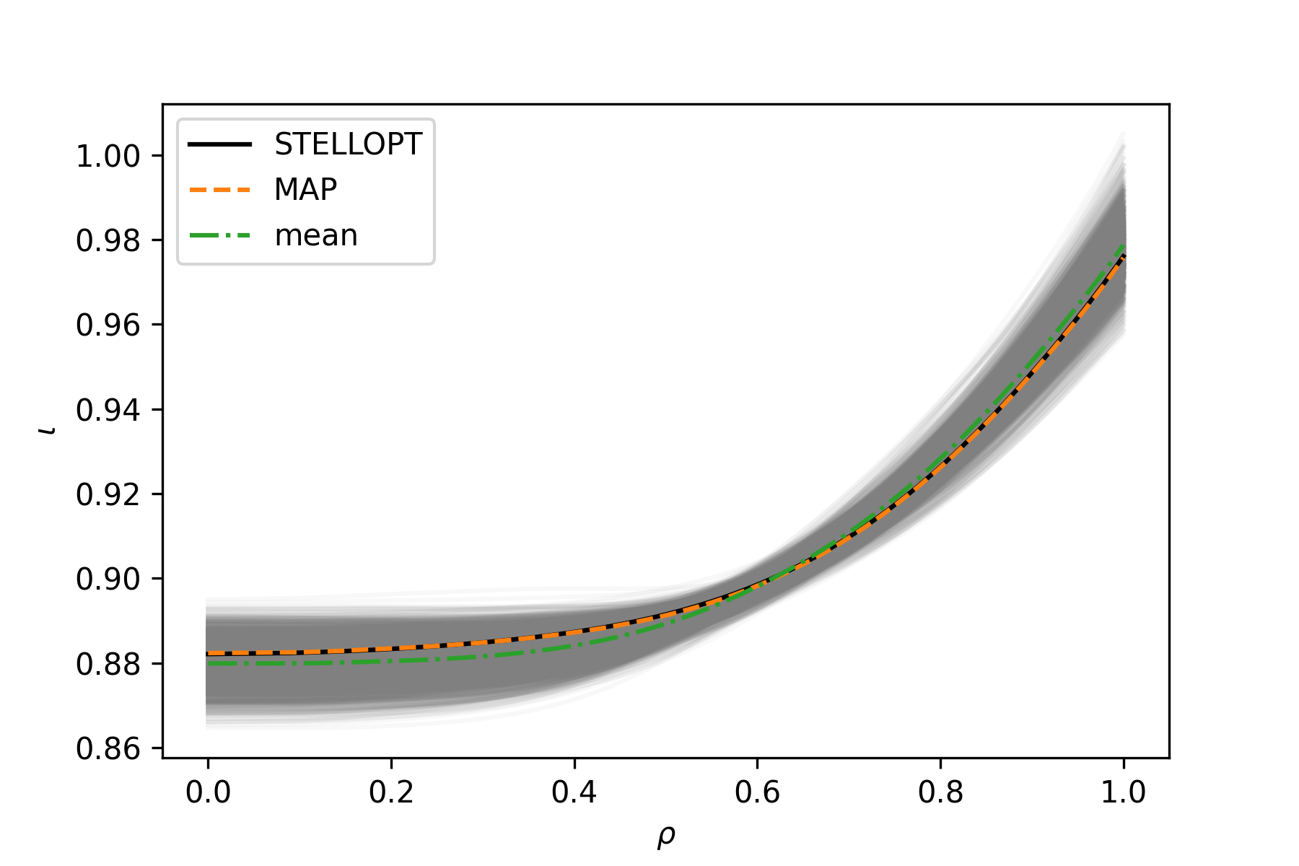
Inference for 20180821.12@5100: iota and pressure-profile
iota-profile directly obtained from re-expansion
pressure-profile calculated from radial force balance
pressure-profile calculated from radial force balance
dim. red. allows for hollow pressure profiles
$$p\left(ρ\right)=\int_{ρ}^{1}{dρ∇ρ\left(J×B\right) }=\int_{ρ}^{1}{−\frac{1}{μ_{0}\left\langle J\right\rangle }\frac{dψ}{dρ}}\left(\frac{d}{dρ}\left\langle B_{ζ}\right\rangle +ι\frac{d}{dρ}\left\langle B_{θ}\right\rangle \right)$$

Slide 14
Summary
proposed framework for equilibrium reconstruction using dimensionality reduction, surrogate modelling and Bayesian inference: surroBIER
for fixed coil currents allows fast best fit estimate (MAP) and uncertainty quantification via MCMC for flux surfaces, $ψ_{0}$, $ι(ρ)$
pressure profile can be calculated from radial force balance directly but can be hollow
comparison to high fidelity reconstruction using STELLOPT showed agreement within uncertainty
Future work
improve prior and dimensionality reduction
couple to more diagnostics for better inference on profiles
include more MHD solvers such as GVEC, DESC etc.

Slide 15
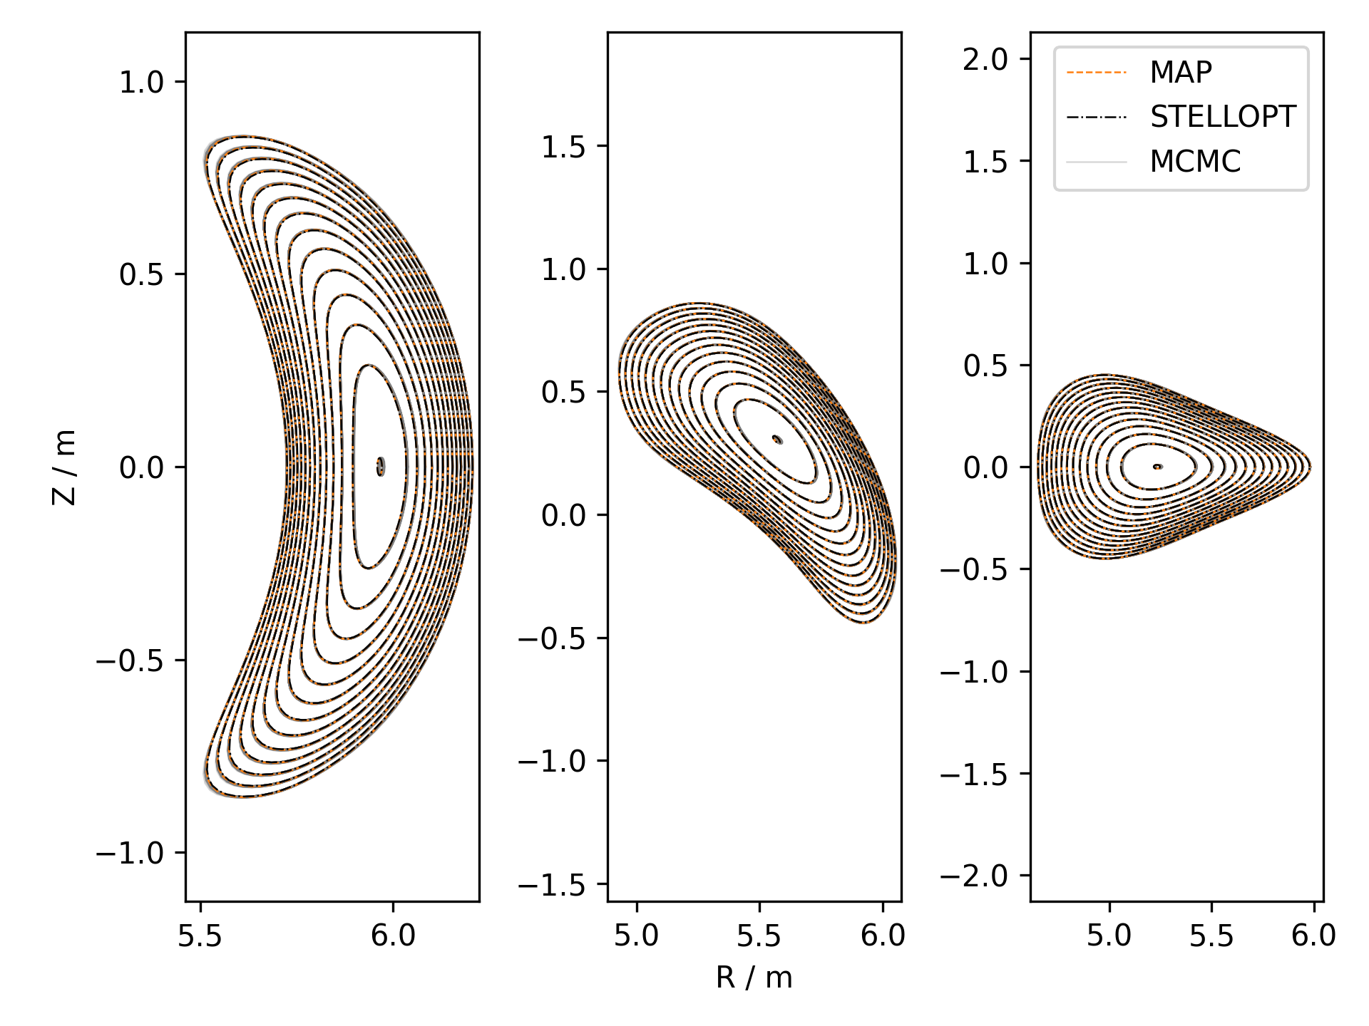
Inference for 20180821.12@5100: rejecting hollow pressure profiles
$$ψ=const.$$
$$ρ=const.$$

Slide 16
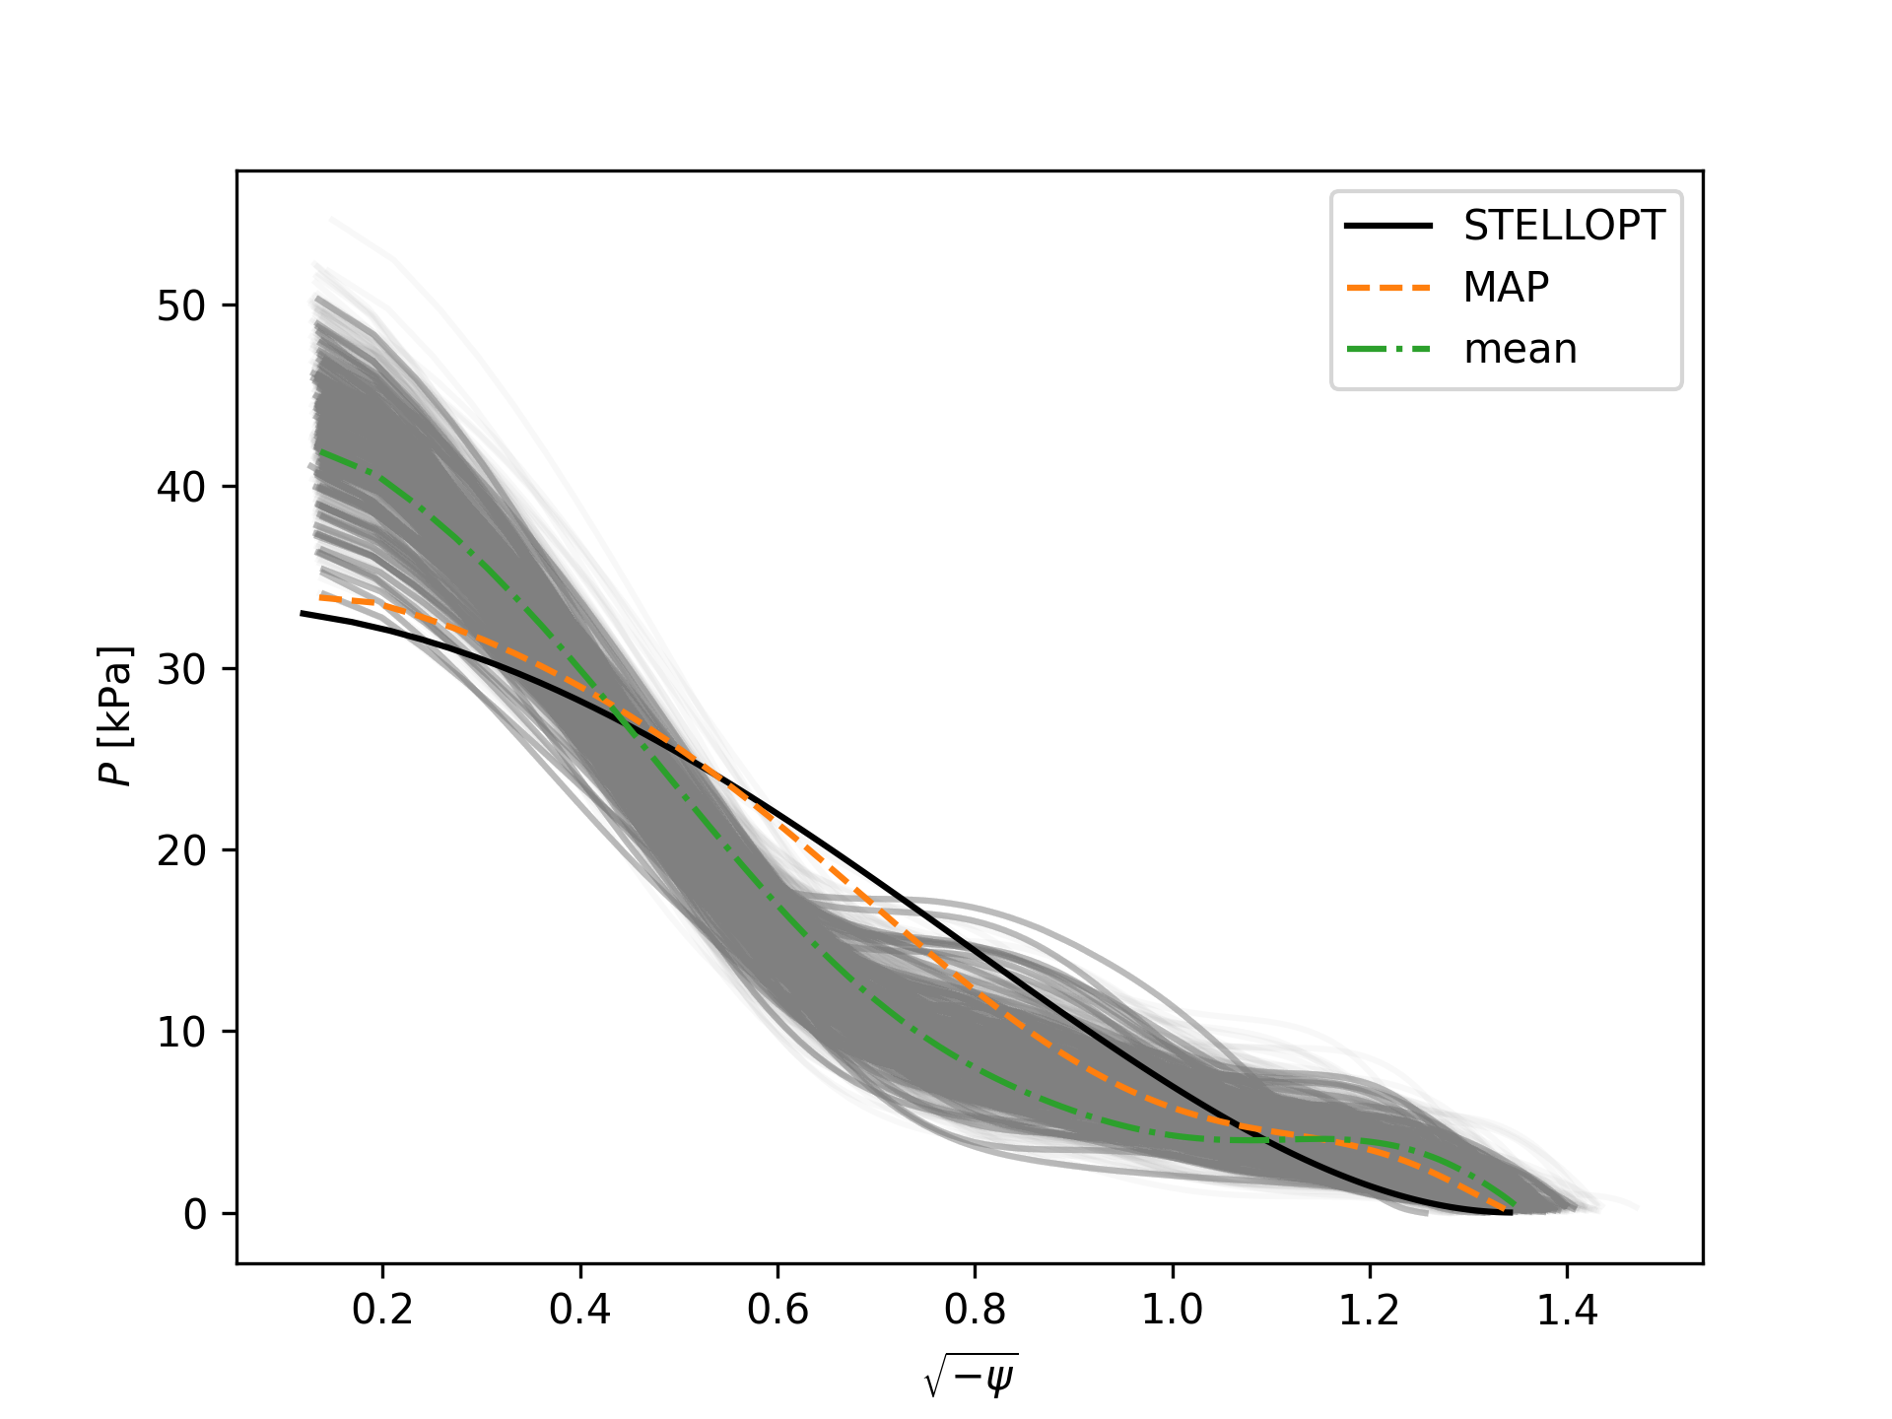
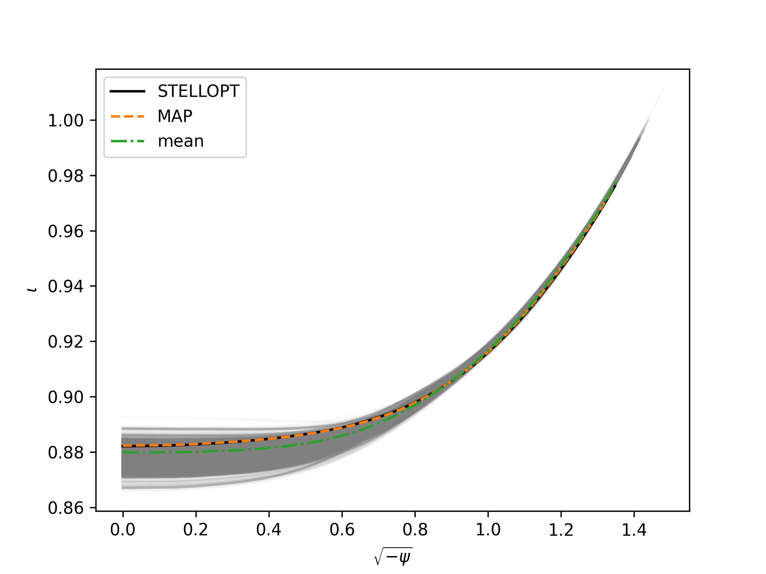
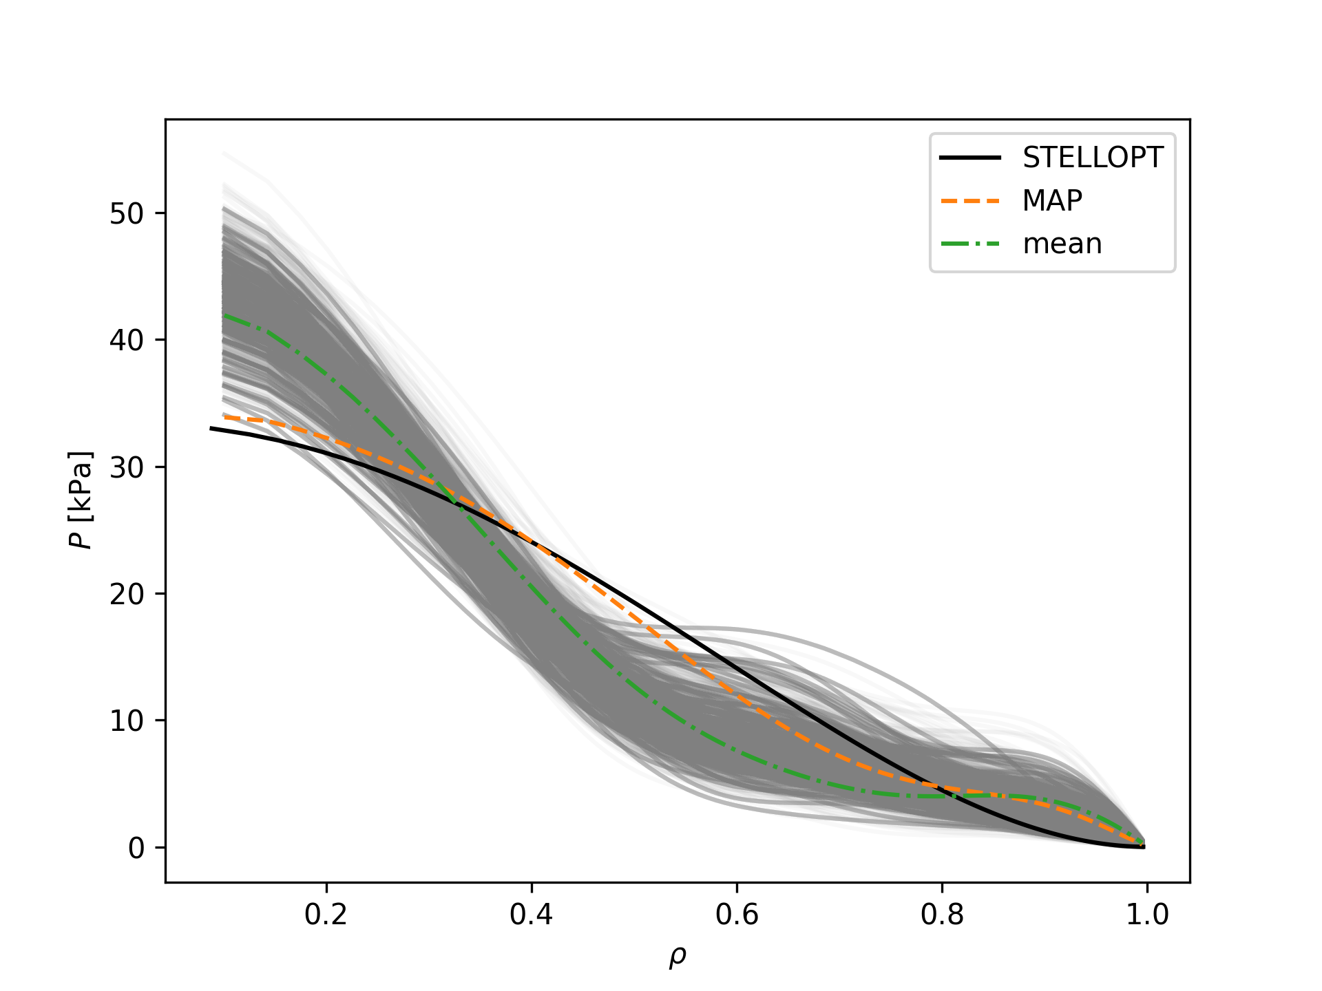
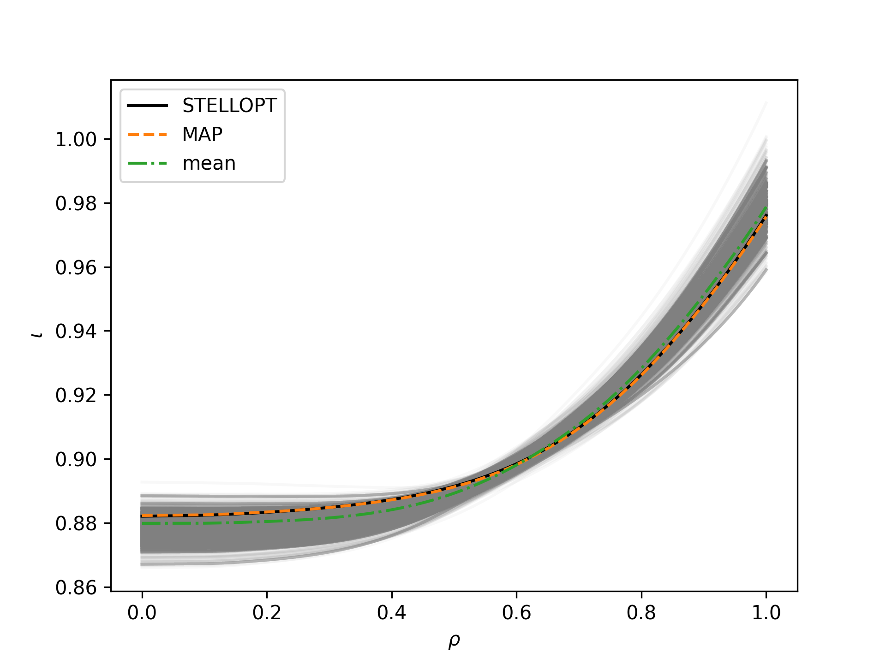
Inference for 20180821.12@5100: rejecting hollow pressure profiles

Slide 17
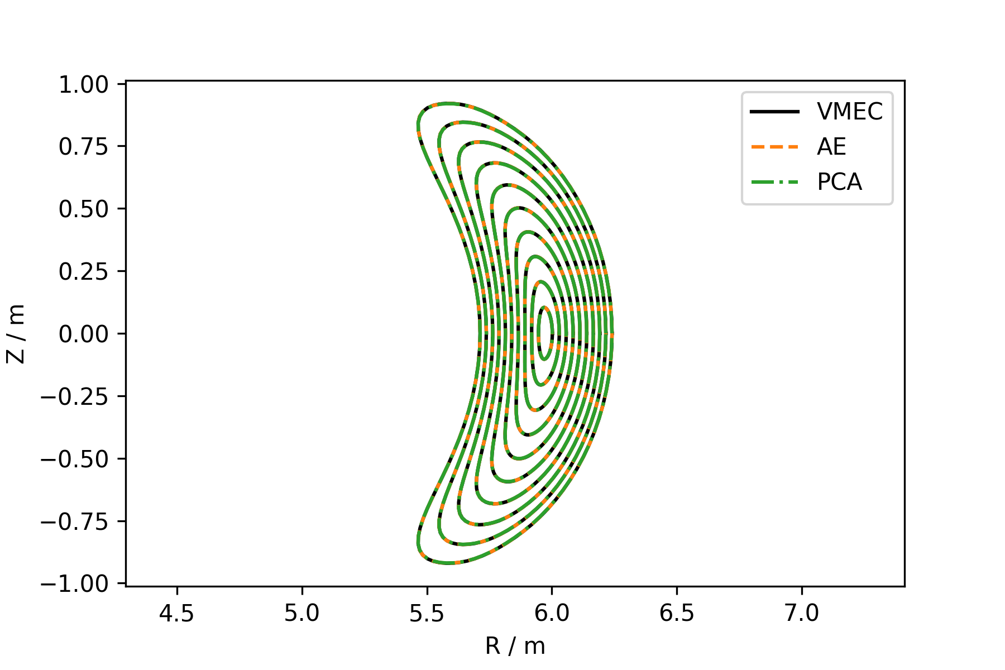
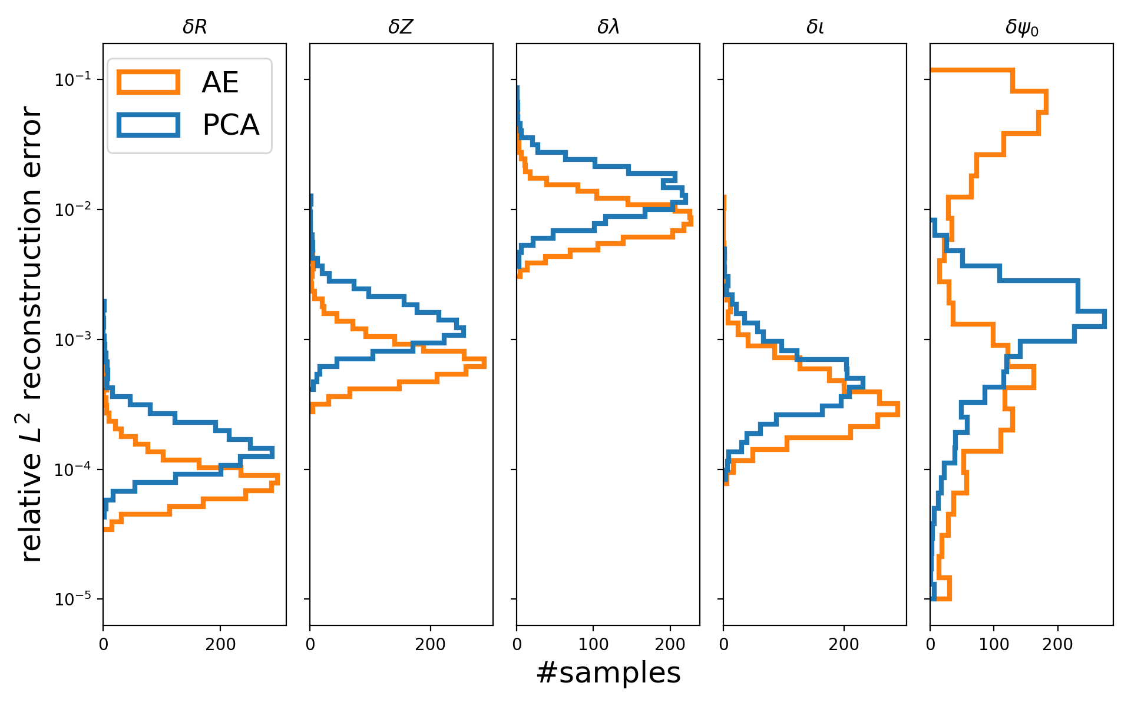
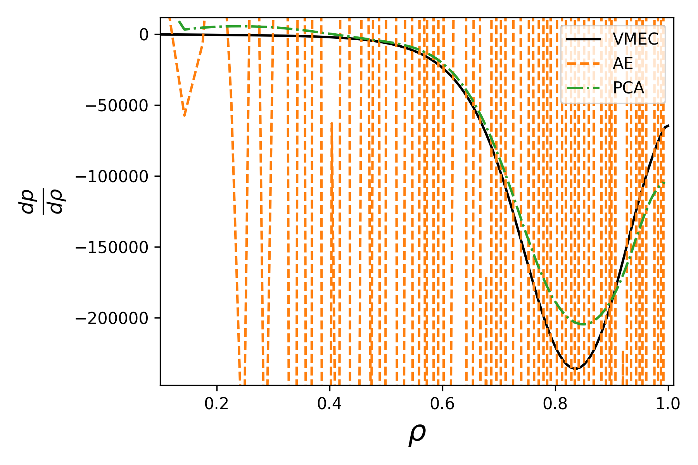
Other forms of dimensionality reduction: Autoencoder

Slide 18
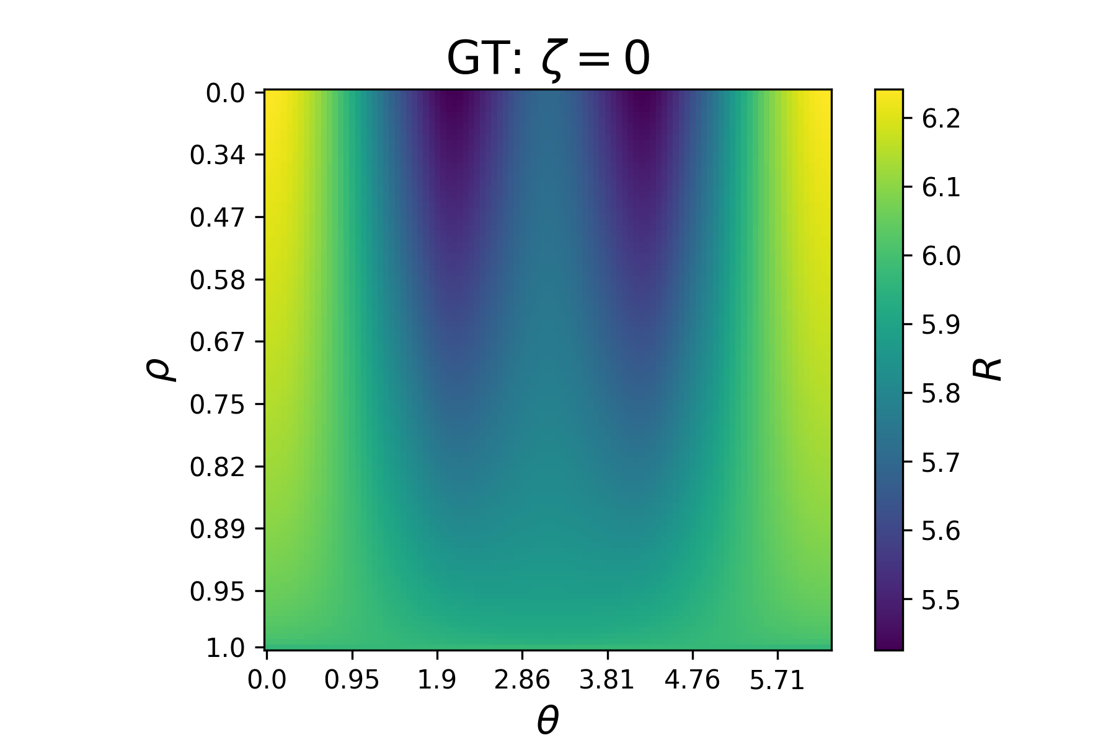
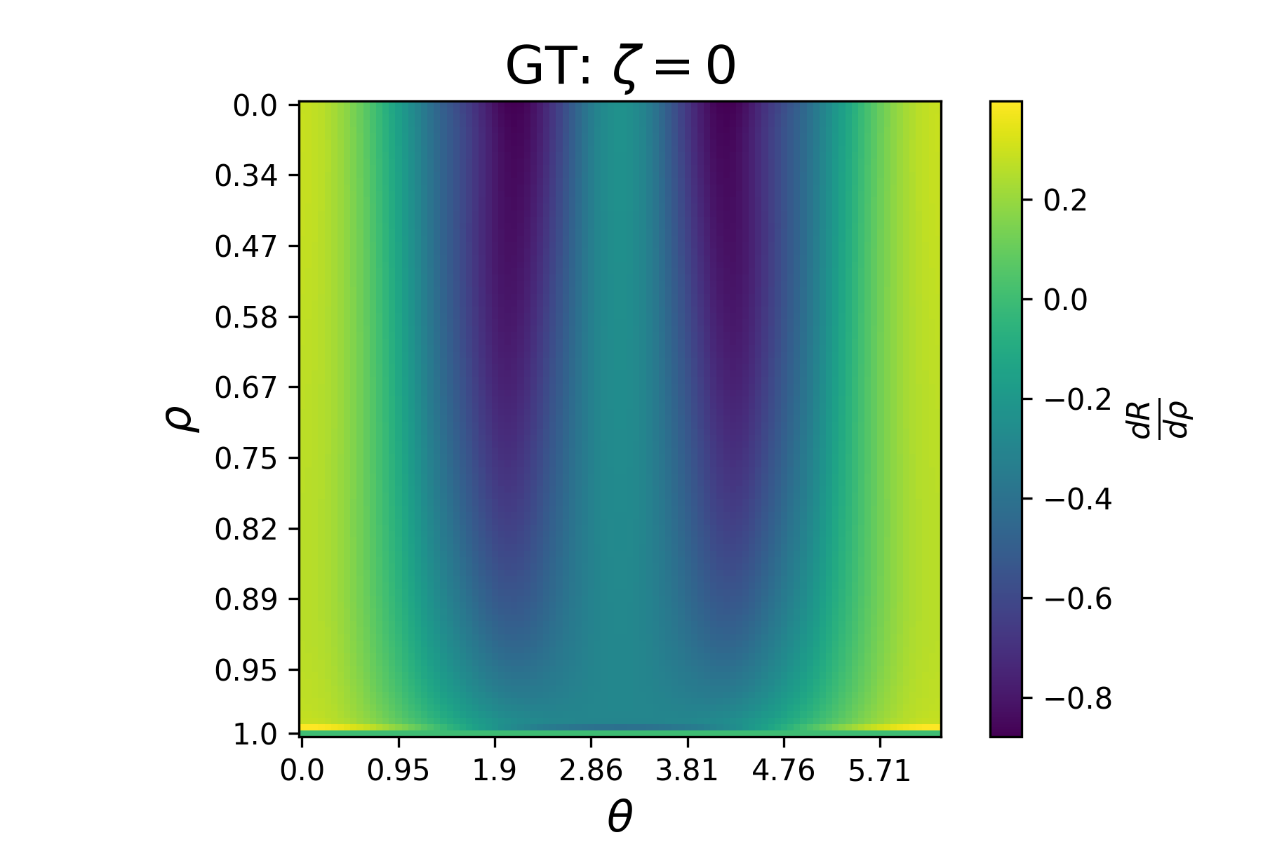
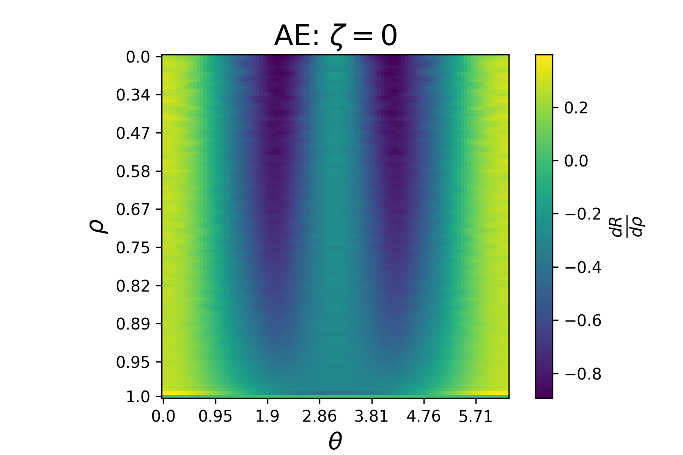
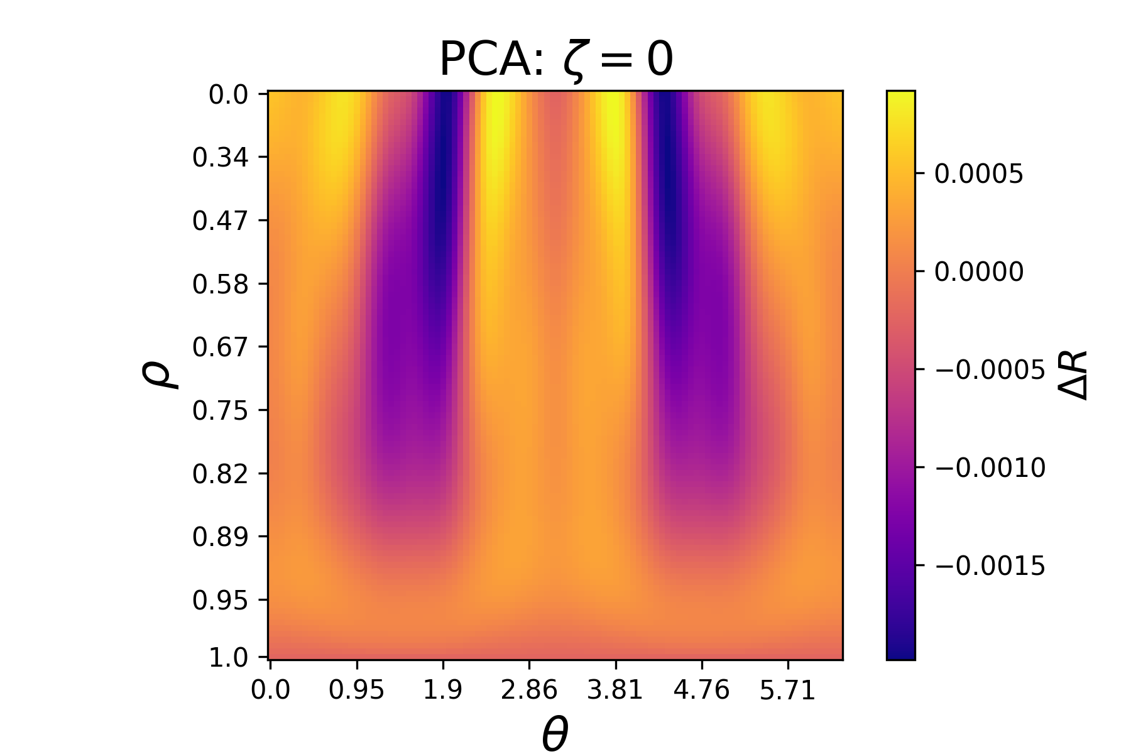
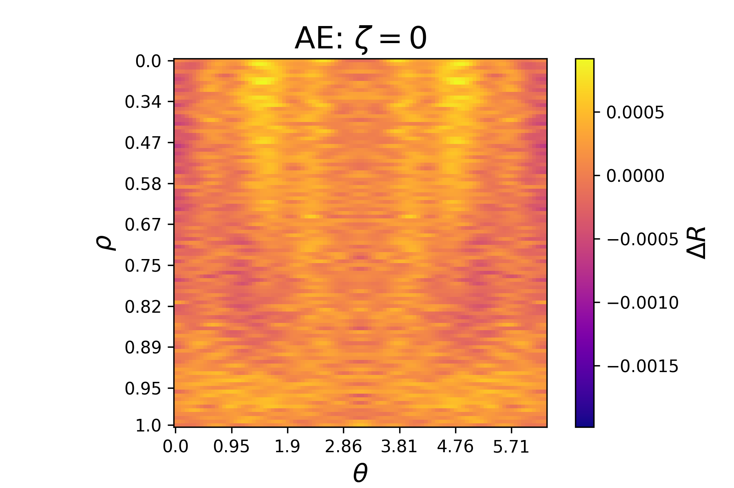
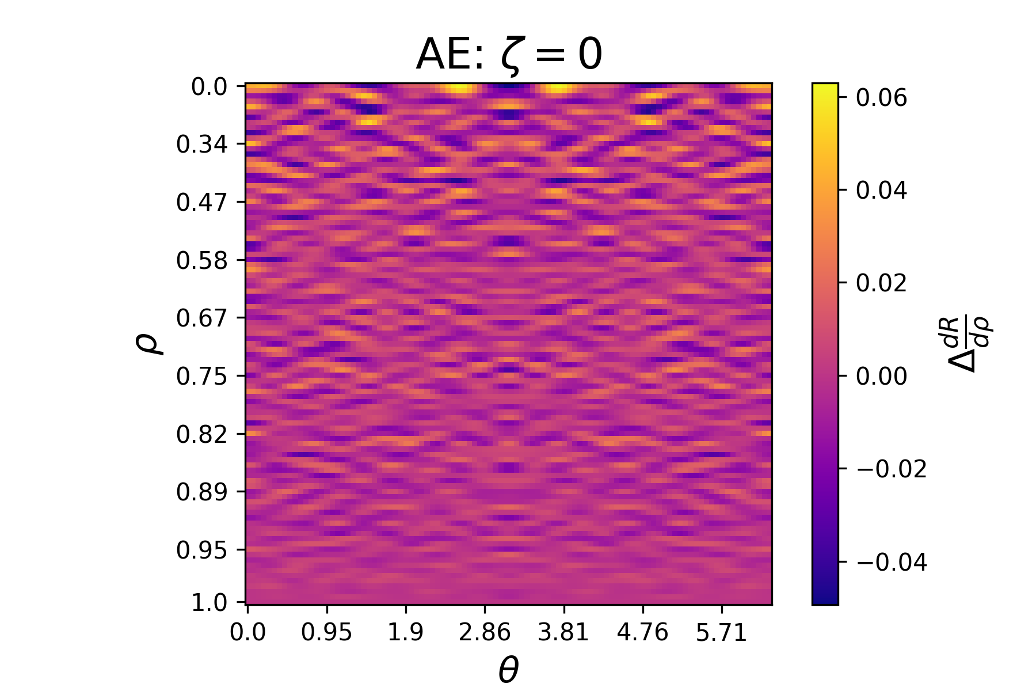
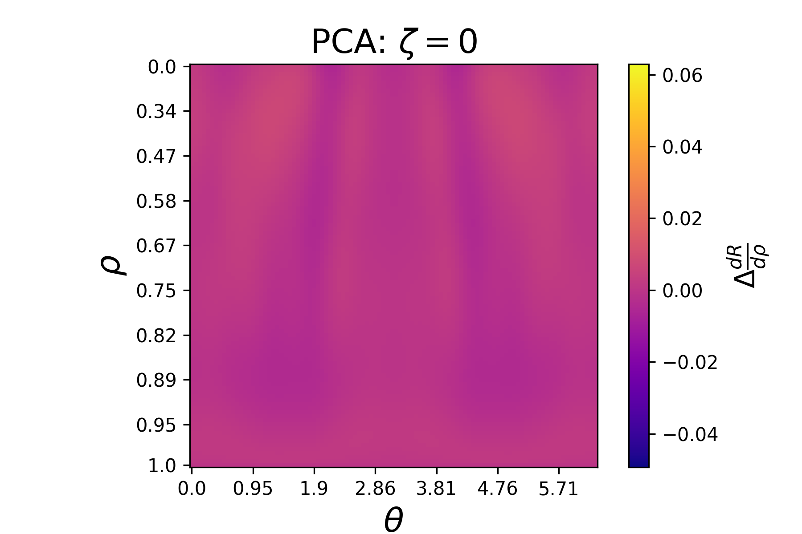
Other forms of dimensionality reduction: Autoencoder

Slide 19
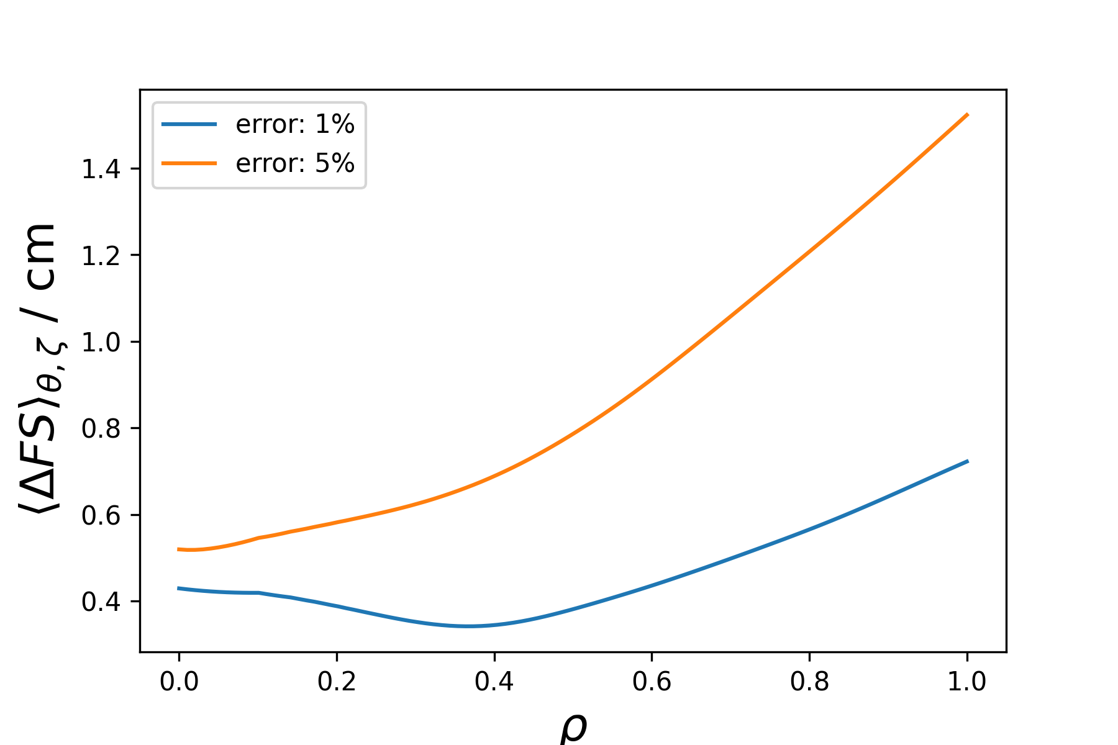
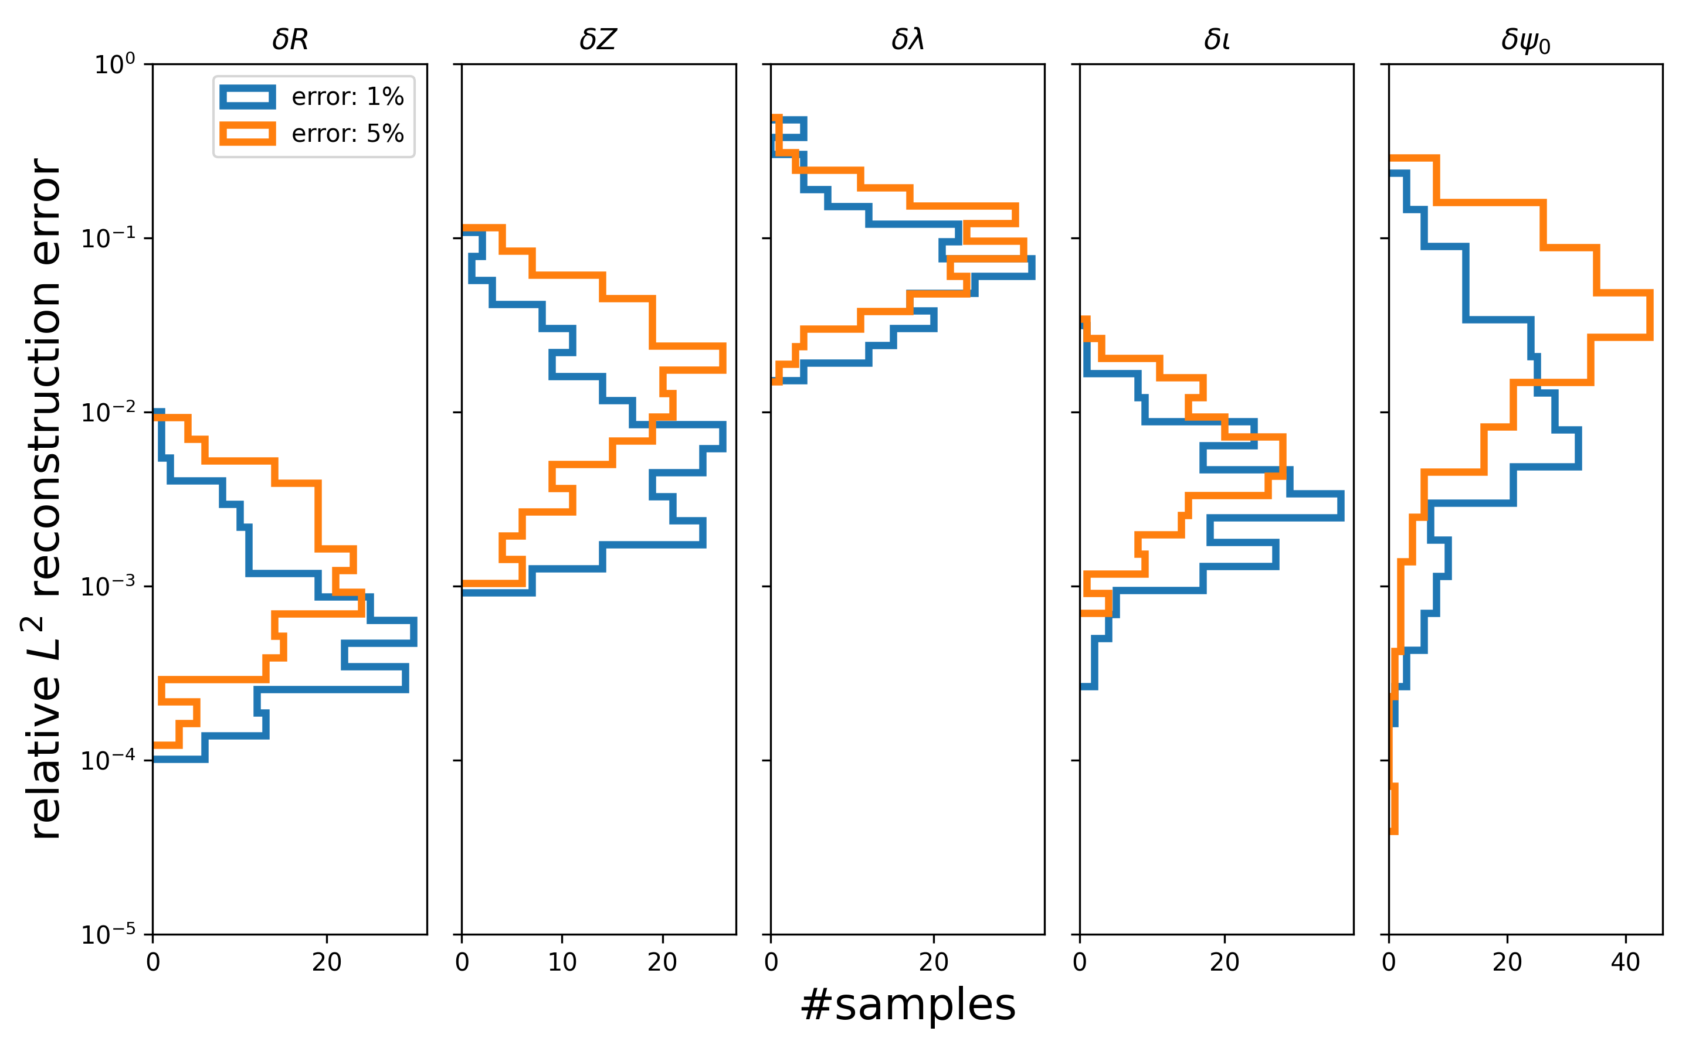
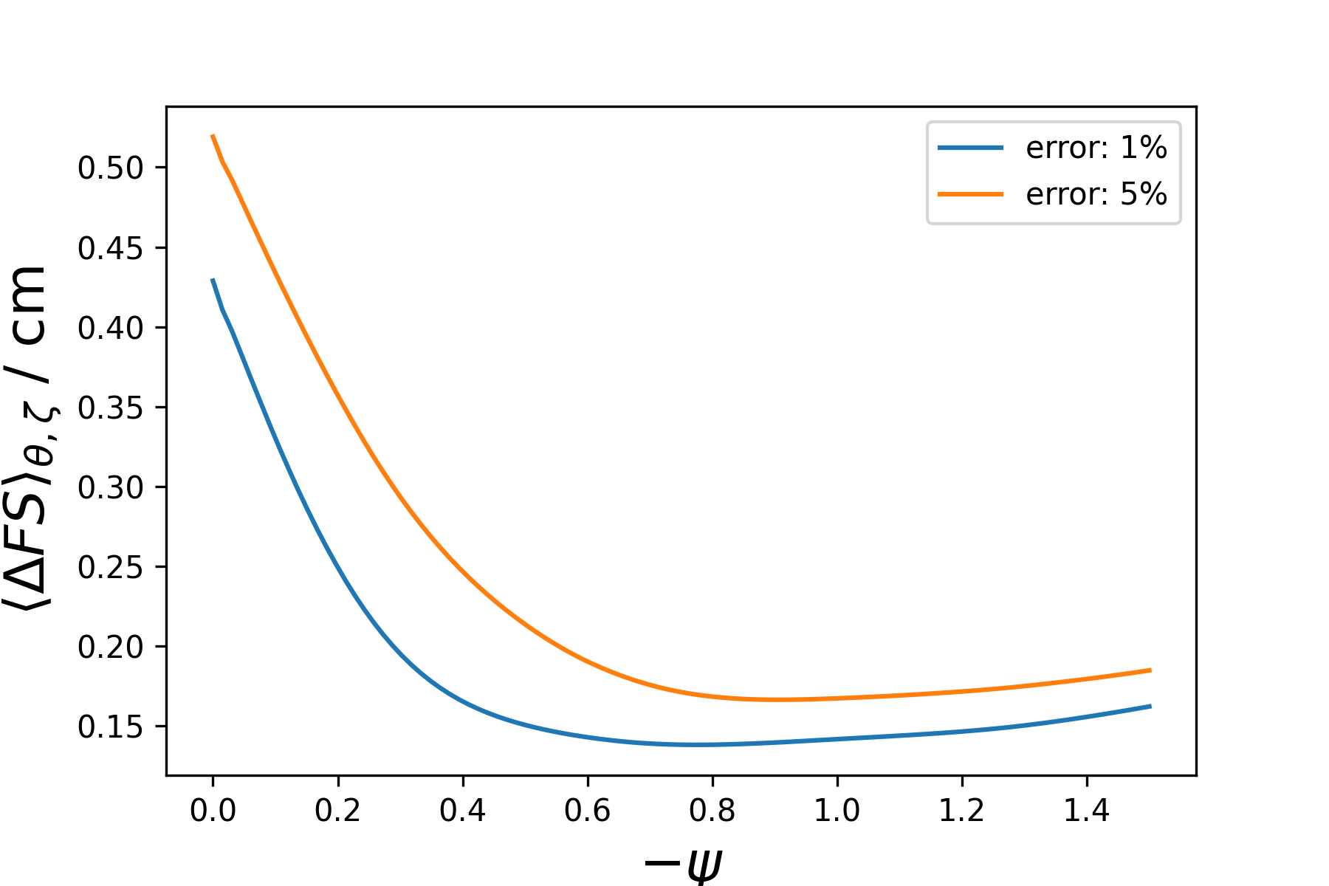
Reconstruction on synthetic validation data
$$D_{i}^{meas}=D_{GT}^{i}+ε_{i}, ε_{i}∼𝒩\left(0,\left|error⋅D_{GT}^{i}\right|\right)$$

