Slide 1
Review: 31st European Fusion Programme Workshop – EFPW31
“Tungsten as first wall material: from ITER towards fusion power plants”
Thierry Kremeyer¹
¹ Max Planck Inst. for Plasma Physics, 17491 Greifswald, Germany

Slide 2
EFPW – Covering physics and programmatic issues
Plasma-Wall Interaction
    Fuel retention, erosion, wall conditioning, dust production, neutron damage etc.
Operating scenarios
    Experimental aspects, including integrated scenario development and modelling
    Available modelling tools for integrated scenario interpretation, validation, extrapolation
Heating mix, fast particles and diagnostics
    Heating system for ITER, alpha particle diagnostics etc.

Slide 3
New Baseline Phases
Pre-First-Plasma Assembly (Pre-FPA), where most in-vessel components are installed (except Blanket First Wall, replaced by inertially cooled W-wall)
Augmented-First-Plasma Phase (A-FP):
  Demonstrate bases of industrial-scale superconducting tokamak system
  Demonstrate H-mode (DD) plasmas
  Commission Plasma Control and Protection Systems (including Divertor) to reduce risks in DT-1
  Install 40 MW of ECH and demonstrate ICWC (and test ICH to 10 MW)
Post-First Plasma Assembly (Post-FPA) + Integrated Commissioning, to complete the installation of the remaining in-vessel components, plasma heating systems (ECH and NB plus ICH upgrade), Test Blanket Systems and remaining Diagnostics
DT-1 operation stage, to achieve Q=10 with P_{fusion} ~500 MW for 300-500 s in DT plasmas with a reduced neutron fluence and to demonstrate the integrated tokamak engineering system
Second phase of ITER license
DT-2 operation stage, with the target to achieve all Project Specification goals
ECH = Electron Cyclotron Heating
ICWC = Ion Cyclotron Wall Conditioning
ICH = Ion Cyclotron Heating
NB = Neutral Beam
DT-1
DT-2
Engineering, Fabrication of System | Pre-First Plasma Ass. (Pre-FPA) | Int. Comm. I | Augmented First Plasma (A-FP) Phase | Post-First Plasma Ass. (Post-FPA) | Int. Comm. II | FPO-1 | FPO-2 | FPO-3 | FPO-4 | FPO-5
FPO-x | (…) | FPO-y
Start nuclear phase
(DD plasma)
H+T plasma
DT plasma
Q = 10
Alberto Loarte – Status of ITER re-baselining

Slide 4

Plasma-Surface Interaction Processes
Divertor und SOL plasma conditions:
T_{e}=1-100 eV
n_{e}=5x10¹⁷-1x10²¹m⁻³
Impact energies:
E_{in}=1-500 eV HI ions
E_{in}=1-2000 eV CX HI
Additional neutron-induced effects:
enhances tritium retention, modifies material properties like thermal conductivity, brittleness, swelling, causes transmutation, impacts erosion etc.
Lack of material damage studies
with 14 MeV neutrons at high dpa
or
HI retention in neutron-damaged
material after plasma loading
HI = Hydrogen Isotopes
Sebastijan Brezinsek – PWI in future fusion reactors

Slide 5
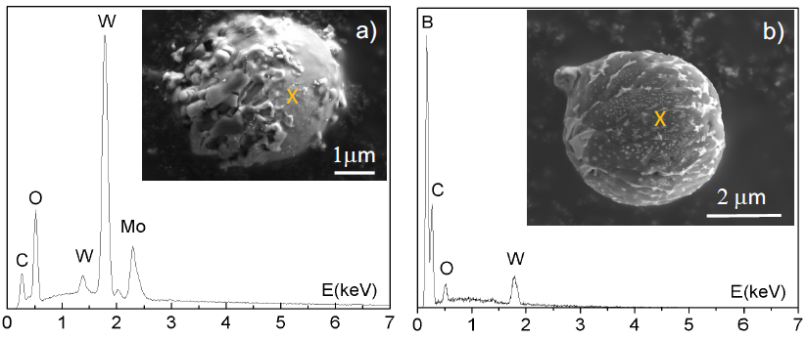
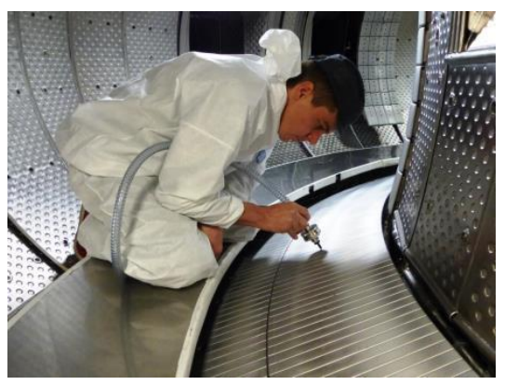
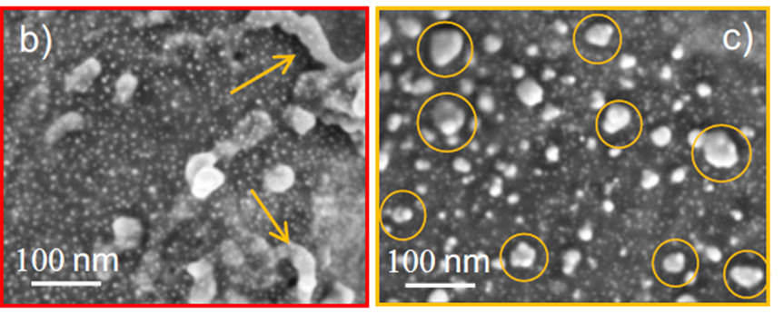
WEST: Large variety of dusts found on the divertor
Insitu collection of dusts on divertor surface
Wide spectrum of dust size & composition
Micrometer tungsten droplets, boron spheres, etc
Nanometer tungsten dusts
  Most numerous particles so far, everywhere
  nucleation process under investigation
Arnas et al. Nuc. Mater. & Energy 36 (2023)
Dust collection in WEST
nanometer dusts
Rudolf Neu – PWI consequences

Slide 6

Start-up of un-boronized AUG
Early transition to divertor (full bore plasma)
1.0
0.5
z(m)
0.0
-0.5
-1.0
Shot: 23677
1.0
1.5
R(m)
2.0
2.5
1.0
1.5
R(m)
2.0
2.5
1.0
1.5
R(m)
2.0
2.5
1.0
1.5
R(m)
2.0
2.5
breakdown on outer limiter (conditions faster compared to inner wall)
early X-point formation
- inner wall conditioned in flat top and ramp down phases

Slide 7
Conclusions
W-Control strategies in AUG are well refined and allow access to practical all confinement regimes
        Generally:
          High n_{e}, and/or seeded scenarios feature low divertor T and allow operation w/o boronizion
          Low n_{e} scenarios feature reactor-irrelevant divertor and SOL conditions and thus, potent, additional W-control strategies are necessary
          W-core transport mostly understood (except for role of MHD)
        High density scenarios feature low W-content, access to good confinement via seeding and higher β
        ITER BL at high n_{e} exhibits confinement gap, which is possibly related to flat n_{e}-profiles
        Edge stability of ITER BL (and slightly τ_{E}) improves when entering a small ELM regime (QCE/EDA)
        Low density scenarios require consideration of W-control, which potentially affects confinement
        Nevertheless high confinement improved H-modes and advanced scenarios demonstrated also two weeks after boronization
        QH and RMP ELM-suppression only possible in AUG with boronization
Thomas Pütterich – Hybrid & baseline scenarios from AUG

Slide 8
W-Control strategies are difficult to extrapolate, because
        Many observations in type-I ELMy H-mode, including edge transport and erosion
        Does neoclassical pedestal transport extrapolate to ITER/DEMO?
        RMPs and QH-modes in AUG at extremely low n_{e} – In ITER high SOL/divertor n_{e}
          In AUG: coverage with B necessary
          Probably no problem in ITER/DEMO as edge must have high n_{e}
        QCE / EDA / high radiation scenarios at high n_{e} (high collisionality):
          Probably scale to ITER/DEMO as separatrix values seem important (but pedestal at different ν*)
      Confinement Gap for ITER BL in AUG possibly disappears in ITER as high n_{e} edge combines with low ν*
Often the uncertainties of predictions for plasmas in ITER‘s/DEMO‘s
are enhanced considering the uncertainties for W-control.
Thomas Pütterich – Hybrid & baseline scenarios from AUG

Slide 9
T_{i} clamping in W7-X and AUG (only electron heating)
W7-X
AUG (EC only)
T_{i}
T_{i}
T_{e}
T_{i}
T_{e}
n_{e}
T_{e}
Beurskens M et al., NF, 2021
Beurskens M et al., NF, 2022
With NBI, T_{e} < T_{i} ≈ 10 keV achievable in AUG
Qualitatively similar behavior in WEST using LH-heating.
P. Manas et al., accepted by NF
Joerg Stober– PWI consequences

Slide 10
Wendelstein 7-X – Germany: SWOT Diagram
W7-X is a large-scale, quasi-isodynamic stellarator with superconducting coils, an island divertor configuration, water-cooled CFC PFCs (currently), and extensive H&CD, Diagnostic and Control capabilities
Indispensable: W7X (primary), PWIE, DC
Possible
strategies
& actions
Weaknesses
Unlike tokamaks, W7-X is part of a very small community of peers, with only a few smaller devices in operation around the world.
Collaboration opportunities very limited.
Strengths
Strong capabilities to fill in physics basis for stellarator power plants.
Leading alternative to the tokamak.
The stellarator plasma is largely free from spontaneous disruptions.
Lots of available heating power.
Opportunities
Opportunity to move the stellarator toward the level of maturity already enjoyed by tokamaks.
Clear advantage in stability due to lack of toroidal current, but confinement, exhaust control, fast particles, etc. requires further study.
Bavarian Master Plan Fusion.
W7-X research plan has appropriately broad scope; use it to build the physics basis. Accelerate/intensify as reasonable.
Collaborate with similar-scale tokamaks to identify relative strengths and weaknesses and build the case for a next-step stellarator.
Use ICRH to study fast particle behaviour.
Seek collaboration between EUROfusion and German BMBF and aim at mutual support wrt W7-X and the stellarator technology.
Explore possibilities and synergies arising from the Bavarian Master Plan Fusion.
Threats
Stellarator technology remains more complicated than tokamaks.
EUROfusion budget is short.
Project should be supported at high priority due to uniqueness to support Mission 8.
Follow the FSD proposal in the Review input docs: proceed by employing all available EU expertise, backfit W7-X with power upgrades and change to an actively cooled metallic wall.
Consider strategies to simplify stellarator design and construction for next-steps.
Rolf Heuer – Results of EUROfusion Facility Review

Slide 11
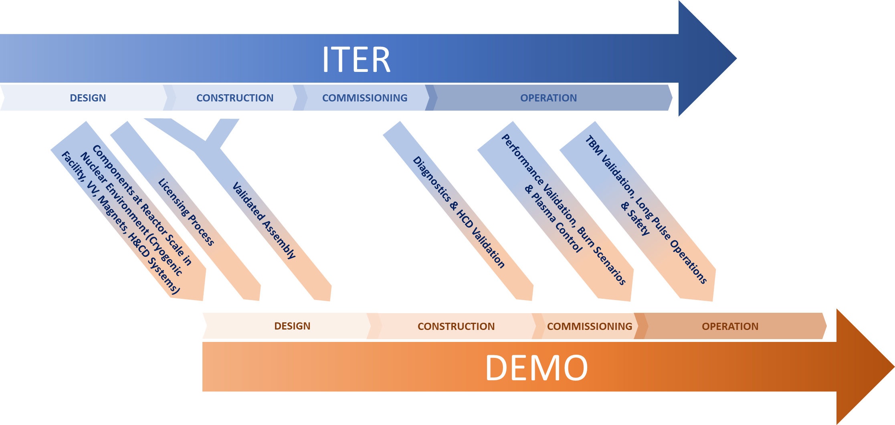
Parallelization of ITER and DEMO and the role of ITER
Ambrogio Fasoli – Panel: The new EU approach to fusion energy
Notes:
TBM program will likely not be in time for DEMO design. Yet, TBMs will yield crucial information for DEMO on qualification, licensing, manufacturing and integrated operation of blankets in nuclear plasma environment
ITER’s experience with safety and waste production, RH, civil engineering, the hot cell, the management of T and radioactive waste, is an essential reference for DEMO

Slide 12
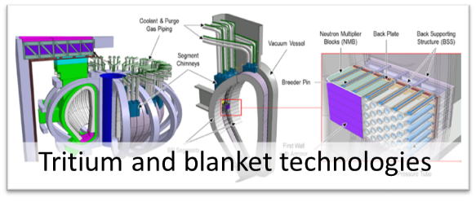
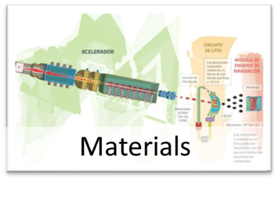
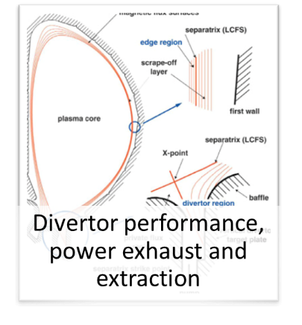
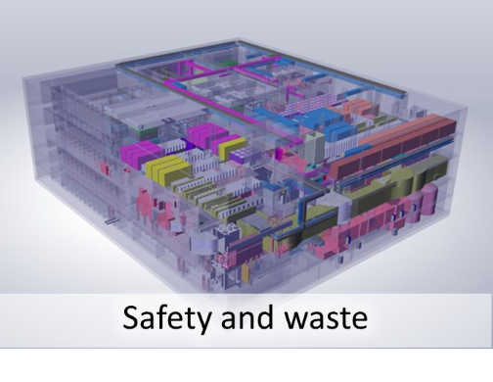
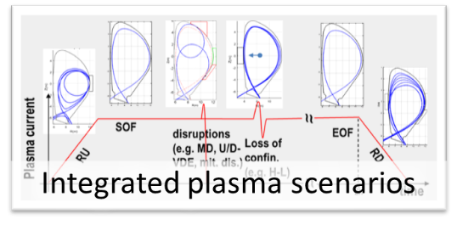
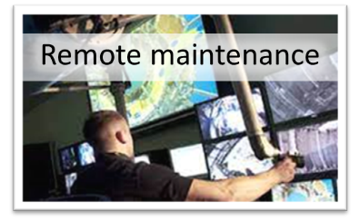
Gaps to be addressed
Ambrogio Fasoli – Panel: The new EU approach to fusion energy
Notes:
+ theory and numerical simulations

