Slide 1
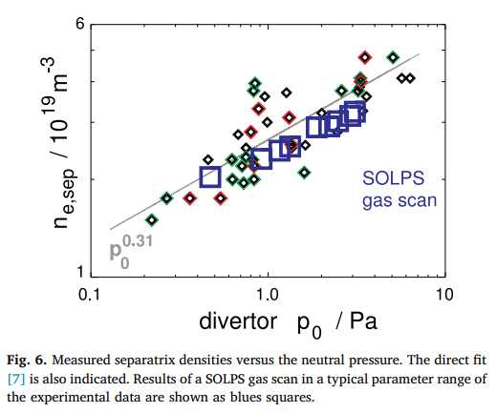
AUG results
Source: A Kallenbach et al 2018 Plasma Phys. Control. Fusion 60 045006

Slide 2
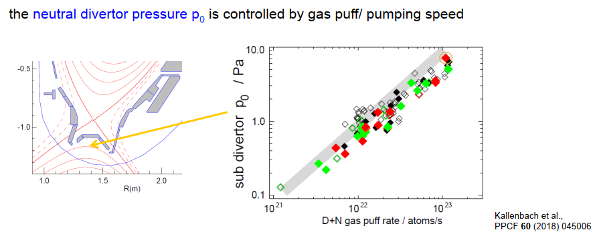
AUG results

Slide 3
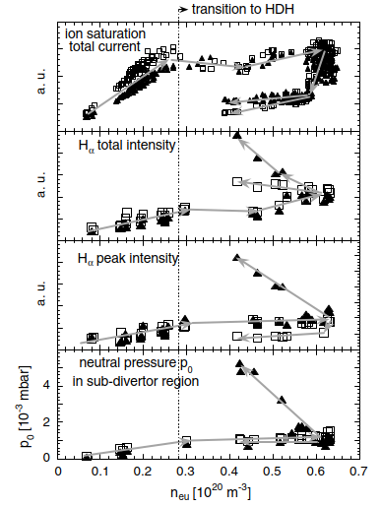
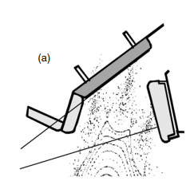
W7-AS results
SDC, NBI = 1.4 MW.
neutral pressures in the sub-divertor regions at top (solid symbols) and bottom (open symbols) divertors as functions of the upstream electron density. At partial detachment (rollover of n_{eu}), the neutral pressure reﬂects the courses of the Hα signals. The strong increase during detachment from the top divertor is associated with the occurrence of volume recombination in that region.
A well pronounced high-recycling regime (with n_{ed} strongly exceeding n_{eu} in consequence of pressure constancy along ﬁeld lines) prior to detachment is not observed in W7-AS.
A considerable loss of parallel momentum in this geometry at T_{ed} values still well above about 5 eV is indicated, where momentum losses due to charge exchange (CX) are not yet effective. EMC3-EIRENE code simulations support this assumption and relate this effect to friction between counter-streaming particle ﬂows within the island SOL as well as cross-ﬁeld particle and momentum transport into shadowed regions between the discontinuous targets.
Neutral particle densities near the wall outside the divertor regions are typically at about 10⁻⁴ mbar.
Source: M Hirsch et al 2008 Plasma Phys. Control. Fusion 50 053001 (p.138)

Slide 4
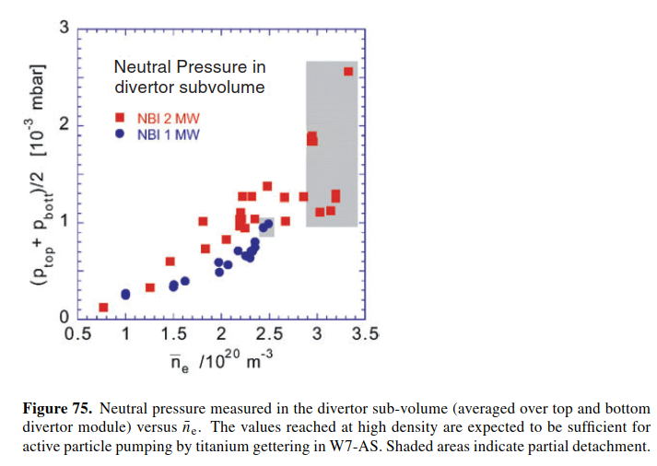
W7-AS results
The transition into detachment at n_{es} = 5.4 × 10¹⁹ m⁻³ results in a sharp drop in downstream density, both in the code and the experiments. It is important to note here that n_{ed} never exceeds n_{es}, and this holds also for the other probe array positions, indicating that detachment is achieved without running through an intermediate high-recycling regime.
Moreover the maximum downstream temperatures, which were found at the same location as the peak densities, remain fairly high compared to the detachment conditions one observes in tokamaks. No indication of volume recombination has been found, neither in the Hα/Hγ images of the lower divertor nor in the Balmer series spectra observed between target and separatrix with the spectrometer set-up at the upper divertor. These observations clearly indicate that the temperatures at detachment remain above 2 eV.
Source: R König et al 2002 Plasma Phys. Control. Fusion 44 2365

Slide 5
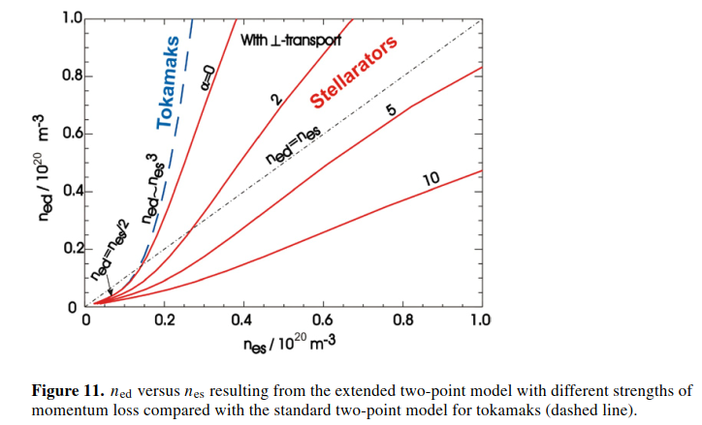
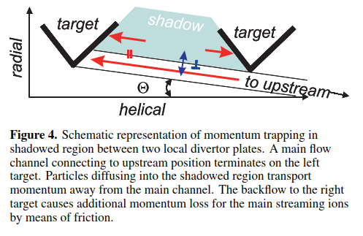
Stellarators vs. tokamaks
Source: Y. Feng et al 2006 Nucl. Fusion 46 807
Source: Y Feng et al 2011 Plasma Phys. Control. Fusion 53 024009

Slide 6
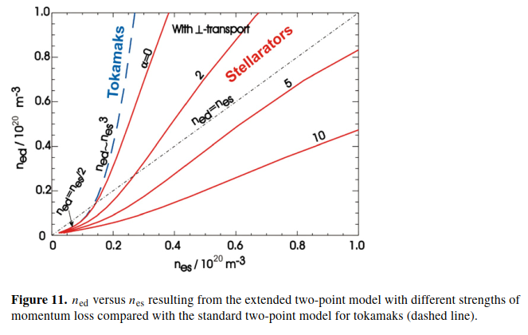
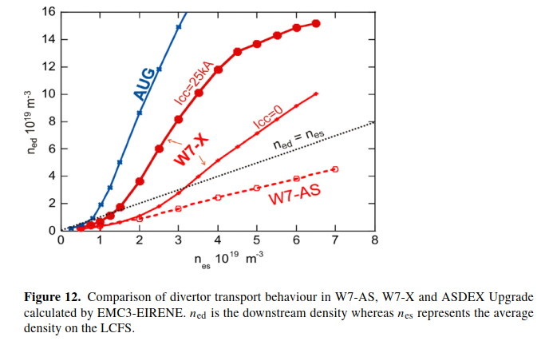
Comparison
https://event.ipp-hgw.mpg.de/event/567/

Slide 7
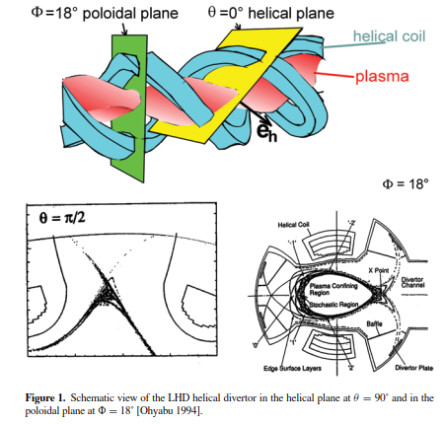
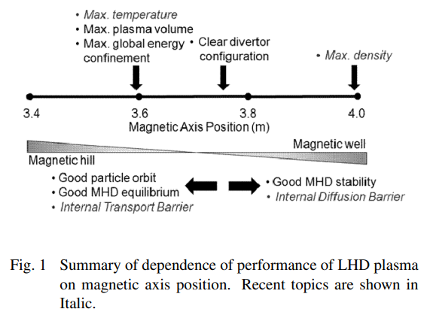
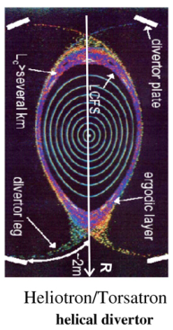
LHD device
The stochastic layer in LHD consists of multiple low-order island chains.
Source: O. Kaneko et al. Plasma and Fusion Research: Regular Articles Volume 4, 027 (2009)
Source: Y Feng et al 2011, Plasma Phys. Control. Fusion 53 024009
Source: R König et al 2002 Plasma Phys. Control. Fusion 44 2365

Slide 8
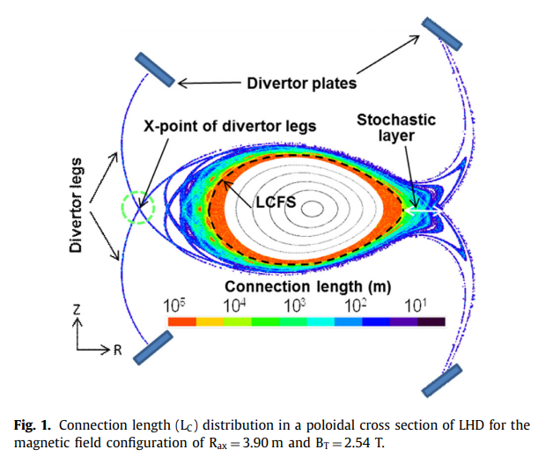
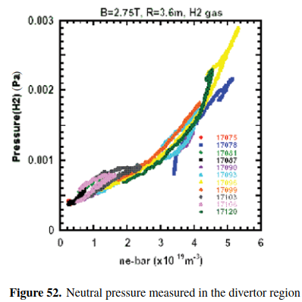
LHD results with open divertor
A non-linear increase in the divertor pressure with increasing line-averaged density has been observed in the open helical divertor conﬁguration (ﬁgure 52) [Noda 2001]. The absolute neutral gas pressure, however, was even at ne = 6 × 10¹⁹ m⁻³ still as low as 3 × 10⁻³ Pa underlining the necessity of a carefully designed closed divertor, to build up sufﬁciently high pressures for efﬁcient particle removal.
Source: M. Kobayashi et al. / Nuclear Materials and Energy 12 (2017) 1043–1048

Slide 9
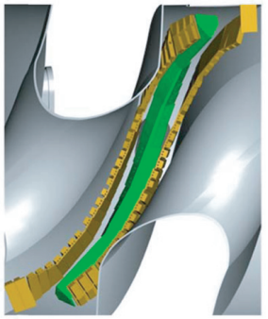
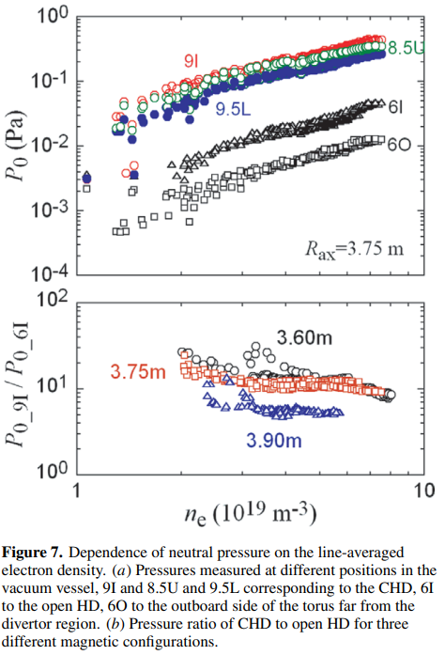
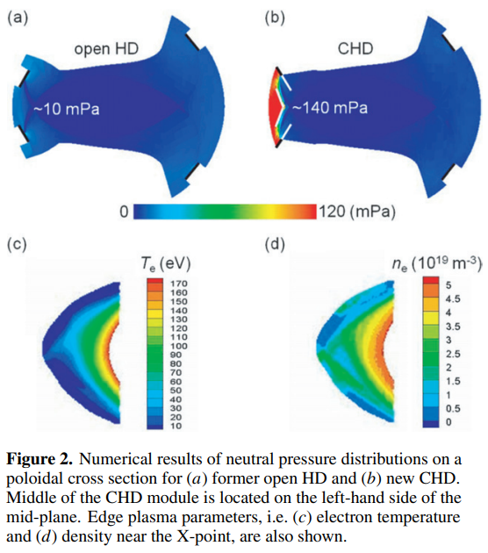
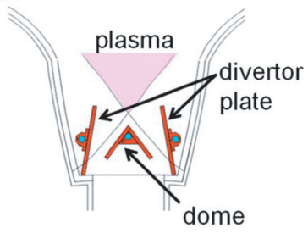
LHD results
CHD installed only on the inboard side of the torus, i.e. ‘partial’ CHD, which consists of ten discrete modules in each helical section. Each CHD module consists of target plates and a ‘dome’ structure.
Source: T. Morisaki et al. Nucl. Fusion 53 (2013) 063014

Slide 10
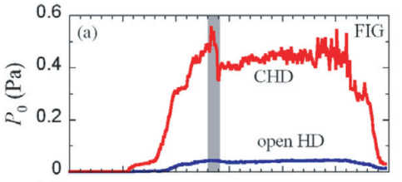
LHD results with closed divertor
The highest performance of the LHD plasma is obtained in the inner shifted configuration of R_{ax} ∼ 3.60 m
recent results (last LHD campaign)
pressures observed up to 1.4 Pa
low electron temperature <0.5 eV,
volume recombination
observed only in the inward shifted configuration with Rax = 3.55 m,
but not with Rax = 3.6 m.
Source: U. Wenzel et al., submitted to Nuclear Fusion (2024)
ASDEX-type fast ion gauges (FIGs) are installed in the dome.
Source: T. Morisaki et al. Nucl. Fusion 53 (2013) 063014

Slide 11
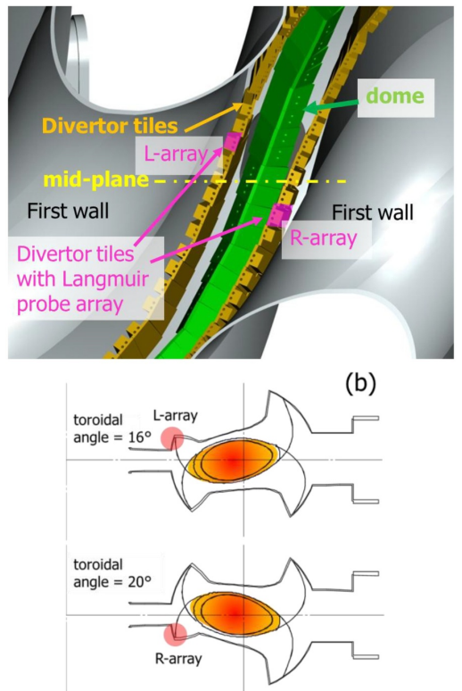
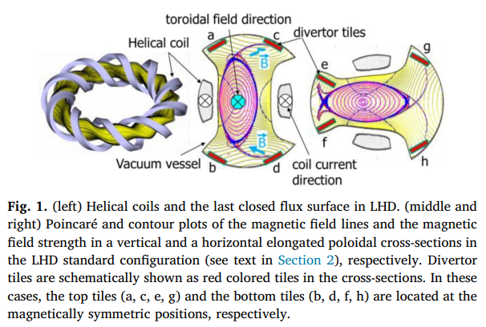
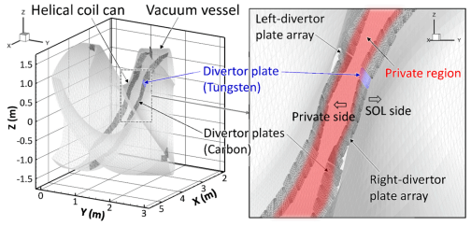
LHD closed divertor
Source: S. Masuzaki et al. Nuclear Materials and Energy 18 (2019) 281–2
Source: M. Shojiet al. Nuclear Materials and Energy 33 (2022) 101257

Slide 12
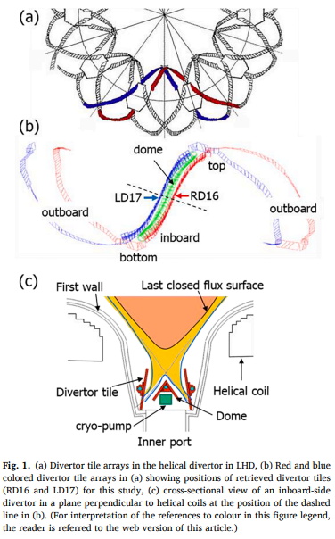
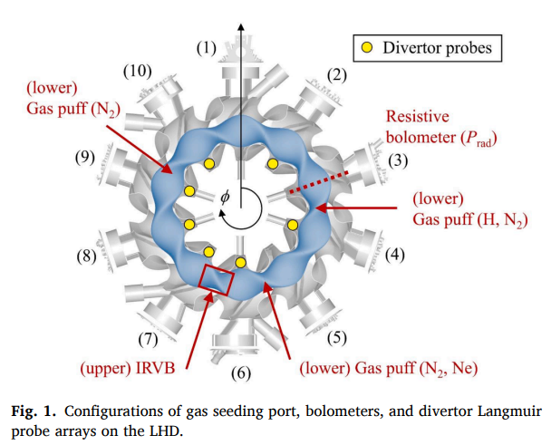
LHD device
Source: K. Mukai et al. Nuclear Materials and Energy 33 (2022) 101294
Source: S. Masuzaki et al. et al. Nuclear Materials and Energy 26 (2021) 100884

