Slide 1
Status Update: EMC3-Lite for Closed Divertors
Amit. K, Robert. D

Slide 2
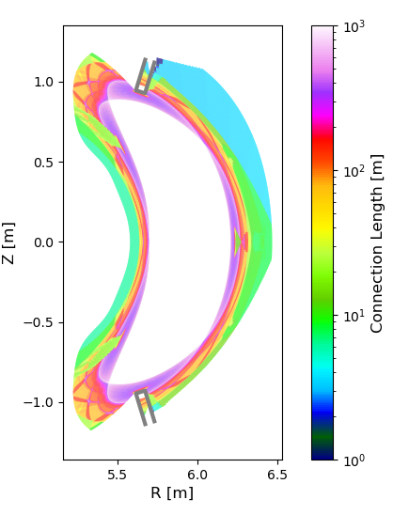
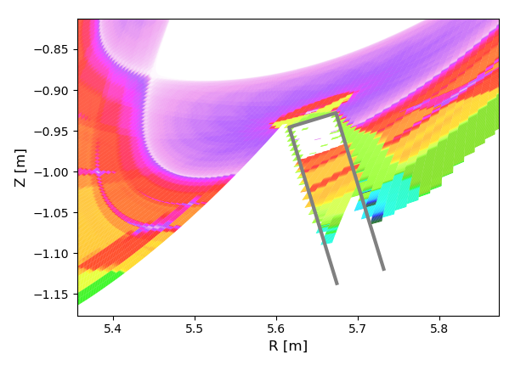
Background
Running EMC3-Lite for closed divertor geometry:
Lc calculation excludes physically relevant regions
Loss of power, inaccurate prediction of PFC heat flux

Slide 3
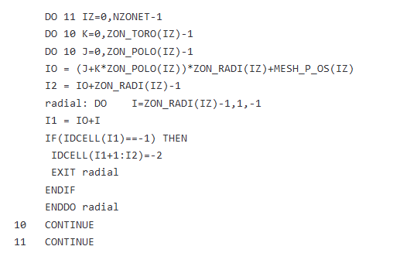
The EMC3 grid
Mesh divided into radial, poloidal cells
“IDCELL” flag
-> 0 : Normal cell
-> -1 : contains PFC aka ‘Limiter Cell’
-> -2 : inaccessible cell; either because it is non-convex OR radially behind limiter cell
-2 cells : Flux tubes excluded from calculation and MC particles are terminated
GRID.f

Slide 4
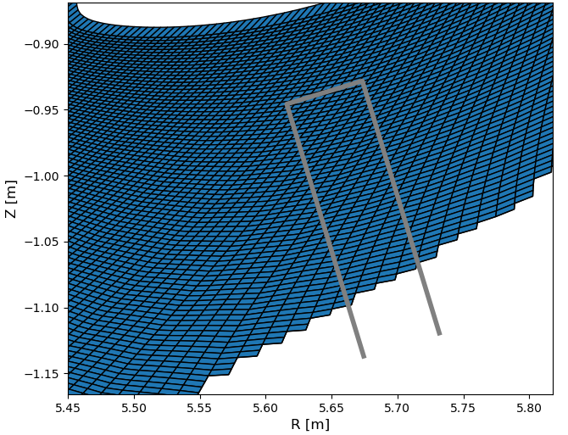
Erroneous “Shadowing”

Slide 5
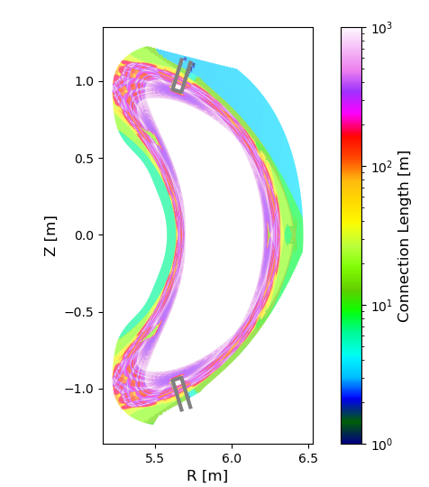
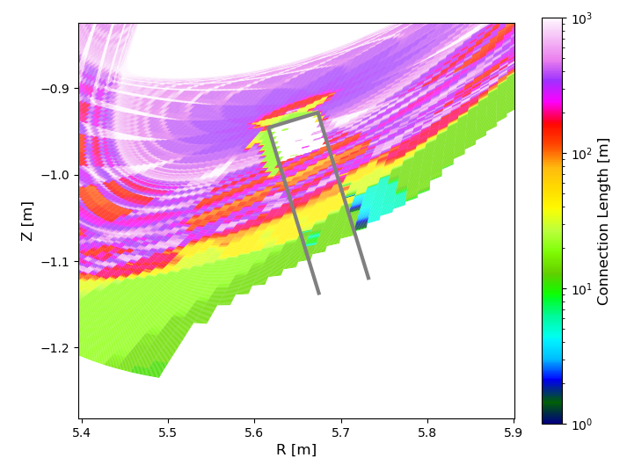
Quick Fix
Remove the block of code flagging cells behind limiter cells as “-2”

Slide 6
Power Statistics
OLD
P_Incident per divertor module (W): 1.00e+06
% P_depo on h_opdvr4.1_pos : 29.9
% P_depo on h_opdvr4.1_neg : 0.349
% P_lost : 69.8
MODIFIED
P_Incident per divertor module (W): 1.00e+06
% P_depo on h_opdvr4.1_pos : 76.5
% P_depo on h_opdvr4.1_neg : 23.3
% P_lost : 0.182

Slide 7
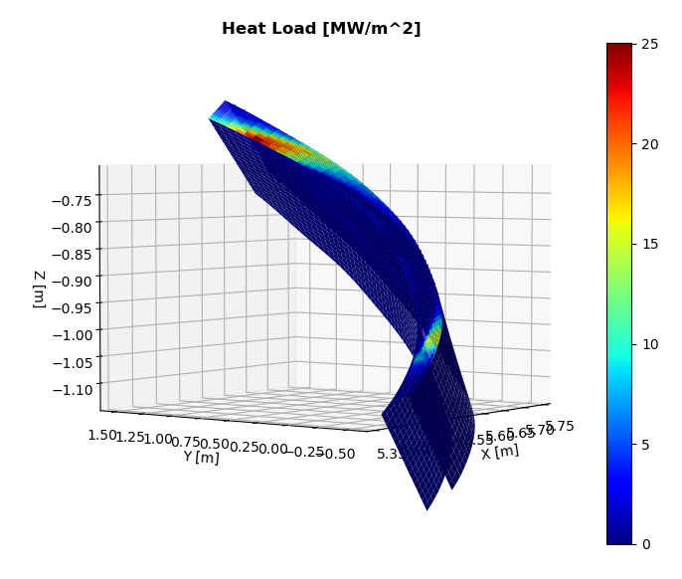
Heat Flux Results
OLD
MODIFIED

Slide 8
Discussion
Roadblocks:
Connection length
MC particles can enter the PFCs in an unphysical way? [in special cases]
Possible paths ahead:
Differentiate between Front and Back of a PFC – LC and heat flux
Keep temporary fix and close off the target manually
Write a new algorithm to flag cells inaccessible aptly

Slide 9
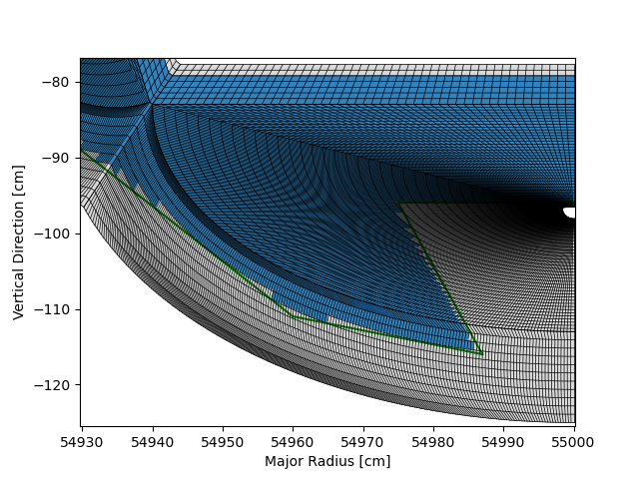
FLARE Capabilities

Slide 10
O-point Divertor – Inverted Triangle

