Slide 1
Objectives, Deliverables and Proposals for OP 2.1
- Relevant for MHD TG –
May 10, 2023
1

Slide 2
Summary of OP2.1 for TF-I deliverables (A. Langenberg/ F. Warmer)
Only part relevant for MHD TG:
Results O1: High Performance Scenarios
D1: Steady State High Performance √ 4 Scenarios developed
D2: Density Profile Control √ Pellets missing
D3: Impurity Accumulation √ No impurity accumulation
Results O2: Heating Scenarios
D4: Effective Ion Heating √ Break of Ti clamping w/ 3 NBI + pure ECRH
D5: W7-X Operational Map √ Max heating powers not available(4 NBI + 9.5 MW ECRH)
D6: Fast Ion Losses √ No unexpected wall loads, initial FILD data

Slide 3
Summary of OP2.1 for TF-III deliverables (D. Carralero/C. Killer)
only part relevant to MHD TG
O1: Core transport and stability
• D5: Reduced equilibrium currents at higher beta and in MC space: accessible scenarios well covered
• D6: MHD stability and modes in the MC space: accessible scenarios well covered
O3: Low-field high beta scenarios
• D1: Optimization criteria at increased beta
• D2: High-beta plasma profiles, magnetic fluctuations
• D3: Field stochastization and implications for SOL / divertor
}
(some diagnostics missing)
no low field scenario
some investigations into intermediate
beta were done, assessment pending

Slide 4
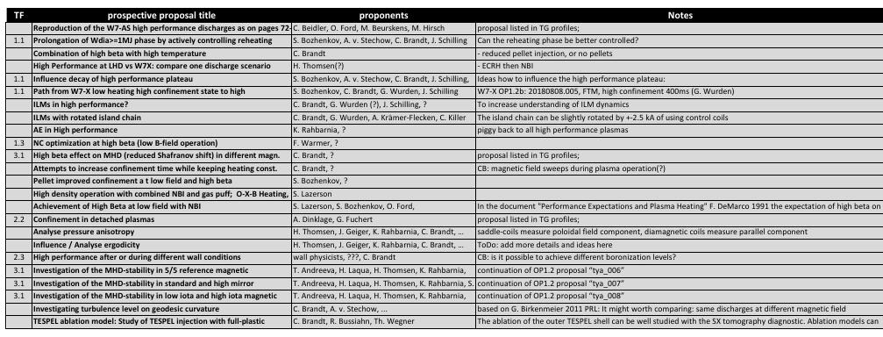
High beta
4

Slide 5
Mode activity
Proposal 1: Characterize AE activity in a wide range of configurations OK
Proposal 2: AE activity for reduced-field operation
Proposal 3: AE activity in low-density plasmas
Proposal 4: AE activity under ICRH conditions (minority heating and 3-ion scheme)
Proponent: (Y. Kazakov or C. Slaby)
Proposal 5: AE activity in combined ICRH/NBI scenarios
Proponent: (Y. Kazakov or C. Slaby)
Proposal 6: Impurity seeding to trigger AEs
C. Slaby ? to be disscussed impurity group (René Bussiahn, Birger Buttenschön?)
Proposal 7: Interplay of ECCD crashes and fast-ion confinement / sawtooth stabilization\\
fast particle part: D. Kulla, stability open → K. Aleynikova?

Slide 6
Equilibrium/ Stability

Slide 7
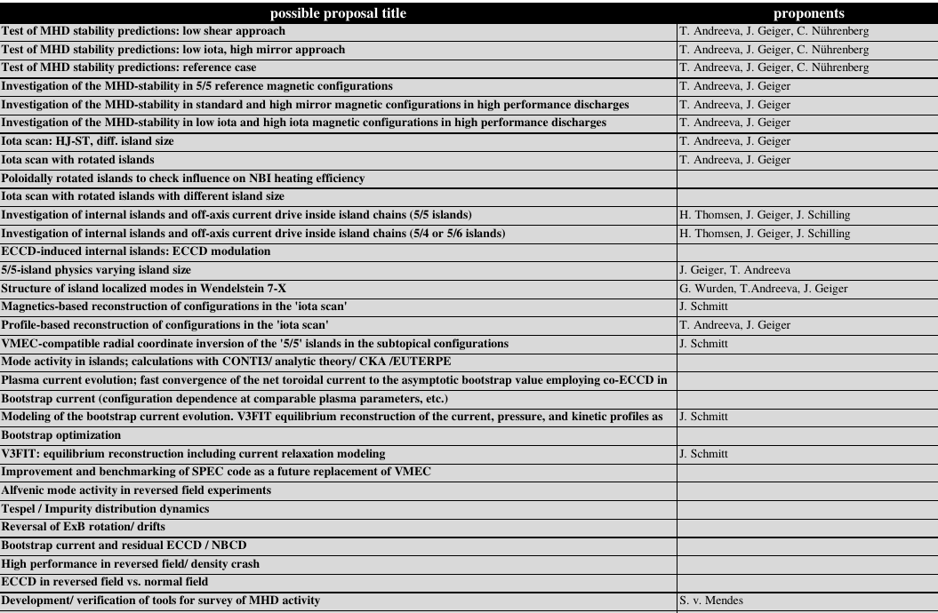
Equilibrium/ Stability II

Slide 8
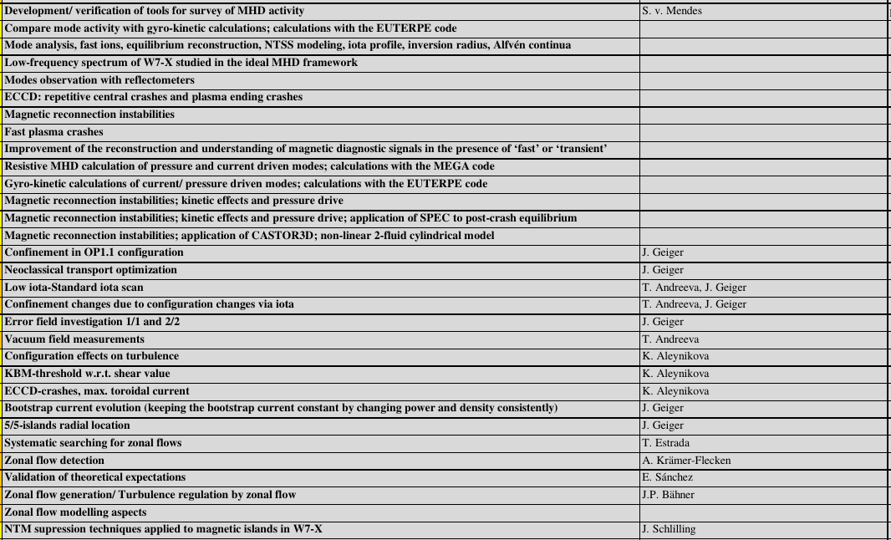
Equilibrium/ Stability III

